Slide 1
BioFuelNet – IEA Bioenergy joint workshop
Mobilisation of forest biomass to produce bioenergy, biofuels and bioproducts: Challenges and opportunities

Slide 2
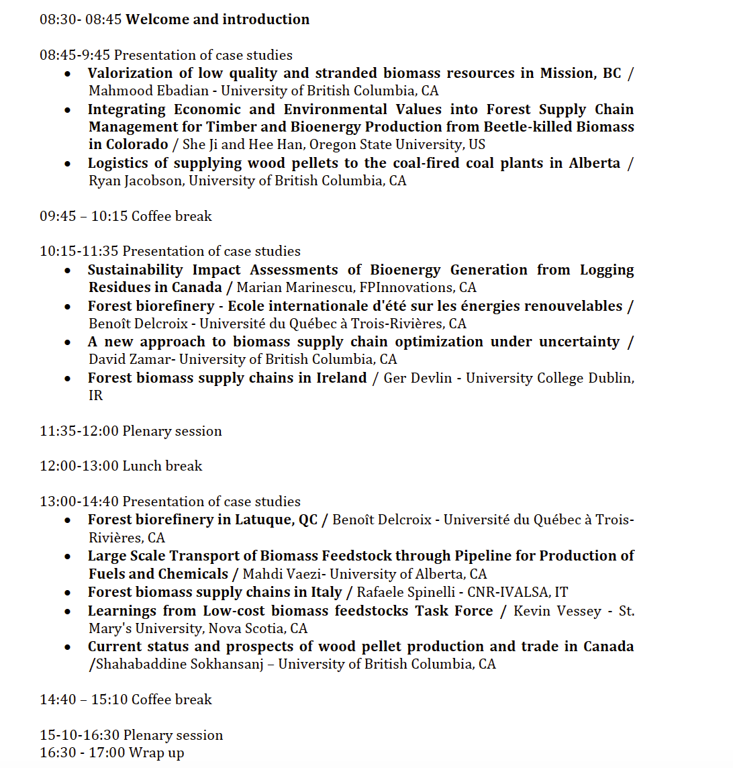

Slide 3

Report on best practices for mobilisation of forest biomass and establishment of successful business case

Slide 4
Outline for table of contents
Introduction

