Slide 1
Overview of Canada’s BioFuelNet
J. Kevin Vessey
BFN-IEA Bioenergy Workshop
UBC, Vancouver
22 September 2016

Slide 2

BioFuelNet: About the network
BioFuelNet Canada is a Network of Centres of Excellence (NCE) that brings together the Canadian biofuels research community.
Operates under a $25 million grant over 5 years (2012 to 2017) through the NCE program.
10 project containing 59 work packages
Facilitates collaboration
Supports commercialization
Government interaction
Represents Canada
Trains students and postdocs
Notes:
Only 11 NCE’s currently in Canada.
Private sector involvement and financial contributions are required to be successful.
With leveraging, value og BFN is > $50M.
Hope for renewal from 2017-2022.

Slide 3
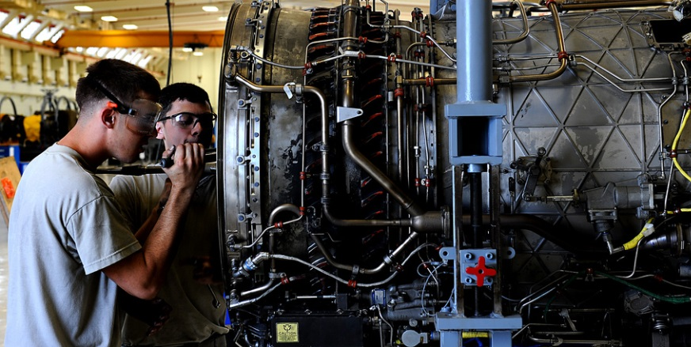
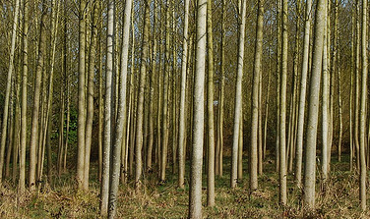
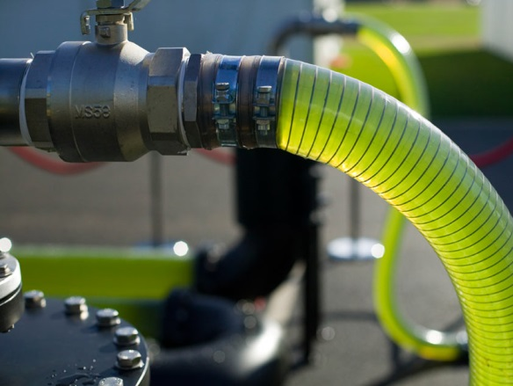
BioFuelNet: Our vision & mission
Our vision is a Canada with a thriving advanced biofuels industry that is socially, economically and environmentally sustainable.
Our mission is to support the growth of Canada’s advanced biofuels industry through coordinated research, innovation, effective education, smart policy and strategic partnerships.

Slide 4
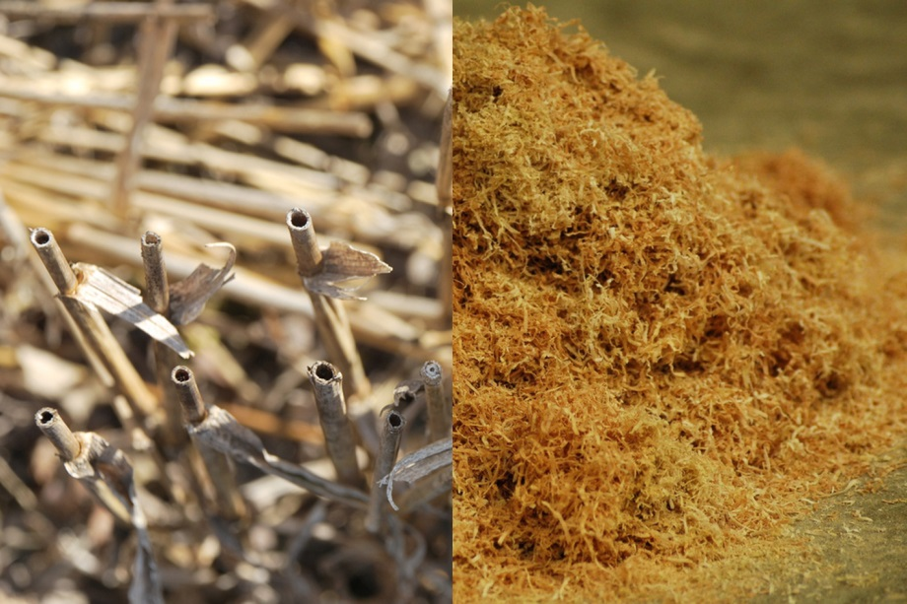
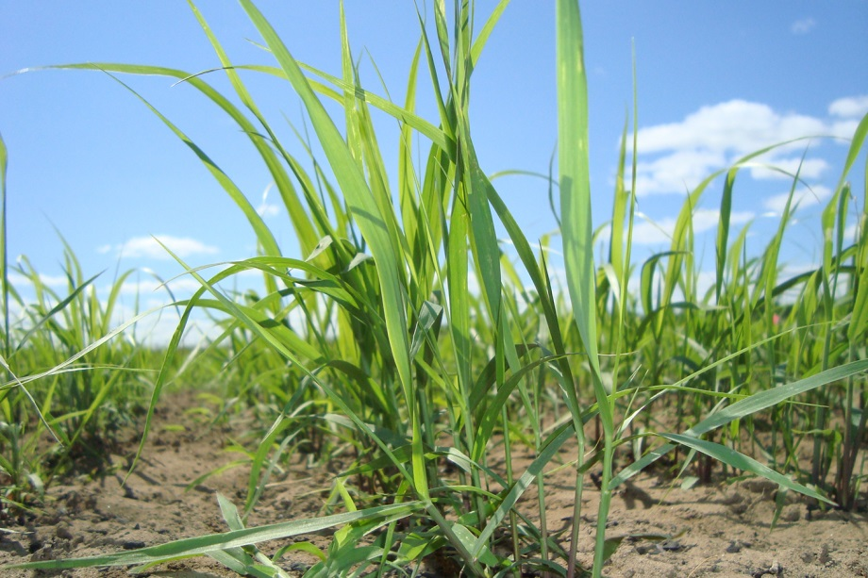
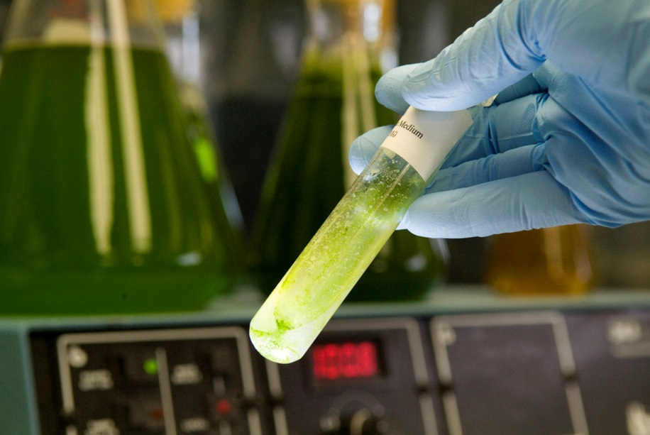
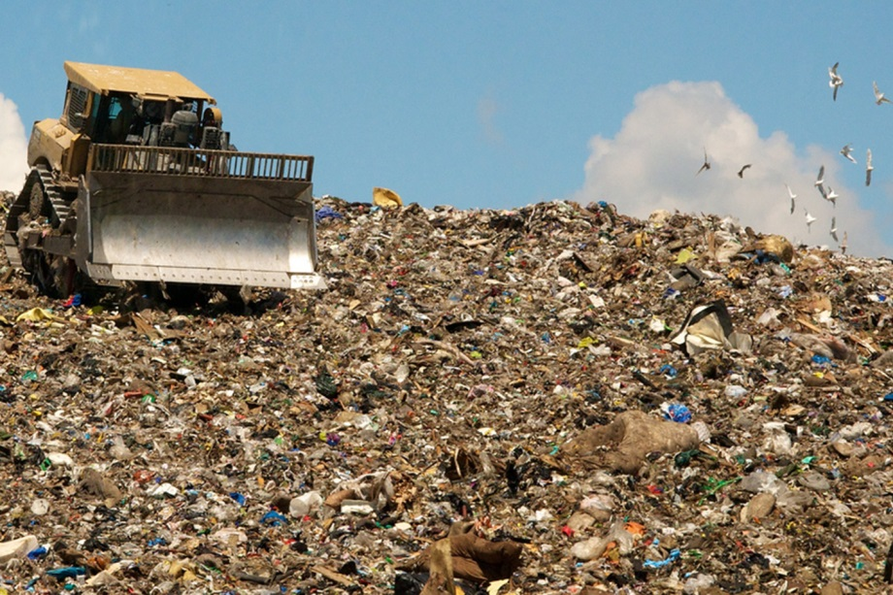
Advanced biofuels are produced from non-food materials
Agro-forestry waste
Energy crops
Algae
Municipal waste

Slide 5
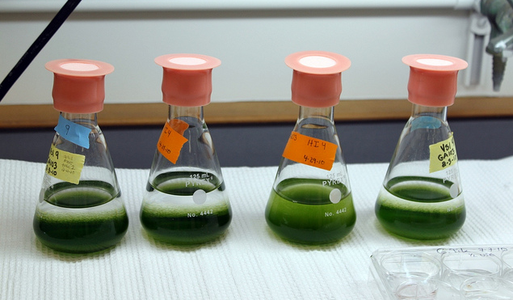
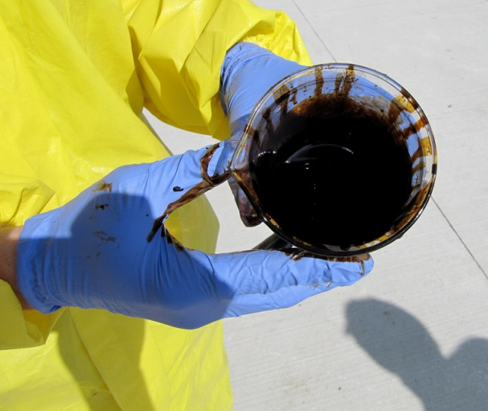
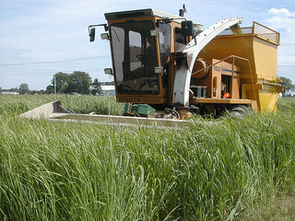
Advanced biofuels
Renewable biofuels can provide:
  Sustainable source of energy
  Reduced GHG emissions
  Reduced reliance on food crops for biofuel production

Slide 6
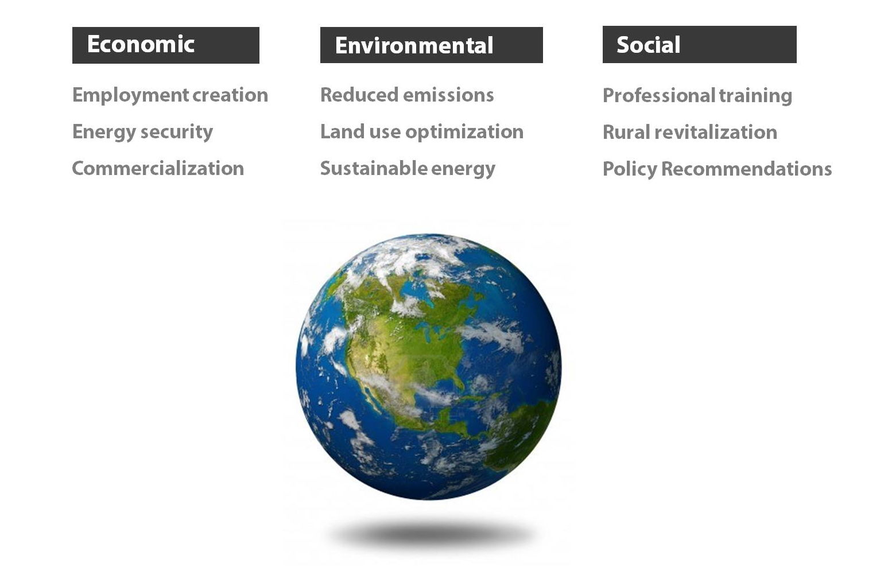
BioFuelNet: Benefits to Canada

Slide 7
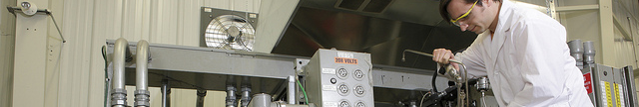

Who is involved?
McGill University, Montreal (Host)
27 universities
~130 researchers
~57 industry partners
Over 140 partners
Almost 400 Highly Qualified Personnel (HQP)
Numerous national & international contacts

Slide 8















































Examples of BFN’s Community
Academia
Government
Industry
Examples: ~1/3 in each case
Other
Investment

Slide 9






BioFuelNet’s Research Structure
1. Purpose-grown feedstock
2. Residues & waste
3. Bioconversion
4. Pyrolysis
5. Gasification
6. Emerging conversion technologies
7. Combustion & engine operations
8. Life cycle analysis & microeconomics
9. Domestic & international policy
10. Supply-chain logistics
FEEDSTOCK
CONVERSION
UTILIZATION
SEES

Slide 10
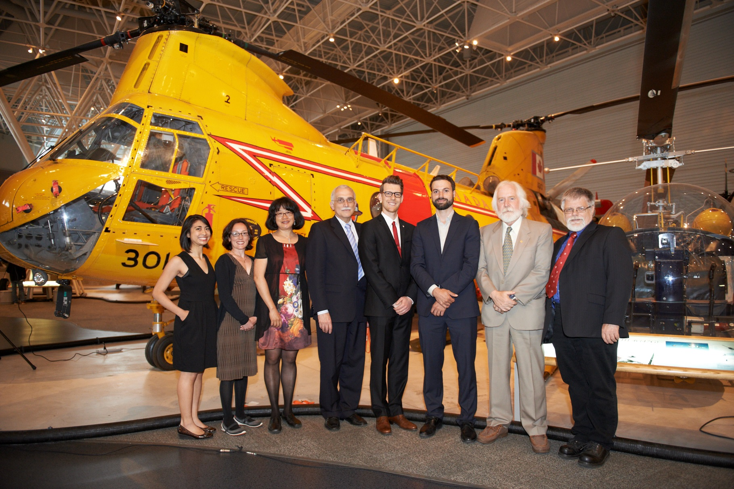
Thank you!
Dr. Donald Smith
President & Scientific Director
BioFuelNet Canada
514-508-2884 / donald.smith@mcgill.ca / www.biofuelnet.ca

