Slide 1
Welcome
Vancouver, September 21, 2016

Slide 2
WP1: Landscape management and design for bioenergy and the bio-economy
WP1 aims at supporting landscape management and design for bioenergy and the bio- economy, by expanding the knowledge base required for sustainable expansion of biomass production systems that also contribute positively to biodiversity and the generation of other ecosystem services.
The work takes a landscape level approach to deployment of biomass production for bioenergy and integration of this objective with ownership and societal objectives for existing land use and associated systems.

Slide 3
WP1: Landscape management and design for bioenergy and the bio-economy
cropping systems such as willow and poplar short rotation coppice, poplar and oil mallee tree plantations, and grasses (e.g., reed canary grass, switchgrass, Miscanthus);
agriculture by-products such as stover, straw and dung;
forest biomass including whole trees, logging residues and other by-flows associated with forest management operations.
Other biomass production systems, which are currently not common but have shown potential for wider implementation, may also be considered.

Slide 4
WP1: Landscape management and design for bioenergy and the bio-economy
Which are the most suitable areas for production and/or extraction of various biomass feedstocks?
How can biomass feedstock production systems be located, designed and managed to increase resource use efficiency, avoid/mitigate negative and promote positive environmental, economic, and social effects?
How can outcomes be optimized to meet the goals of individual stakeholders and society as a whole, including environmental, economic, and social goals?
How can analysis and assessment inform participatory processes engaging landowners, policy makers, and other stakeholders in further developing and re-defining goals and plans for landscape management and designs?

Slide 5
WP1: Landscape management and design for bioenergy and the bio-economy

Slide 6
WP1: Landscape management and design for bioenergy and the bio-economy
WP2 – Developing effective supply chains for sustainable bioenergy deployment
Economic performance of biomass from sustainably managed landscapes
WP3 – Governing land use and bioenergy supply chains
Advancement and assessment of governance addressing LUC impacts.
(“iLUC free biomass”: intensification and use of marginal/degraded land)

Slide 7
WP1: Workshops and other events
Workshop: Sustainable landscape management and design for food, bioenergy and biomaterials. March 15-16, Göteborg, Sweden
Workshop: The world needs more land use change. EUBCE, June 7, Amsterdam, The Netherlands.
Workshop: Landscape Management and Design for Bioenergy and the Bioeconomy, September 21, Vancouver, Canada.
Call for contributions: Landscape Management and Design for Bioenergy and the Bioeconomy, Winter 2017?
Workshop: Title TBC, Spring 2018, somewhere in Europe.
Special Issue in suitable journal?
Task 43 report
Inter-Task reports
IEA Bioenergy Conference 2018

Slide 8
WP1 Workshop
Vancouver, September 21, 2016

Slide 9










WP1 Workshop

Slide 10
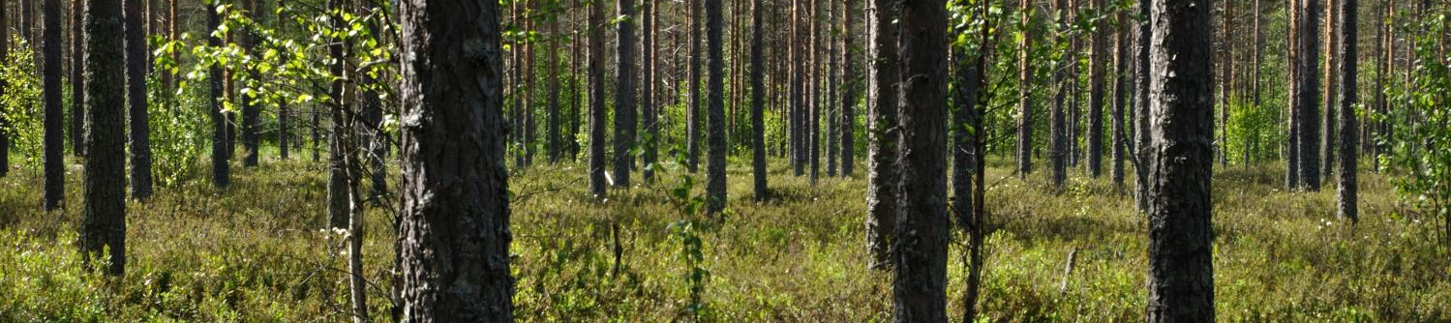
Questions…
What are the priorities and challenges with respect to ecosystem services in different countries and sectors?
How can forestry and agriculture be driven to optimize provisioning of ecosystem services at a landscape level?
What trade-offs may be necessary, and will these be the same in different countries?
What are the effects of differences in governance between countries?

Slide 11
Expectations
Information exchange and new ideas regarding:
  Methodologies to quantify environmental ecosystem services
  Methodologies for generalizing and up-scaling environmental impacts from stand to landscape level
  Tools and assessment frameworks to support participatory processes and decisions on landscape management and planning
Connect with people who have complementary skills and approaches
Create work plan for 2017-2018

Slide 12
Workshop agenda

Slide 13
Workshop agenda

