Slide 1






Valorization of low quality and stranded biomass resources in Mission, BC
Mahmood Ebadian, Fahimeh Yazdanpanah, Shahab Sokhansanj, Évelyne Thiffault
Biomass and Bioenergy Research Group, UBC
Forestry Task Force, BioFuelNet Canada
BiofuelNet/IEA Bioenergy Workshop, Vancouver, September 21-22, 2016
Notes:
Today I would like to talk about a big challenge that we are dealing with in the bioeconomy and that is the inconsistency in the quality of biomass. as you can see in my slide, we have quite a uniaue situation in BC Coatal region and also I will talk about a long-term soltuin to provide the righ feedstock for the right end user.

Slide 2
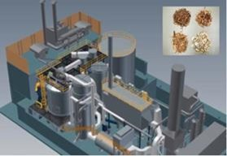
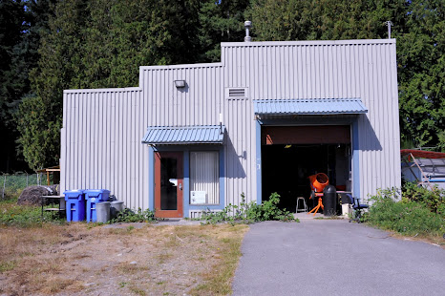
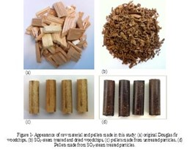
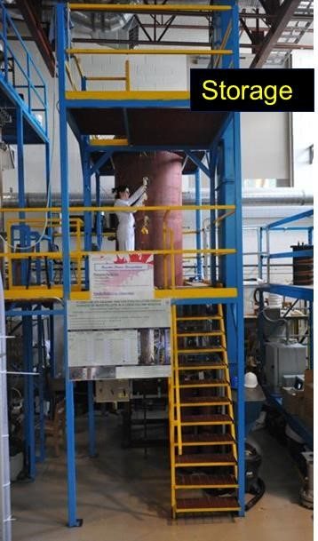
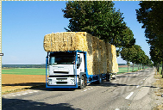
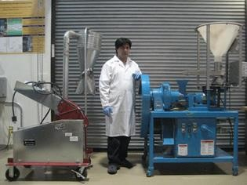
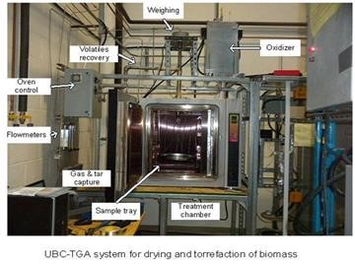
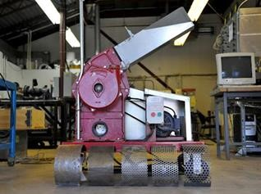
Biomass and Bioenergy Research Group (BBRG)
UBC biomass gasifier
Biomass engineering lab
Biomass logistics modeling
Pellet mill
Biomass dryer
Hammer mill
Wood pellet storage

Slide 3
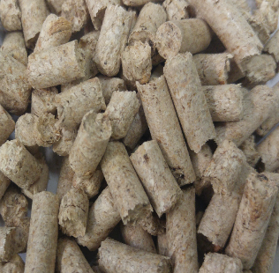
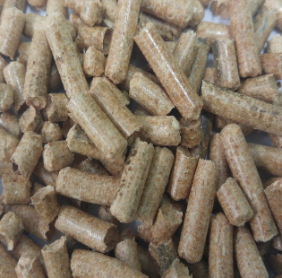
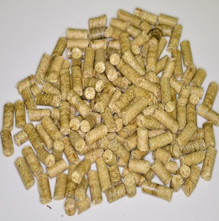
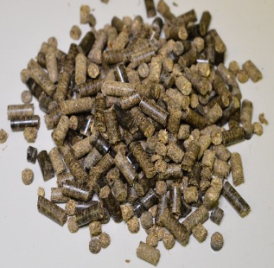
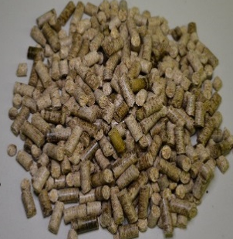
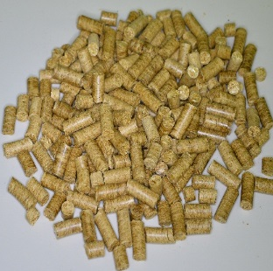
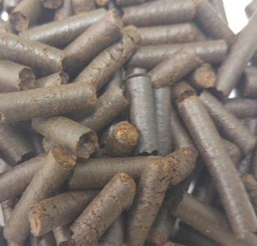
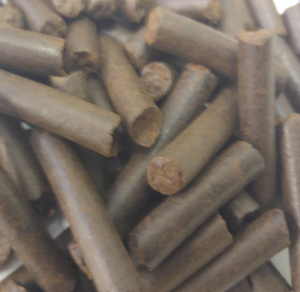
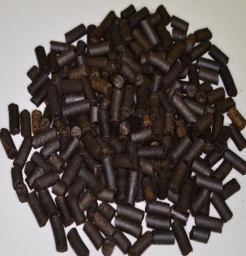
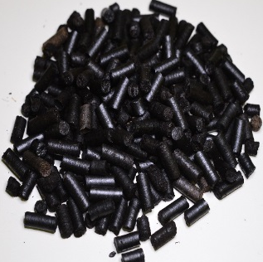
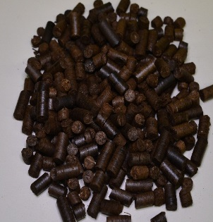
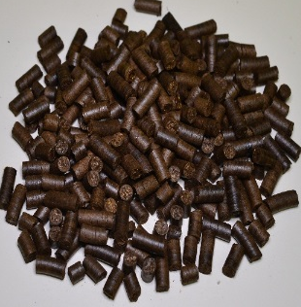
Woody and Herbaceous Pellet Samples at BBRG
Aspen
Douglas fir
Switchgrass
Corn Stover
Miscanthus
Wheat straw

Slide 4
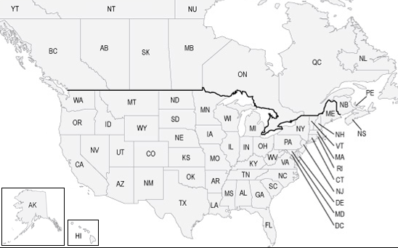
Industrial Projects in North America
Feasibility Study of cofiring wood pellets with coal
Logistics of wheat straw for the proposed Iogen cellulosic ethanol plant
UBC Gasification facility
Logistics of corn stover for the OPG power facility in Lambton
Boeing-UBC Biojet Project
Logistics of woody biomass and pellet distribution for two pellet plants
Logistics of corn stover for the BIC Cellulosic Sugar Plant in Sarnia
Logistics of corn stover for the DuPont cellulosic ethanol plant
Logistics of Miscanthus for the proposed Chemtex cellulosic ethanol plant

Slide 5
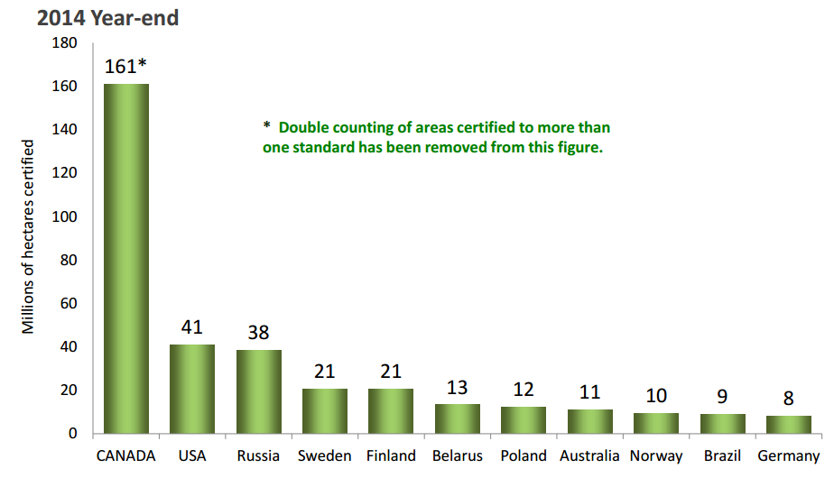
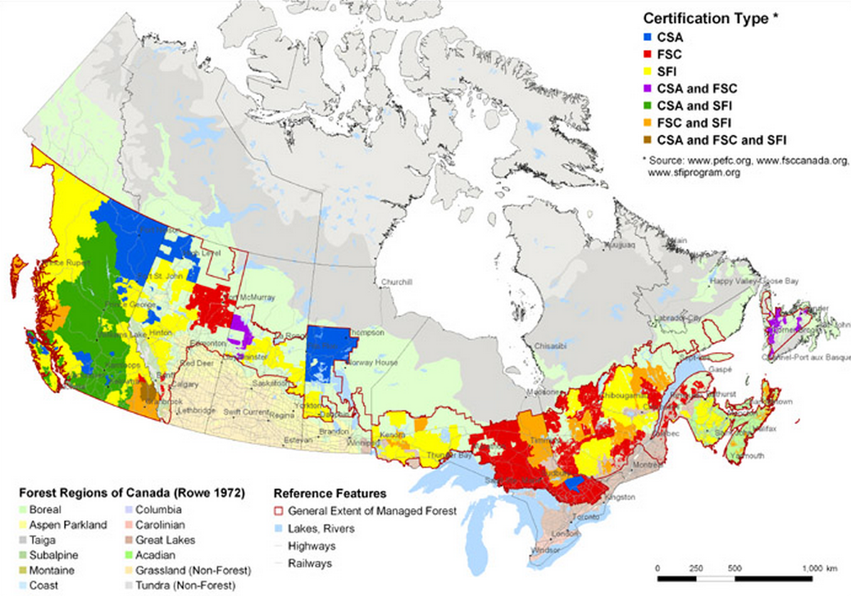
Sustainability: Established practice in the Canadian forest sector
Forest or other wooded land make up 40% of Canada’s 979 million hectares.
Canada has 310 million hectares of forests.
10% of the world’s forests are certified. Canada holds 40% of the world’s forest certification.
Currently, 161 million hectares of forests in Canada are certified to three sustainable forest certification standards.
Canadian forest certification in the global context (million hectares)
Forest certification map of Canada
BC holds 32% of the certified forests in Canada with a total of 52 million hectares certified.
Source: Forest Products Association of Canada, 2014
Notes:
- Canada is the second largest country in the world with forest or other wooded land, making up 40% of its 979 million hectares.
Ninety-three per cent of Canada’s forests are publicly owned-77% by the governments of the provinces and territories and 16% by the federal government. The remainder is held by some 450,000 private landowners.
In some parts of the country, an increasing amount of forest is coming under Aboriginal jurisdiction as land issues are settled (Canadian Council of Forest Ministers, 2014).
- The leading country in forest certification on a global scale

Slide 6
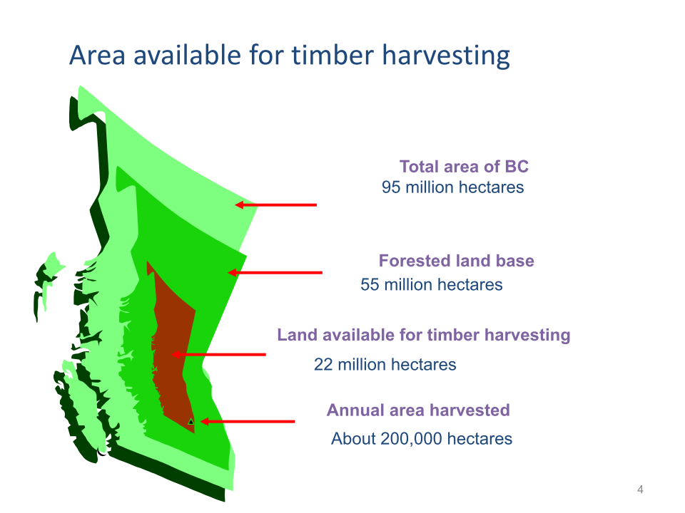
Land and forest ownership in BC
Source: Ministry of Forests, Mines and Lands, 2010; Government of Alberta, 2014.

Slide 7
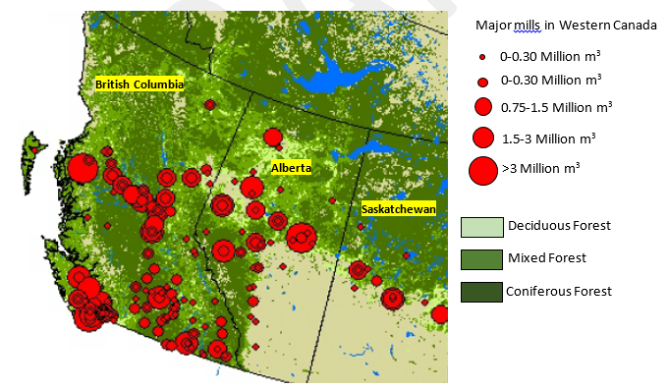
Major wood processing mills in Western Canada
Source: Keddy et al., 2010.
Notes:
- Large availability of wood fibre and sustainable forest practices in BC have led to the growth of various industries including primary and secondary forest products (e.g. lumber, panels and a multitude of value-added products), pulp and paper, bioenergy (i.e. heat and power), and solid biofuel (i.e. wood pellet).
- These industries have created assets such as skilled labors, knowledge and expertise in processing and distribution of wood fibre from forest stands to the marketplace via road, rail and water. These assets along with the potential availability of wood fibre make BC an attractive location for the development of future biorefineries in Canada.

Slide 8
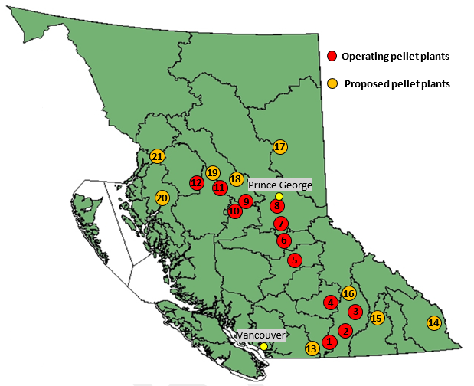
Wood pellet plants in BC
There are currently 12 operating pellet plants in BC with the annual production capacity of 2.2 million tons.
Annual production level of wood pellets in BC is over 1.7 million tonnes.
Primary feedstocks for pellet production are mill residues (1,185,500 Odt) and low-grade logs (435,750 Odt).
Prince Rupert
Source: Canadian Biomass Magazine, 2015.
Notes:
There are currently 12 pellet plants, 14 co-generation facilities, 30 wood-based community heating systems and 8 independent power plants in BC.
They consume about 5 million oven dry tonnes (M odt) to produce pellet, bio-power and bio-heat (Bradburn, 2014).: the amount used by residual industry.

Slide 9
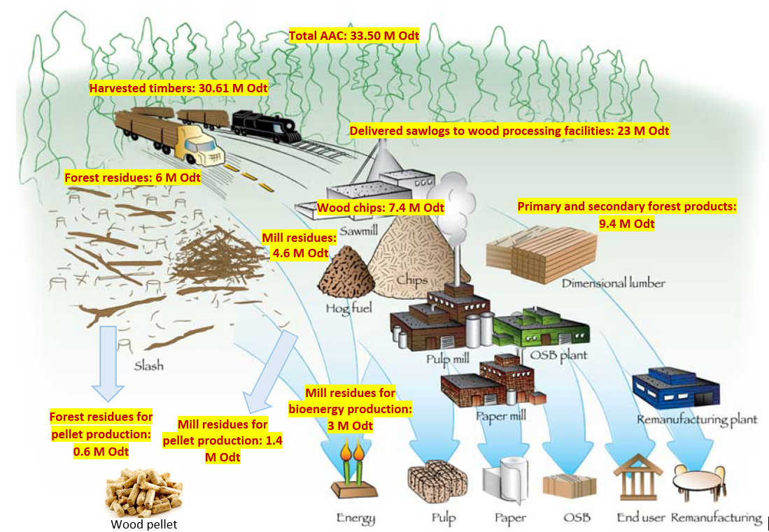
Flow of wood fibre within the BC forest industry
Unharvested standing timbers: 2.9 M odt
Logging residues:
5.4 M odt
Source: Roach and Berch, 2014; Industrial Forestry Service Ltd. et al., 2013; AEBIOM et al., 2013; FPInnovations, 2010; Bradburn, 2014; PricewaterhouseCoopers, 2007
Notes:
Two main points: 1) leftover and waste stream in the system 2) supply and market uncertainties and dynamics.
This flow keep changing due to the nature of the forest industry.: the US crisis housing market in 2008, mountain pine bettele tough competition from pulp and paper industry from south America and Asia and also fast growth of the pellet industry in the last decade. Change the shortage and surplus of materails
The industry has to use the whole wood fibre, especially the residuals and byproducts, for example the industry has been burning forest residues, in the past burning sawmill residues so diversficstion is criticall in the forest industry to produce maximum value from wood fibre
The beetle has infected just over 18 million hectares of forests and an estimated 710 million m³ of pine trees (53% of all pine volume in the province) are dead or dying.

Slide 10
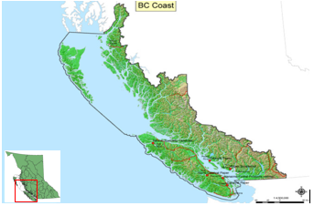
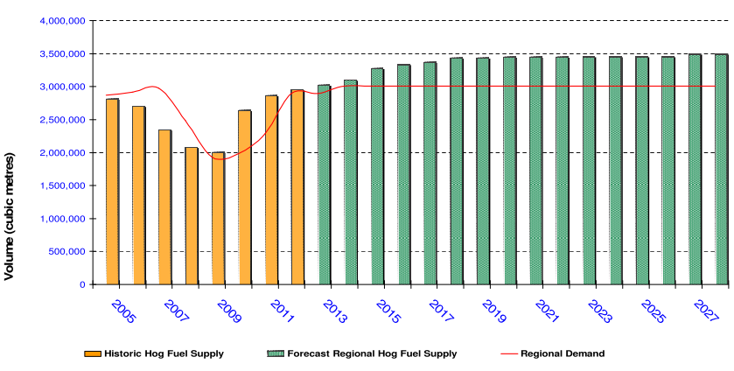
Forest Industry in BC Coastal Region
Cumulative Allowable Annual Cut (AAC) : 22 million m³
Sawlog and pulp log demand: 14.2 million m³
21 sawmills, 3 plywood mills, 6 pulp and paper mills and several shake and shingle mills
BC coastal hog fuel supply and demand
Source: Hall, 2014.
Notes:
(mention hog fuel in a challenge in BC Costal region)
A region in Canada that has a huge potential to develop a sustainable bio-economy is the BC coastal region due to the size of the forest industry.

Slide 11
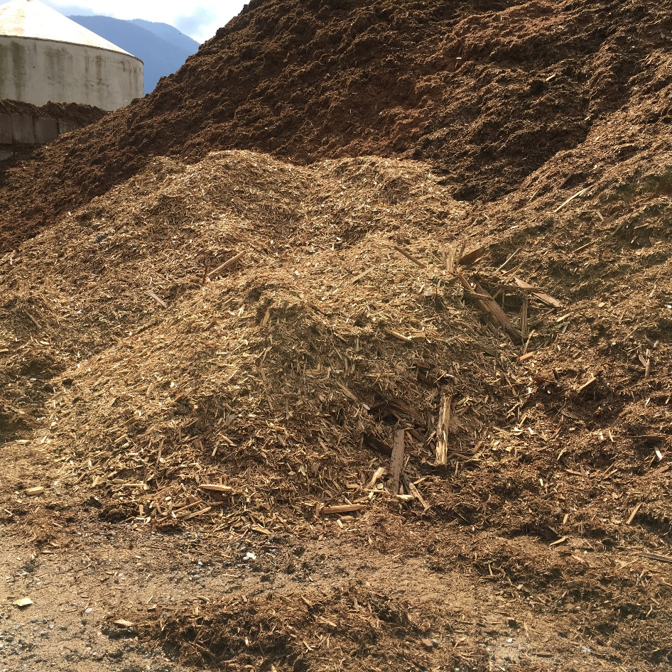
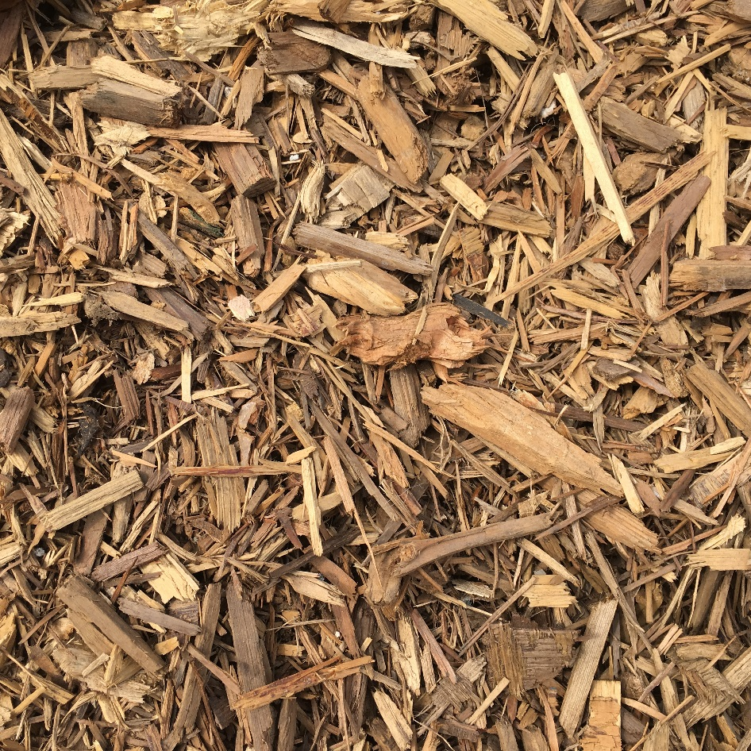
Hog fuel
By-products of processing of logs at coastal log sorts
By-products of whole log chipping facilities for the manufacture of wood chips for pulp and paper
By-products of the manufacture of lumbers at sawmills
Urban wood waste
Notes:
With the closure of Elk Falls pulp mill several years ago, and the reduction of a number of product lines in the remaining costal pulp and paper facilities, the hog fuel supply now greatly exceeds demand. It is estimated the gap between hog fuel supply and demand will continue to grow well into the future unless other uses for the material are found.
FPI is investigating ways to reduce the hog’s moisture level as well as the salt content. FPI, in discussion with CFPA (newly formed “Hog” Working Group [HWG]), will also be investigating opportunities to create new products such as pellet and biofuel production and other potential value streams.
Maintain safe and efficient whole log chipping, log sorting and sawmill operations: we have to find solutions otherwise this is going to impact these industries.
Two short term disposal solutions include open burning at local log sorts or placement of the non-hazardous wood residue into nearby landfills. While some limited burning can take place now, the permitting comes with very restrictive conditions. The HWG acknowledges that recent proposed policy changes to the Open Burning Smoke Control Regulation (OBSCR) may alleviate disposal via burning in some areas, but not
in all cases. The proposed OBSCR changes, while positive, will be implemented sometime in the future and not address the current build-up of wood residue. The HWG is committed to working with the Ministry of Environment (MOE) to enable the proposed policy changes in a timely manner.
CFPA has requested MOE to form a joint ministry/industry team to review the landfill Code of Practice which currently treats all wood residue as hazardous waste. The working group mandate would be to recommend landfill operational requirements (siting, permeability, etc.) suitable for non-hazardous wood residue. There could be significant opportunities from this review as participants, including senior MOE staff, noted they did not observe any adverse environmental effects from pre-Code of Practice wood residue landfills during a coastal field tour last fall. Both the burning and landfill options offer viable solutions in the short term as the
surplus of wood residue, including hog fuel, continues to grow daily. The HWG is confident that longer term solutions will be developed as FPI continues to diligently work on this important issue.
The primary consumer of coastal hog fuel has been the pulp and paper industry as a feedstock for power boilers

Slide 12
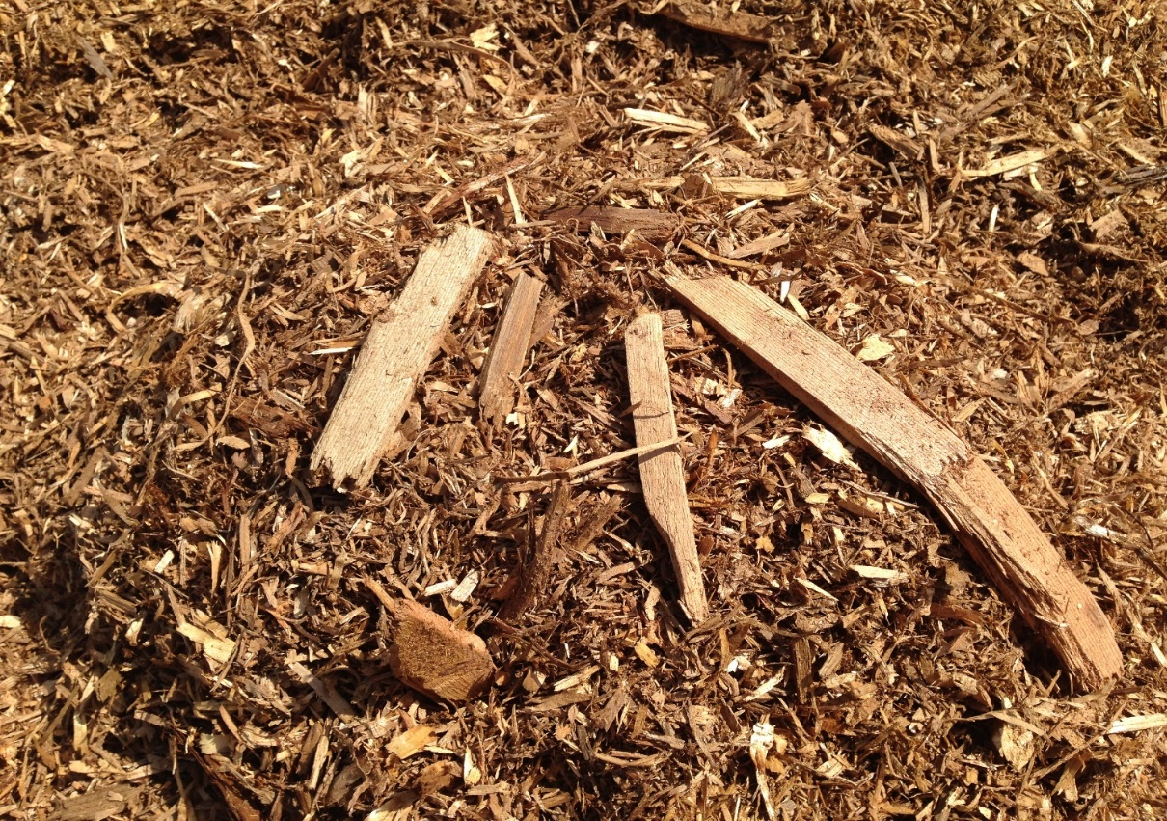
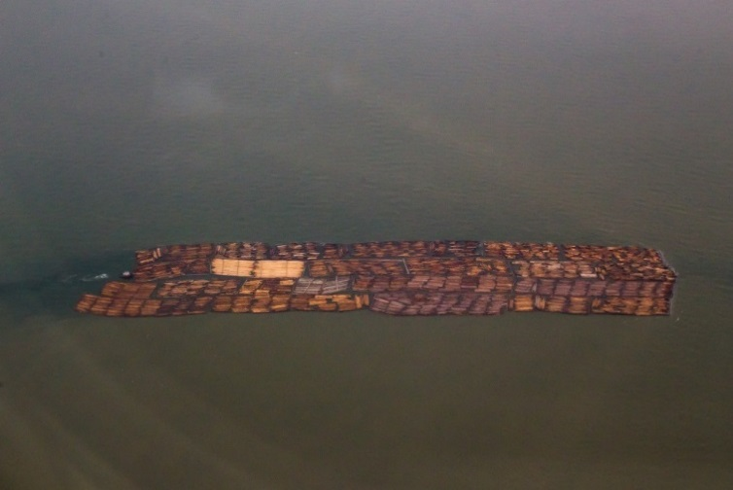
Challenges with hog fuel in BC Coastal region
High Moisture Content – 50 to 65%
Poor combustion requires fossil fuel additive to burn
During winter months excessive moisture prevents producers from maximizing steam rates
High Fine Particulate Levels – up to 25%
Causes boiler issues and plugging of heat exchangers in power boilers
Inconsistent particle sizes
Irregular and incomplete combustion
High Chlorine Content
Limits useability
Creates pollution upon combustion
Low Demand
Viewed as a problem by producers
Creates storage issues
Low value necessary for pulp producers
Low value provides no incentives for producers to upgrade fuels
Environmental Concerns
Wet fuel creates increased emissions when burnt
Wet hog fuel piles spontaneously combust
Significant CO2e and VOC releases from burning fossil fuels to combust
Legacy piles of hog fuel off-gas causing additional green house gas emissions
(Photo by Gordon, Wikimedia Commons)
Notes:
- These facilities are connected to the power grid and sell additional electricity to BC Hydro. However, high moisture content and large portions of fine materials (up to 50% of hog fuel mass) have adversely affected the efficiency of boilers. The efficiency of a boiler utilizing wet hog fuel (50-60% moisture) is 60-68%. This efficiency is 80% for a boiler utilizing dry hog fuel (FPInnovations, 2012). The low efficiency of boilers are usually offset by using natural gas. The separated fine materials can be used as feedstock for the boilers of the cement manufacturing industry, pellet plants and biofuel plants.
Most wood manufacturing facilities on the coast utilize the ocean to collect, store and transport sawlogs and pulp logs in booms. Log booms have been practiced for decades in the BC coastal region to move large volumes of harvested timbers from forests to wood manufacturing facilities. Log booms are towed by tugboats hundreds of meters or kilometers to get to their destination
The mix of mill residues results in uncontrolled particle sizes (1-100 mm) and irregular particle shapes
No incentive to upgrade residual stream due to lack of demand

Slide 13
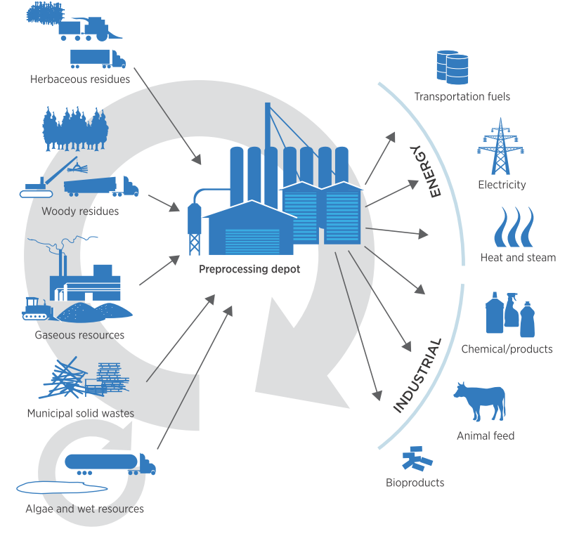
Depot Concept to valorize low-quality and stranded biomass resources
2016 Billion Ton Study, US DOE (2016)

Slide 14
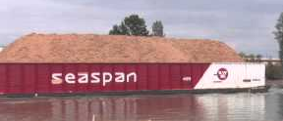
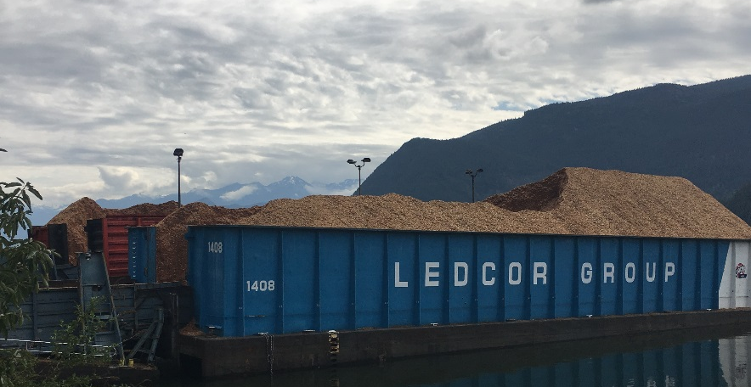
Geographical advantages of BC Coast
-
BC Coast: a transportation hub- access to different transportation modes and international markets
Presence of large-sized transportation and handling companies that are flexible to respond to the needs of new markets
Availability of skilled workforce
Support from local communities and municipalities to find solutions for waste stream
Notes:
Mention the message that we nned such large-scale and reliable suppliers in the bioconeomy for the mobilization
Importance in the optimal location of bioreiniries and also the importance of geographical advantges in the growth of bioeconomy.
Outsource handling operations at HSPP website
The barges used in the HSPP supply chain range in size from 8,00 to 1,460 volumetric units (1,500 to 3,000 short tons)
Ledcor Resources and Transportation, a division of the Ledcor Group of Companies out of Vancouver, British Columbia, Canada and newcomer to the trade, has taken delivery of twelve new 62.2m x 16.0m x 4.0m wood chip barges, the series “Ledcor 1401 – 1412” built by Nanjing Wujiazui Shipbuilding of Nanjing, China, to inaugurate its marine transportation service to Howe Sound Pulp and Paper and has acquired Renew Resources, a B.C. based company that specializes in the processing of wood fiber in the interior. Renew produces the woodchips and hog fuel that will be transported to customers by truck and Ledcor’s new barges. Its acquisition of marine vessels and Renew Resources represents an investment of $70 million.
Each barge holds about 2.5-day supply of hog fuel for the power boiler
The capacity of each barge is equivalent to a total capacity of ~150 53ft semi-trailer chip vans.

Slide 15
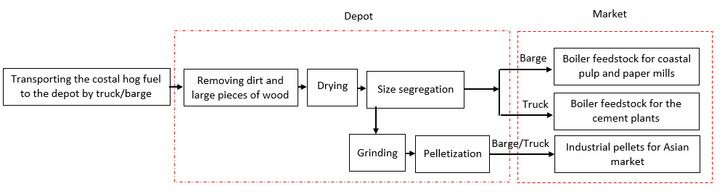
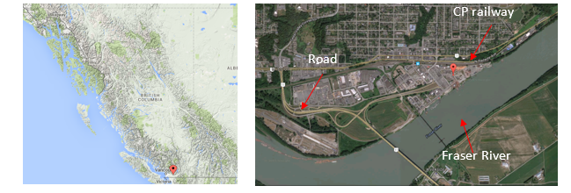
Depot Demonstration: Mission Facility
Mission facility, Mission District, BC
Notes:
Mention this is the initial desging based on the two current customer we have
These technology solutions include screening, size reduction, segregation, drying and pelletization. These preprocessing operations aim at providing a feedstock with consistent and desirable quality for end users.
The final objective of this project is to demonstrate the depot concept as a solution for utilizing low quality biomass for the production of bioenergy and biofuel. Depot is an independent entity in the biomass supply chain where various types of biomass with different chemical compositions and physical properties are received and preprocessed. The outcome is the production of bio-feedstocks with predictable quality for various end users such as independent power plants, co-generation facilities in pulp and paper mills and cement manufacturing plants, pellet plants and biofuel plants.
the integrated knowledge of the university researchers and the industry is implemented to demonstrate the depot concept.
this package of technology solutions in a depot would provide the opportunity to maximize the value extracted from large volumes of low-quality hog fuel in this region.
Preparation of on-spec feedstocks for multiple end users will add to the delivered cost of feedstock. To reduce the delivered cost, minimizing the upstream and downstream transportation costs play a vital role in the viability of a depot.
The facility is located at Mission District, South Coast of BC. It is next to rail tracks (in 100 meters), has access to roads and loading/unloading facilities for truck transport, and barge loading facilities for river bound freight. The facility is about 75 km away from shipping terminals in Port Metro Vancouver, 85 km away from Vancouver International Airport and less than 20 km away from the US border.

Slide 16
BiofuelNet Knowledge Translation Program
Task 1. Characterize the available wood fiber and residues in the region to further develop data on physical properties and composition.
Task 2. Develop computational tools to facilitate the analysis and optimization of a multi-modal feedstock transportation scheme
Task 3. Model and optimize each of the unit operations at the Mission facility: trommel screen and Altentech dryer.
Task 4. Develop educational materials, develop and implement guidelines for the best practices with respect to safety requirements and to mitigate any potential for off gassing, dust accumulation, and dust explosion
Task 5. Organize workshop on standards, quality management, and the best practices. The participants in the workshop will be key operators from biomass supply, biomass processors, end users, transportation, insurance, government and educators.
Notes:
The goal is to look at the technical and economical factors of depot and upstream and downstream operations

Slide 17




International Bioeconomy Cooperative
This coop is designed to enhance and transform the existing fibre residuals flowing through the Fraser valley and provide the right feedstock to the right process.
The Coop is being well received by other stakeholders approached to date.

Slide 18

Thank You for your attention
Q&A
Dr. Mahmood Ebadian, mahmood.ebadian@biomassupplychain.com
Dr. Fahimeh Yazdanpanah, fyazdanpanah@chbe.ubc.ca
Dr. Shahab Sokhansanj, shahab.sokhansanj@ubc.ca
Dr. Évelyne Thiffault, Evelyne.Thiffault@sbf.ulaval.ca

