Slide 1
TASK 43
Biomass Feedstocks for Energy Markets
Ioannis Dimitriou
Swedish Univ. of Agricultural Sciences

Slide 2

Bioenergy
significant scope to make a greater contribution to secure a sustainable energy provision
Global modelling results - Total primary energy supply
IEA Energy Technology Perspectives 2014
Notes:
----- Meeting Notes (07/01/2014 11:20) -----
NN

Slide 3
Central question of Task 43
How to go from today’s ca. 50 to ca. 150 EJ/yr in 2050?

Slide 4
WP1 - Landscape management and design for bioenergy and the bioeconomy
Leader:
Göran Berndes
(Sweden)
Technology learning and efficiency improvements drive changes in the land use matrix and needs for new landscape designs
Sustainability requirements set a framework for landscape design
Policy and stakeholder decisions on changes in land use and land management affect biomass availability
Adapted landscape management and design directs governance and adds to its legitimacy
Increased demand for biomass increase the need for regulatory requirements
WP2 - Developing Effective supply chains for sustainable bioenergy deployment
WP3 - Governing land-use and bioenergy supply chains
Regulatory requirements affect supply chain design, costs and risks
Leader:
Mark Brown
(Australia)
Leader:
Tat Smith (Canada)/
Hans Langeveld (The Netherlands)

Slide 5
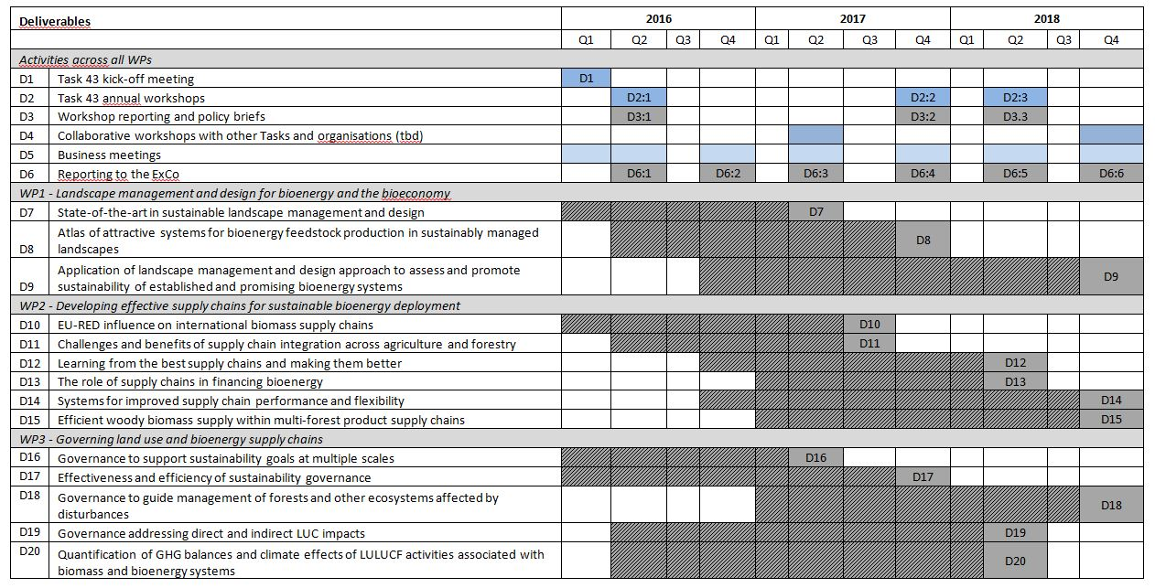

Slide 6
ADMINISTRATIVE TASK 43 INFORMATION
Operating Agent: Åsa Forsum (Sweden)
Task Leader: Ioannis Dimitriou (Sweden)
Work Package Leaders: Göran Berndes (Sweden)
Mark Brown (Australia)
Hans Langeveld (The Netherlands)
Tat Smith (Canada)
National Team Leaders: Mark Brown (Australia)
Tat Smith (Canada)
Biljana Kulišić (Croatia)
Inge Stupak (Denmark)
Jean-Francois Dallemand (EC)
Antti Asikainen (Finland)
Jörg Schweinle (Germany)
Ger Devlin (Ireland)
Wolter Elbersen (Netherlands)
Bruce Talbot (Norway)
Gustaf Egnell (Sweden)
Marilyn Buford (USA)

Slide 7
WP1 - Landscape management and design for bioenergy and the bioeconomy
Technology learning and efficiency improvements drive changes in the land use matrix and needs for new landscape designs
Sustainability requirements set a framework for landscape design
Policy and stakeholder decisions on changes in land use and land management affect biomass availability
Adapted landscape management and design directs governance and adds to its legitimacy
Increased demand for biomass increase the need for regulatory requirements
WP2 - Developing Effective supply chains for sustainable bioenergy deployment
WP3 - Governing land-use and bioenergy supply chains
Regulatory requirements affect supply chain design, costs and risks

