Slide 1
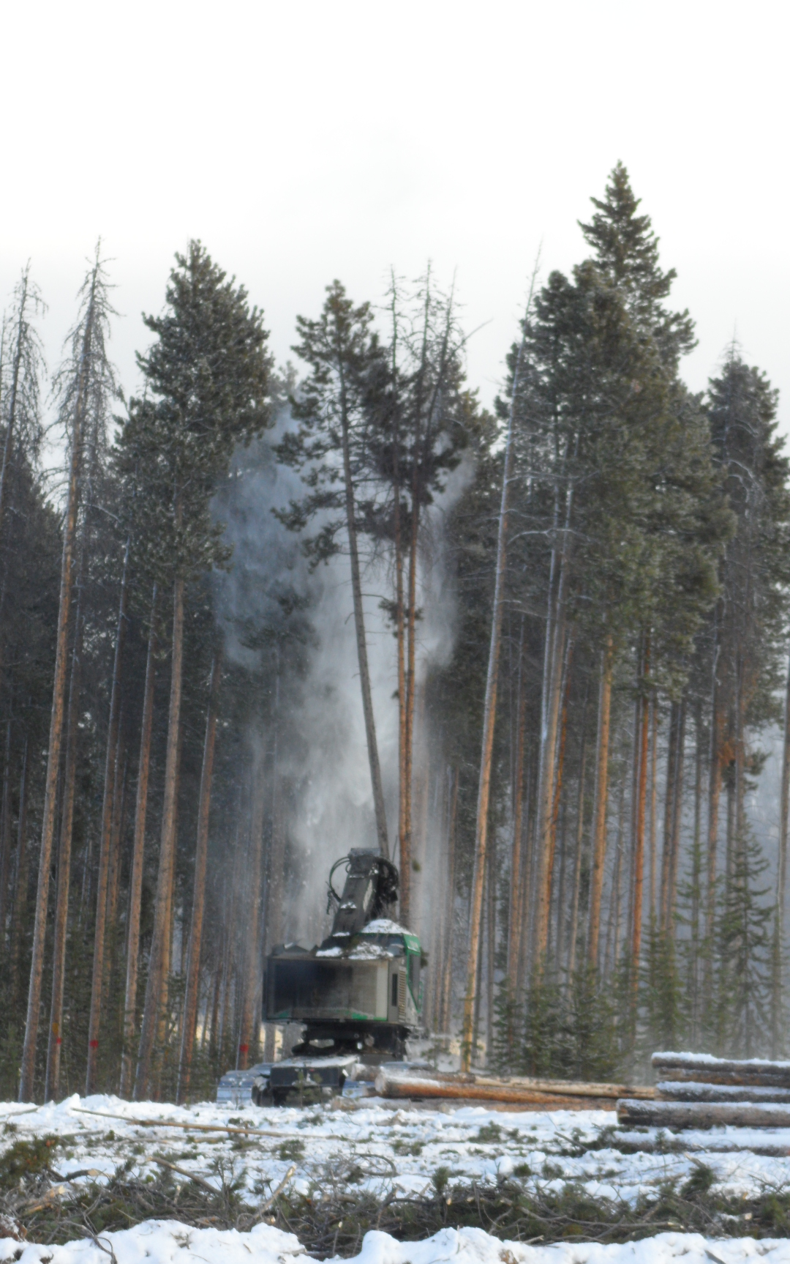
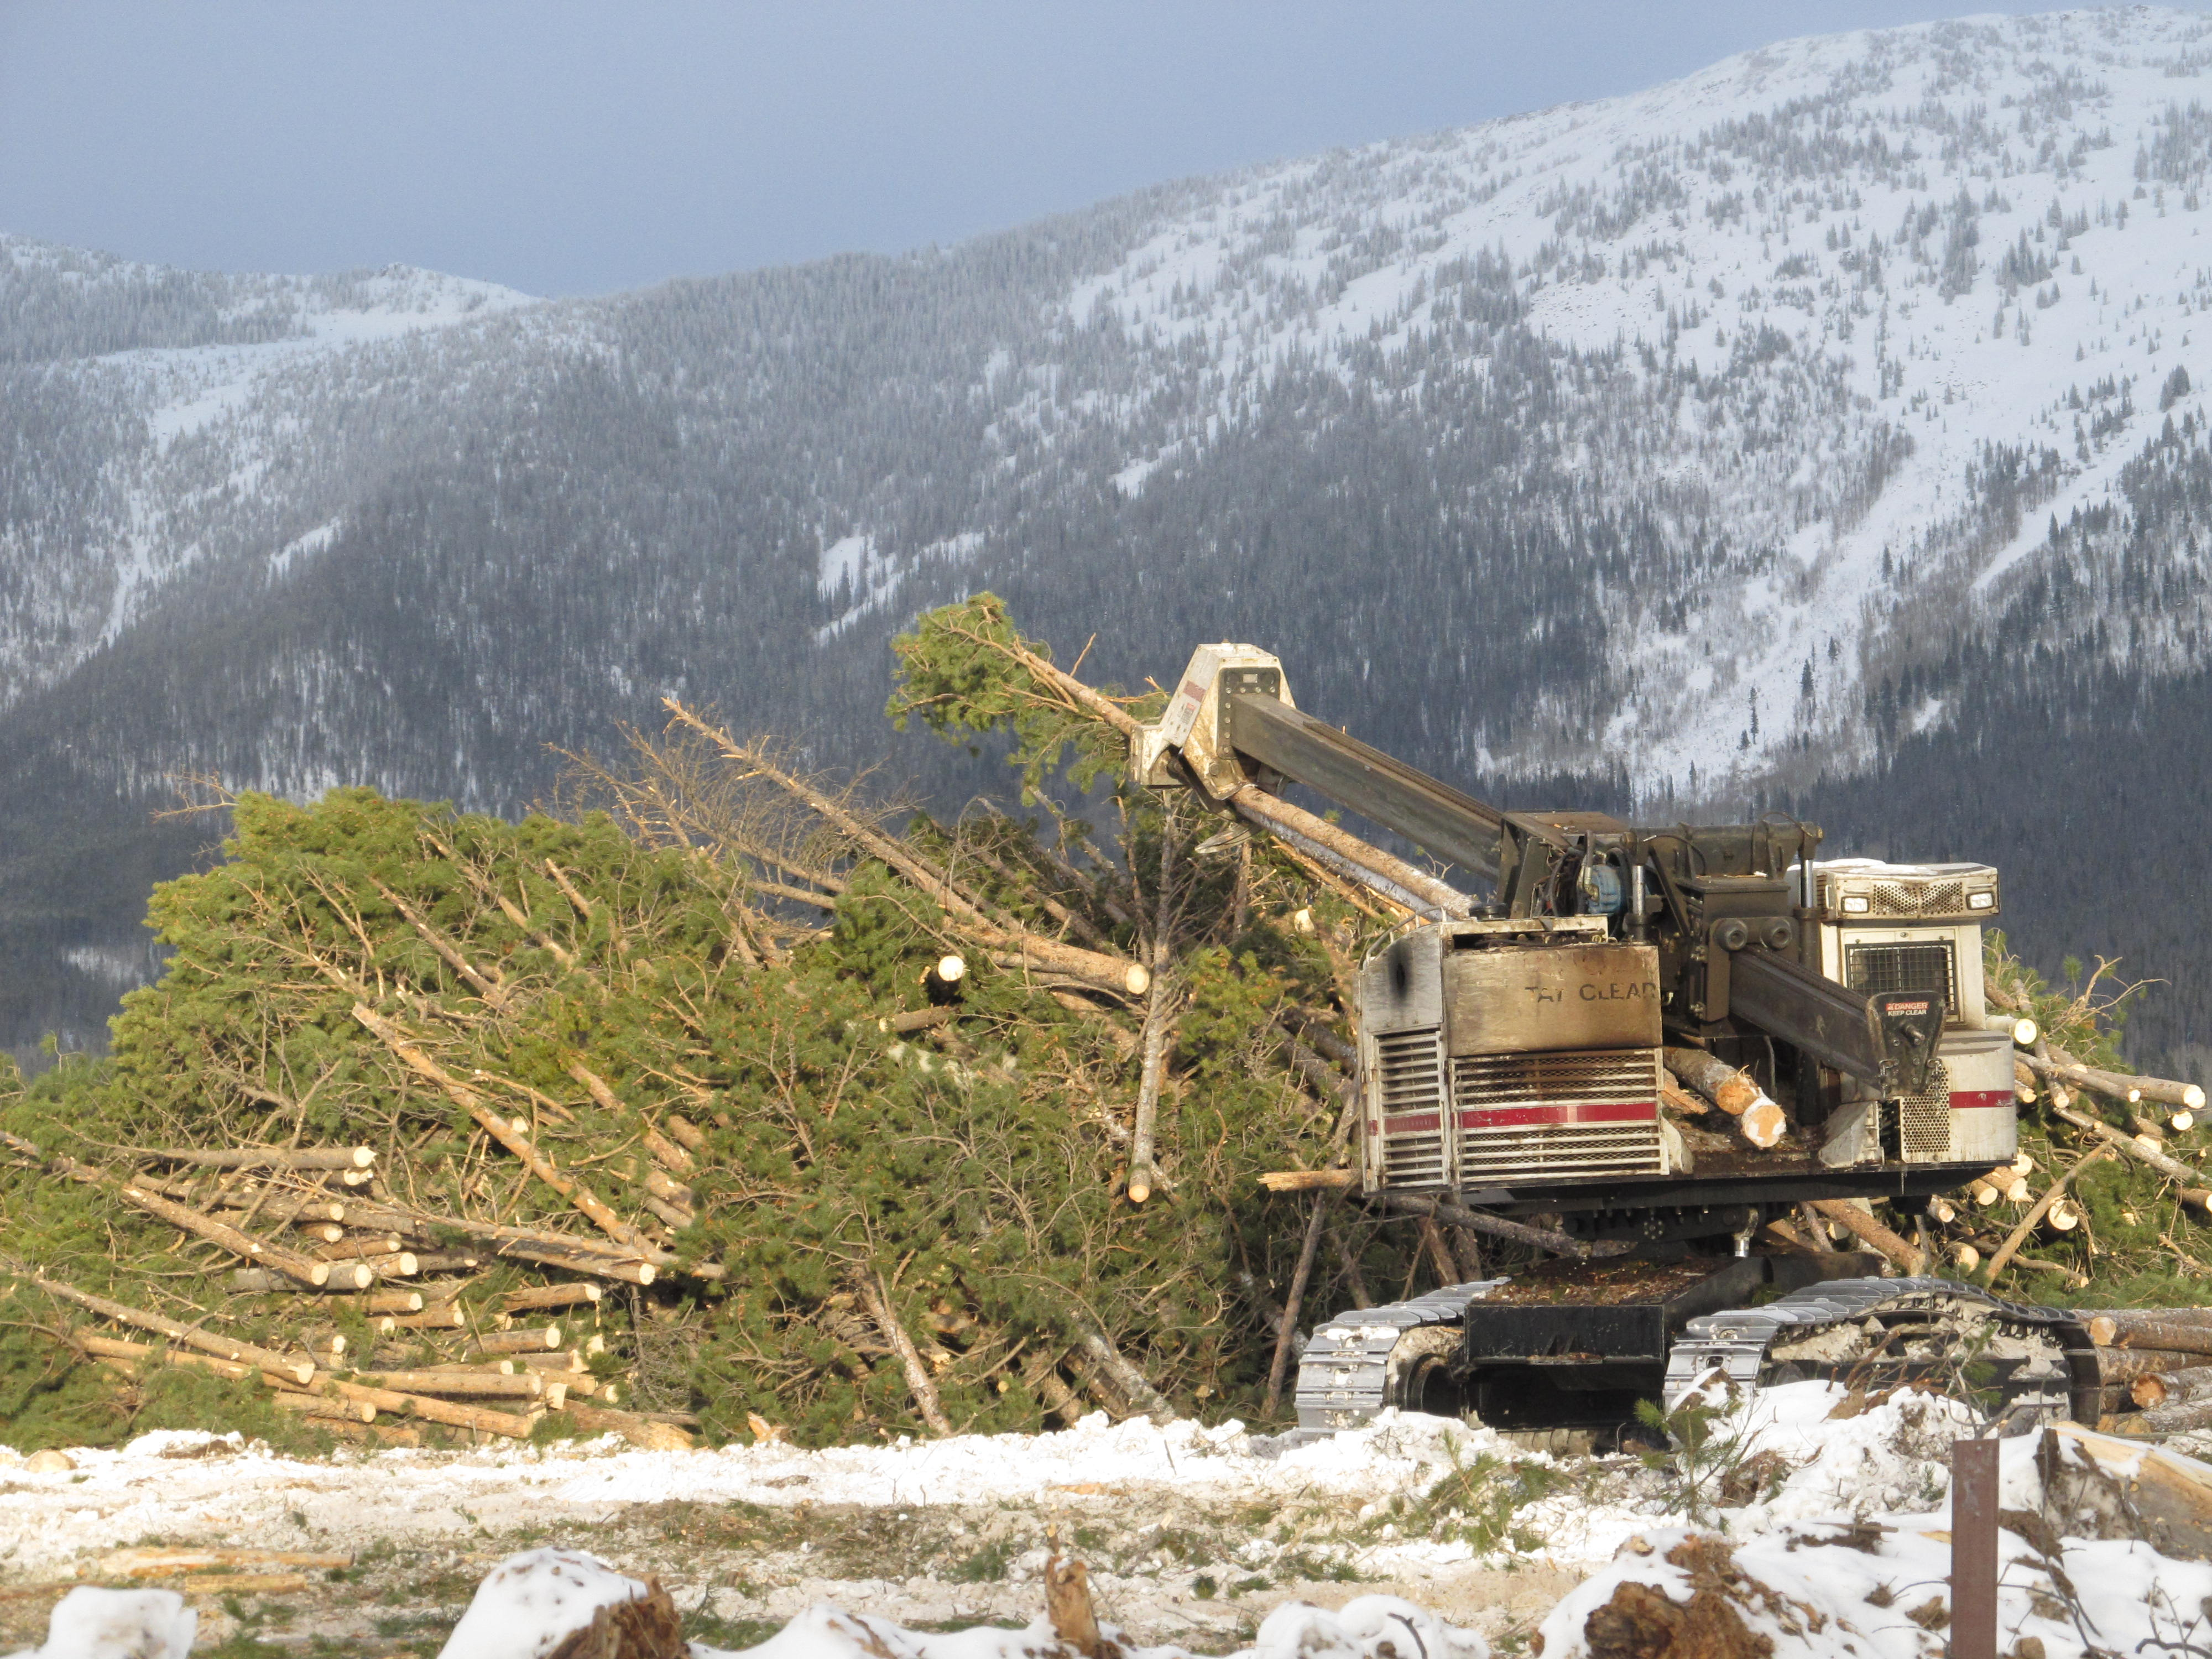
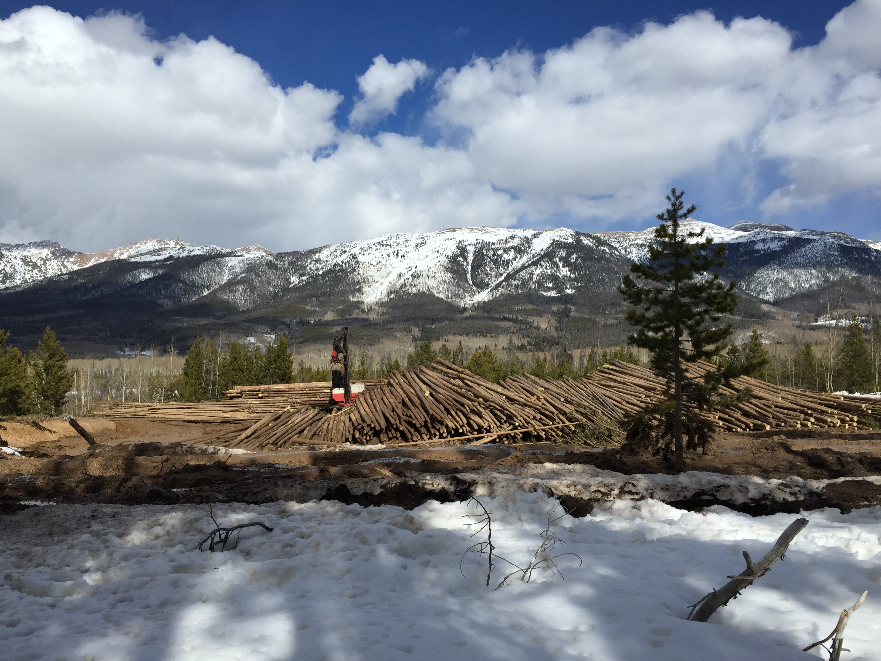
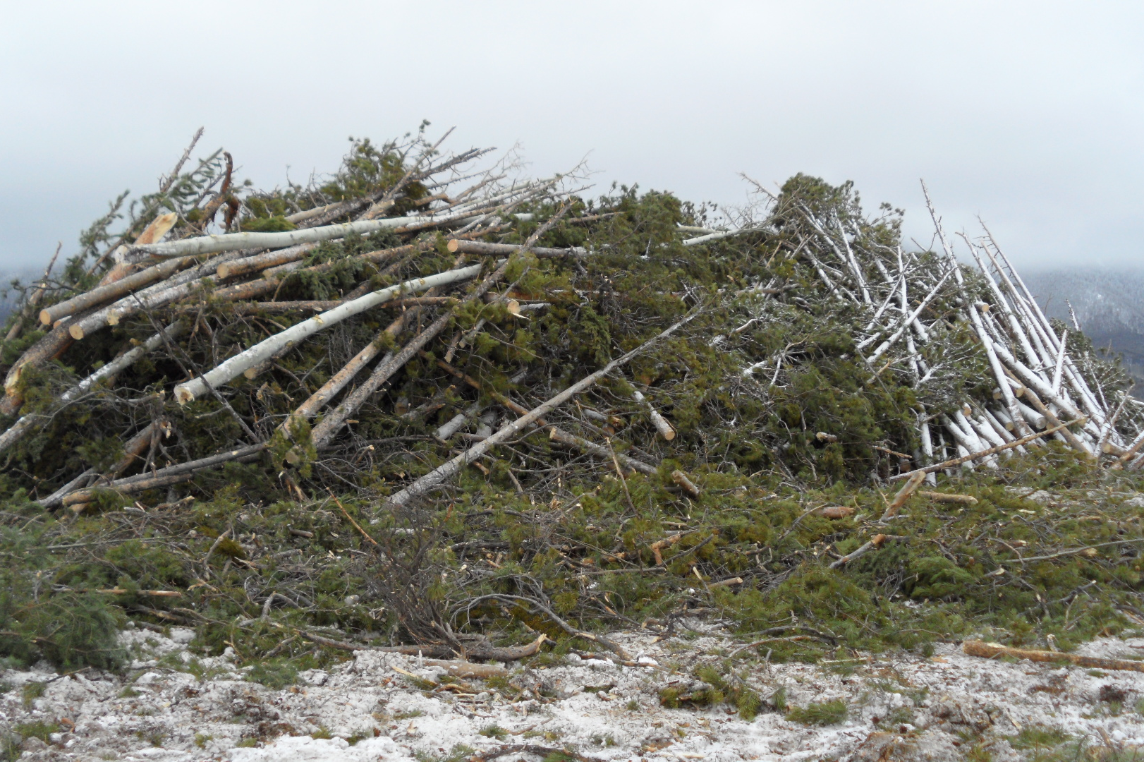
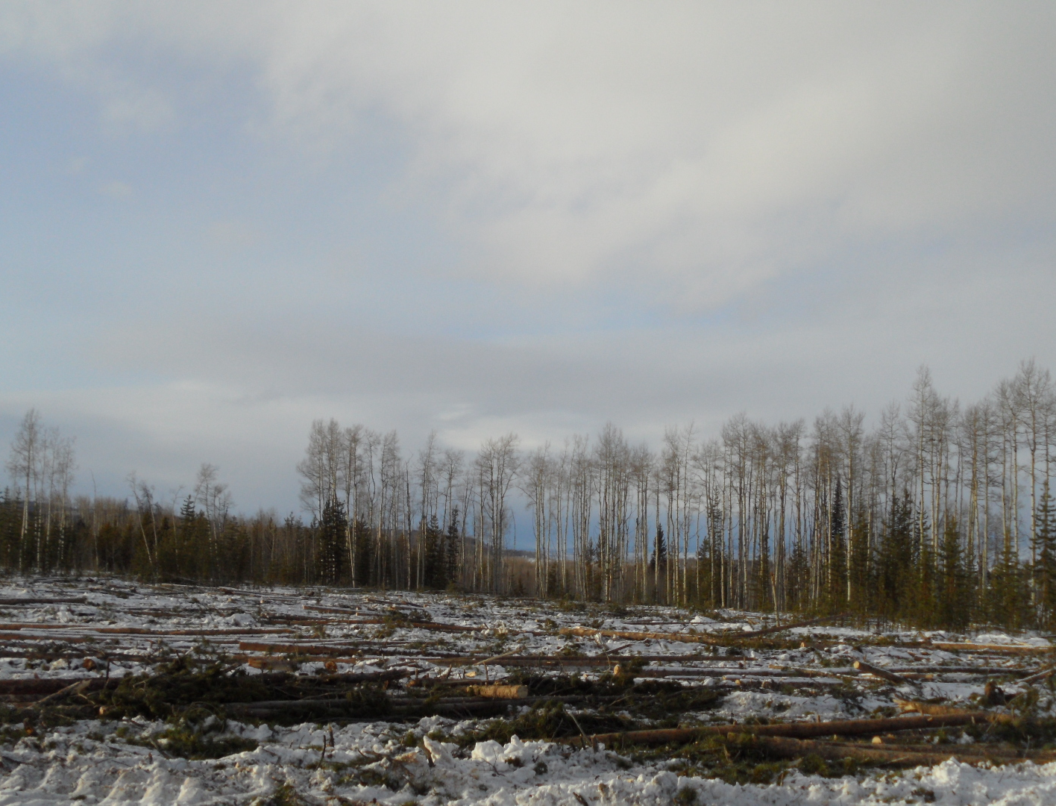
Upstream forest supply chain management with multiple objectives
– A case study on harvesting beetle-killed forest stand in Colorado
Ji She, Hee Han, Woodam Chung

Slide 2
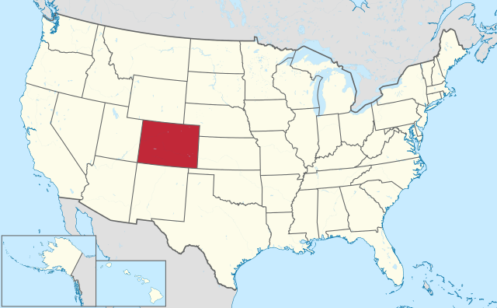
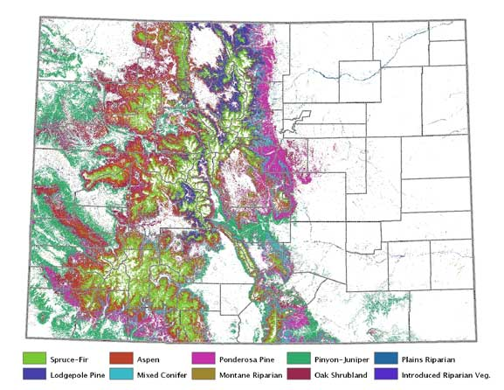
Colorado
Colorado is the only U.S. state that lies entirely above 1,000 meters elevation
9.87 million hectares of forested landscape with a diverse mix of coniferous and deciduous species
The most extensive forest types: Spruce-fir, ponderosa pine, lodgepole pine, aspen and piñon-juniper
https://commons.wikimedia.org/w/index.php?curid=15948090
http://csfs.colostate.edu/colorado-forests/forest-types/
http://csfs.colostate.edu/colorado-forests/forest-types/

Slide 3
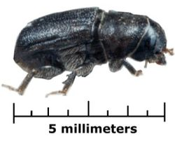
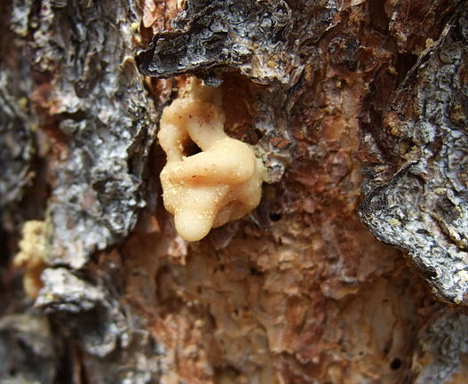
Mountain Pine Beetles
The mountain pine beetle is a species of bark beetle native to the forests of western North America from Mexico to central British Columbia.
Mountain pine beetles inhabit ponderosa, whitebark, lodgepole, Scotch, jack pine, and limber pine trees.
https://en.wikipedia.org/wiki/Mountain_pine_beetle
https://commons.wikimedia.org/w/index.php?curid=187153
https://commons.wikimedia.org/w/index.php?curid=5704298

Slide 4
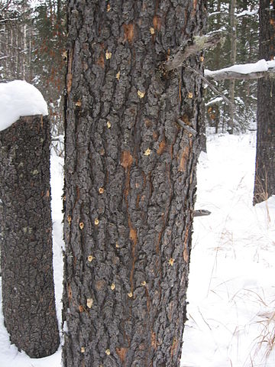
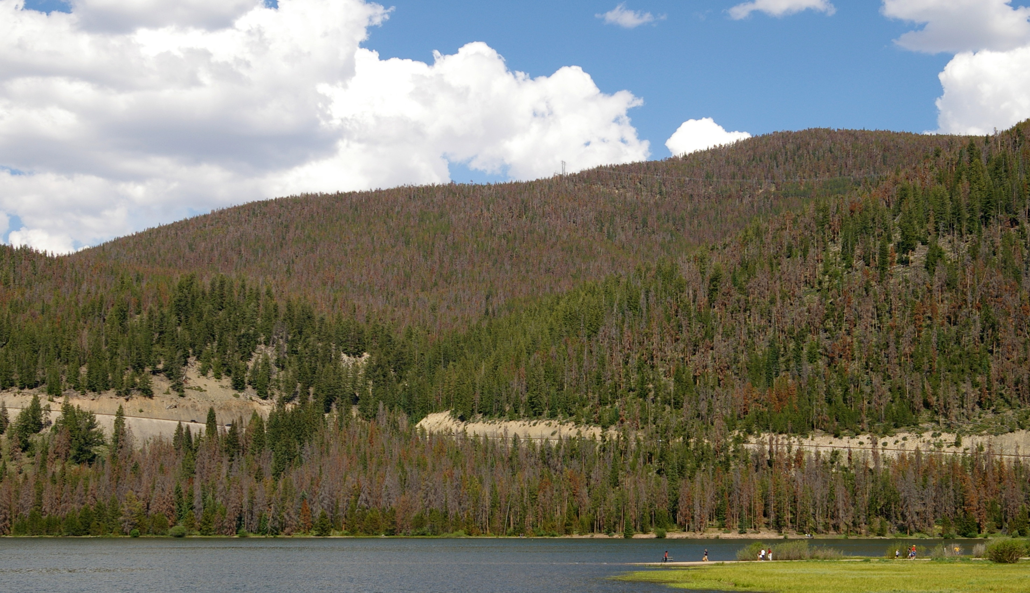
Mountain Pine Beetle Infestation
https://commons.wikimedia.org/w/index.php?curid=3527351
https://commons.wikimedia.org/w/index.php?curid=5704315
Between 1996 and 2013, 1.38 million of Colorado’s 9.87 million hectares of forestland were infested (Colorado Forest Health Report 2015)

Slide 5
Colorado’s Wood Market
More than 90 percent of wood-based products used in Colorado are imported from out of state, representing an annual expense of $4 billion of Coloradans (Colorado Forest Health Report 2015).

Slide 6
Colorado’s Renewable Energy Fact
In 2013, 64 percent and 20 percent of the electricity generated from coal and natural gas, respectively.
Only 17 percent was from renewable energy sources.
Investor-owned electric utilities are requested by Colorado’s Renewable Energy Standard to provide 30 percent of their energy generation from renewable energy resources by 2020.
EIA State profile and energy estimate http://www.eia.gov/state/?sid=CO#tabs-4

Slide 7
Opportunity for Forest Industry
Timber product:
Harvesting dead trees utilizes resources that are otherwise wastes, contributes to wood products manufacturing and local employment, increases the market competitiveness of Colorado wood products, and benefits recreation and tourism at the same time.

Slide 8
Opportunity for Forest Industry
Bioenergy:
Logging residues including tree tops, branches and non-merchantable parts of trees, and low grade logs produced from forest management and restoration activities are attractive as locally available bioenergy feedstock.

Slide 9
Knowledge Gaps
The linkage between traditional timber products and bioenergy feedstock has not been built yet.
Upstream forest harvesting operations are isolated from downstream supply chain management.
Notes:
Until now most studies in forest supply chain management have dealt with exclusively either traditional timber products or bioenergy feedstock, and the linkage between these two important products has not been built yet.
However, not only technical and economic feasibility of biomass feedstock logistics, but also conventional silvicultural treatments and harvesting methods often become barriers of producing and utilizing forest biomass for bioenergy.
For instance, many bioenergy supply chain studies assume biomass residues become available at the landing at free of charge.

Slide 10
Objectives
Create a framework that considers both timber production and production of bioenergy products
Include decisions of forest harvesting operations during the supply chain management
Simultaneously account for both economic remuneration and environmental benefits
Use an optimization approach to improve this supply network with multiple entities and corresponding processes.

Slide 11
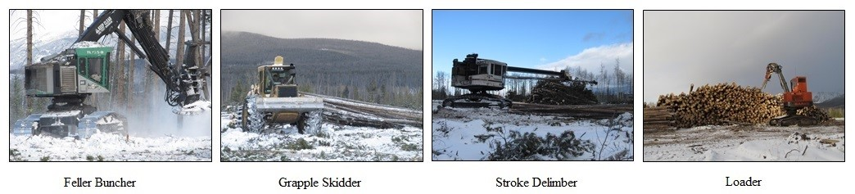
Our case
Ground-based clearcut operation
Options of mechanized harvesting systems
  Lop-and-scatter system
  Whole-tree harvesting system

Slide 12
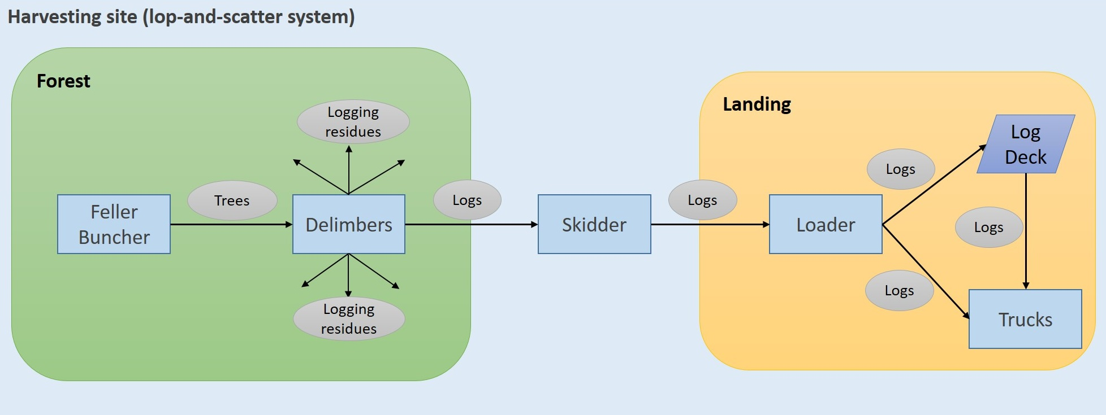
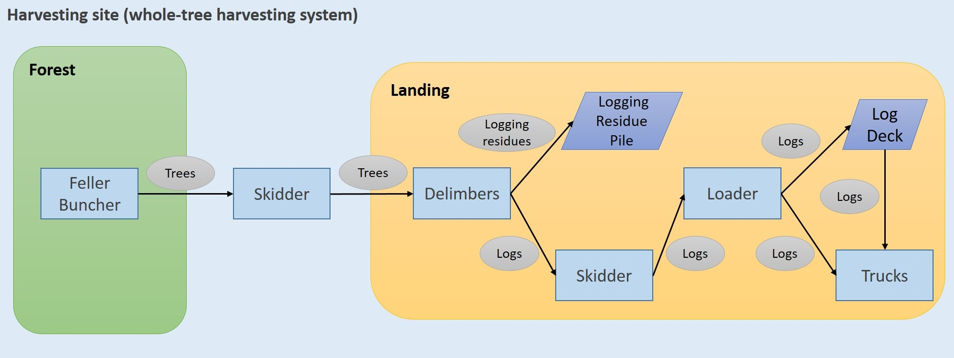
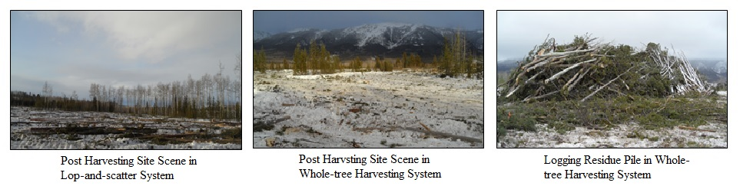
Harvesting Systems
Lop-and-scatter system
Whole-tree harvesting system

Slide 13
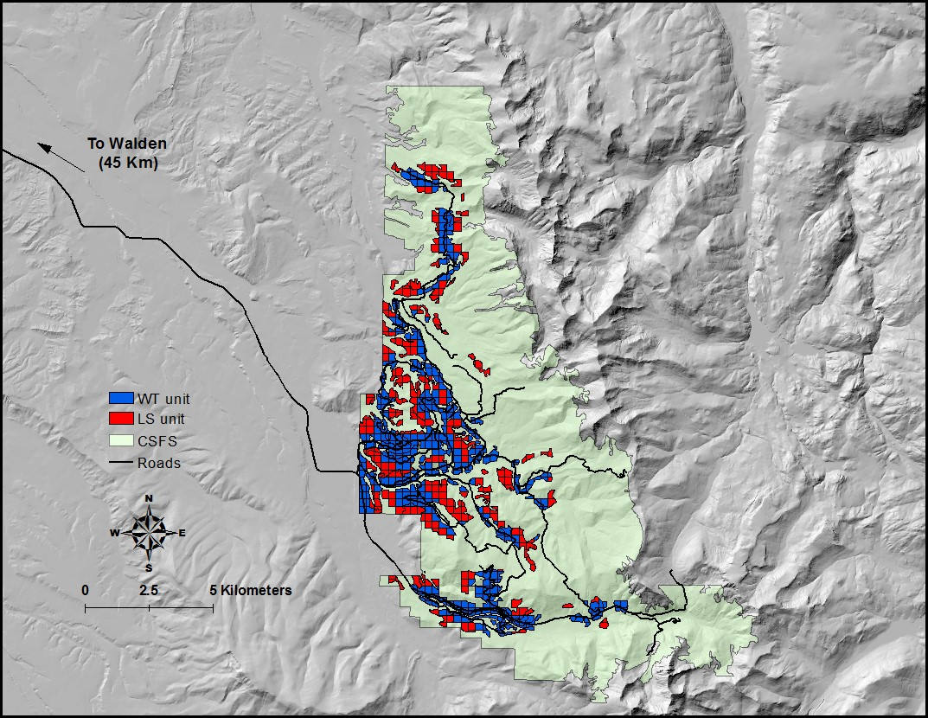
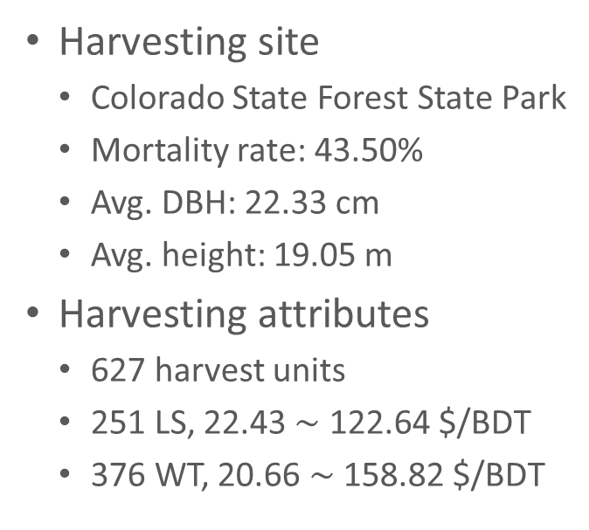
Study Site
Harvesting site
  Colorado State Forest State Park
  Mortality rate: 43.50%
  Avg. DBH: 22.33 cm
  Avg. height: 19.05 m
Harvesting attributes
  627 harvest units
  251 LS, 22.43 $\sim$ 122.64 $/BDT
  376 WT, 20.66 $\sim$ 158.82 $/BDT
Timber production: sawlogs
Biomass: logging residues

Slide 14
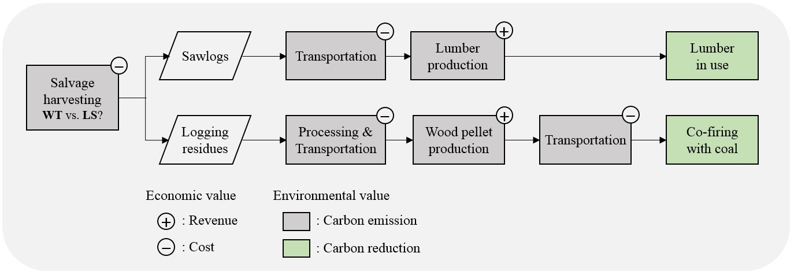
Framework
All products transported to Walden, CO for processing
One sawmill: lumber production
One wood pellet plant: pellet production

Slide 15
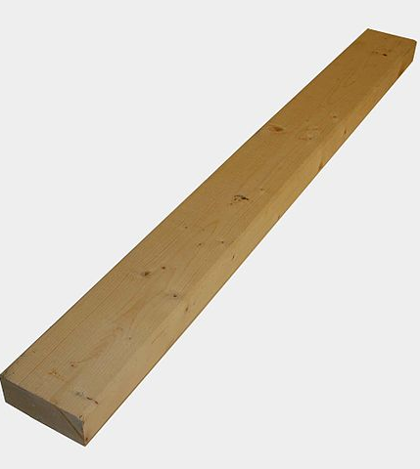
Lumber
2×4 stud
Lumber dimension 2 inches thick, 4 inches wide, and 8 feet long.
  Approximately 0.444 ft³ or 0.0126 m³
https://commons.wikimedia.org/w/index.php?curid=4192223

Slide 16
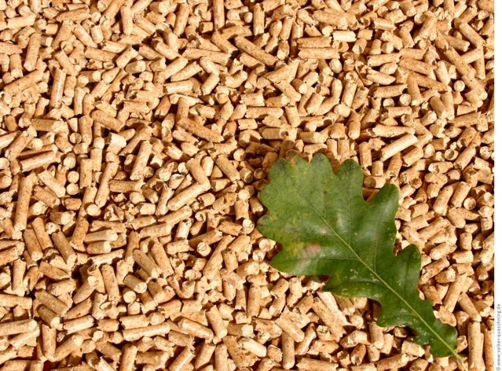
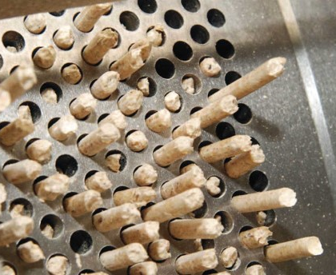
Wood Pellets
Commonly made from compressing woody biomass such as chips, sawdust, shavings, but can also produced from whole logs
Densified wood fuel
Bulk density (lb/ft³): 38.0 - 46.0
Diameter (in.): 0.230 - 0.285
Moisture (%): < 6 - 10
(Pellet Fuel Institute 2011)
http://cecoreysepticsystems.com/pellets.html
http://www.woodland-pellets.eu/index.php/en/about-pellets

Slide 17
Method
Multi-objective Optimization (MOO)
  Mathematical programming
  The optimal solution considers multiple aspects
  the solution output is a set of “Pareto optimal solutions” where in each solution one of the objectives cannot be improved without sacrificing one or more other objectives
Integrate the economic and environmental objectives into forest supply chain management for both timber and bioenergy production

Slide 18
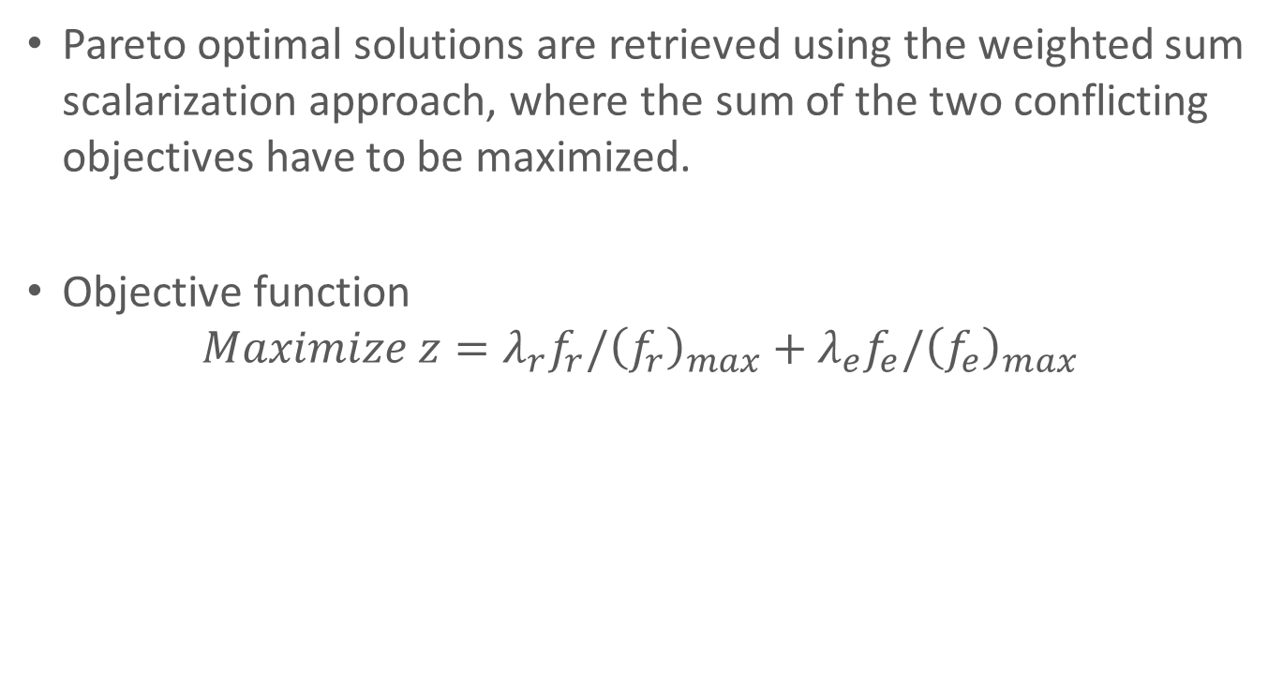
Method
Pareto optimal solutions are retrieved using the weighted sum scalarization approach, where the sum of the two conflicting objectives have to be maximized.
Objective function
$$Maximize z=λ_{r}f_{r}/{\left(f_{r}\right)}_{max}+λ_{e}f_{e}/{\left(f_{e}\right)}_{max}$$

Slide 19
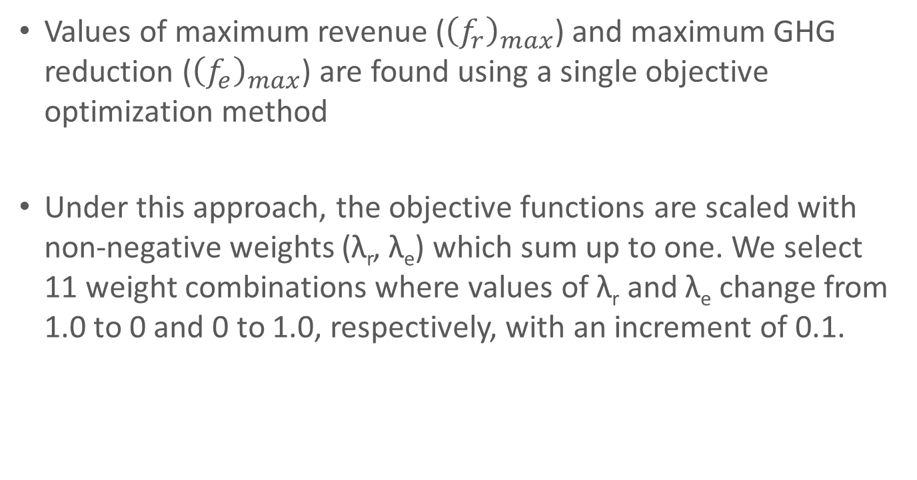
Method
Values of maximum revenue (${\left(f_{r}\right)}_{max}$) and maximum GHG reduction (${\left(f_{e}\right)}_{max}$) are found using a single objective optimization method
Under this approach, the objective functions are scaled with non-negative weights (λ_{r}, λ_{e}) which sum up to one. We select 11 weight combinations where values of λ_{r} and λ_{e} change from 1.0 to 0 and 0 to 1.0, respectively, with an increment of 0.1.

Slide 20
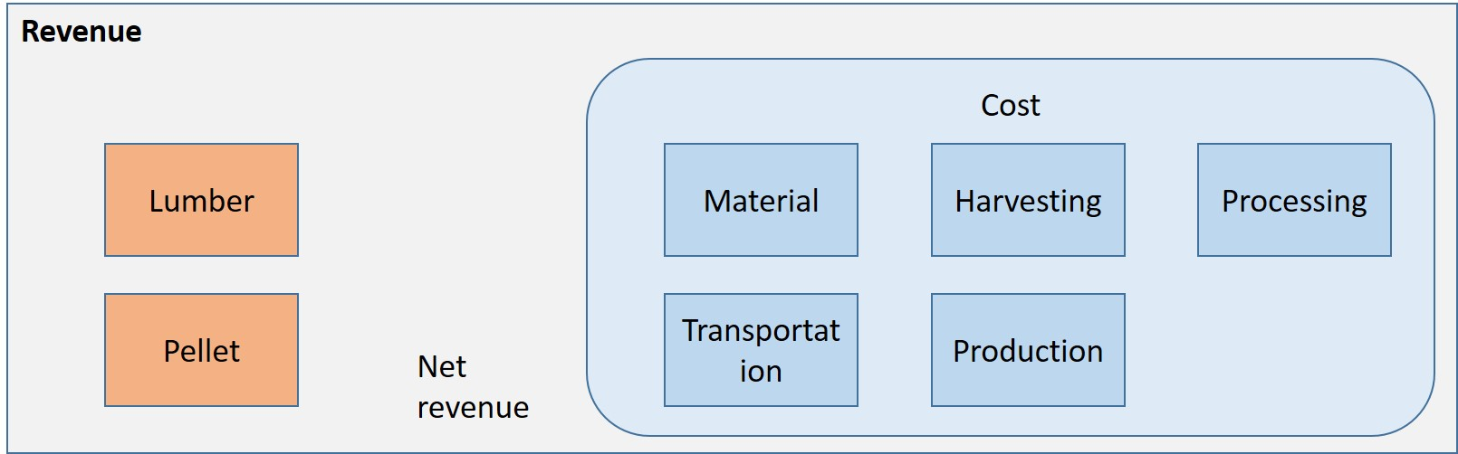
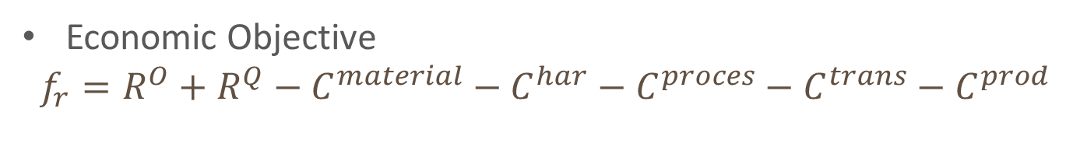
Economic Aspect
Economic Objective
$$f_{r}=R^{O}+R^{Q}−C^{material}−C^{har}−C^{proces}−C^{trans}−C^{prod}$$

Slide 21
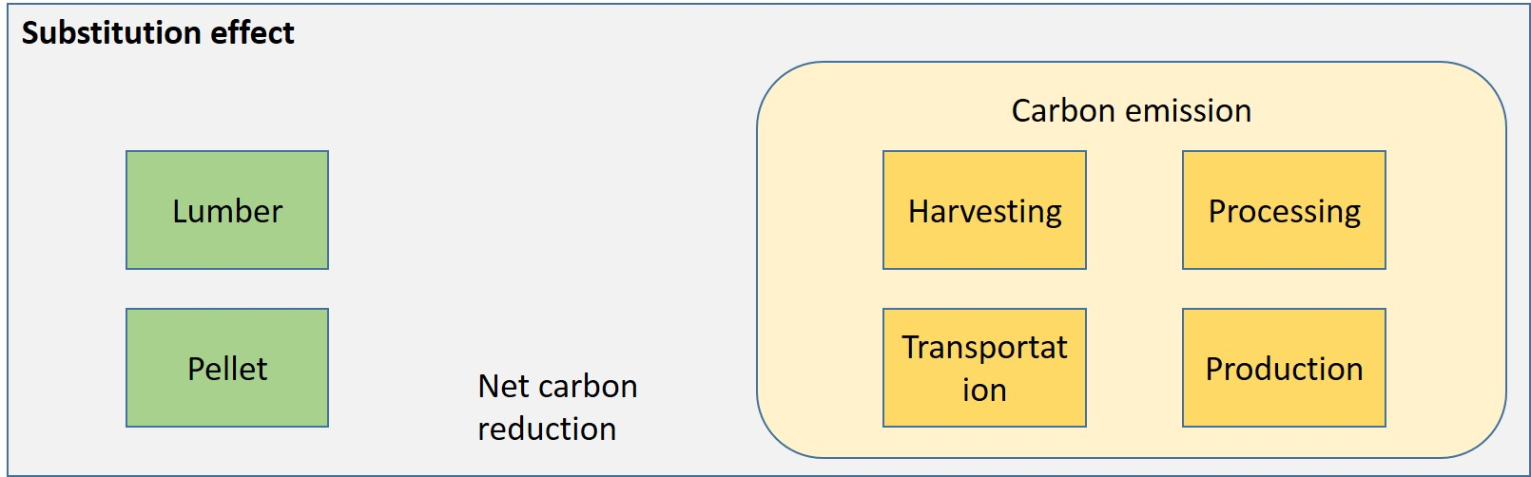

Environmental Aspect
Environmental Objective
$$f_{e}=E^{O}+E^{Q}−E^{har}−E^{proces}−E^{trans}{−E}^{prod}$$

Slide 22
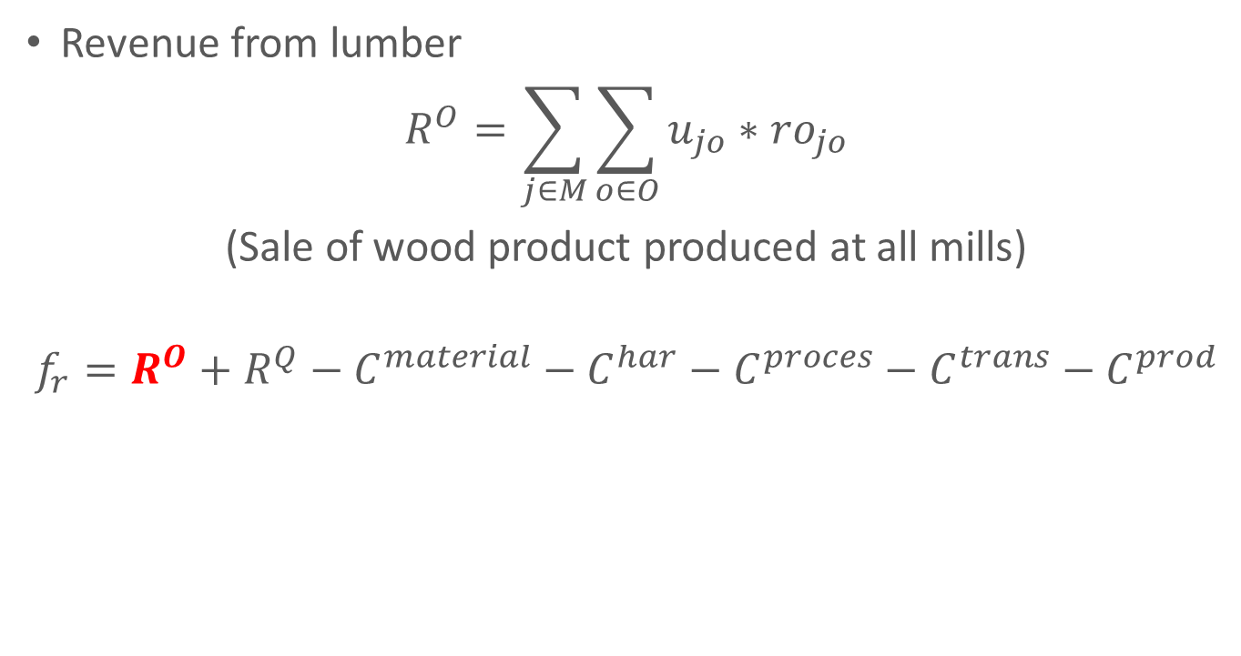
Economic Objective Component
Revenue from lumber
$$R^{O}=\sum_{j∈M}{\sum_{o∈O}{u_{jo}∗{ro}_{jo}}}$$
(Sale of wood product produced at all mills)
$$f_{r}=R^{O}+R^{Q}−C^{material}−C^{har}−C^{proces}−C^{trans}−C^{prod}$$

Slide 23
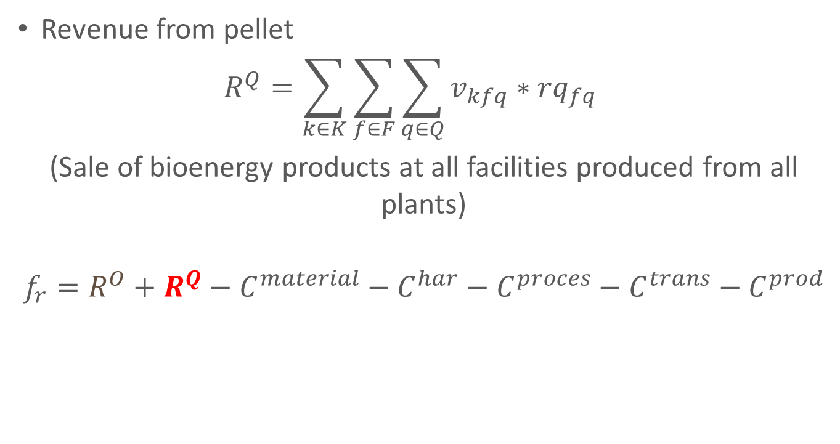
Economic Objective Component
Revenue from pellet
$$R^{Q}=\sum_{k∈K}{\sum_{f∈F}{\sum_{q∈Q}{v_{kfq}∗{rq}_{fq}}} }$$
(Sale of bioenergy products at all facilities produced from all plants)
$$f_{r}=R^{O}+R^{Q}−C^{material}−C^{har}−C^{proces}−C^{trans}−C^{prod}$$

Slide 24
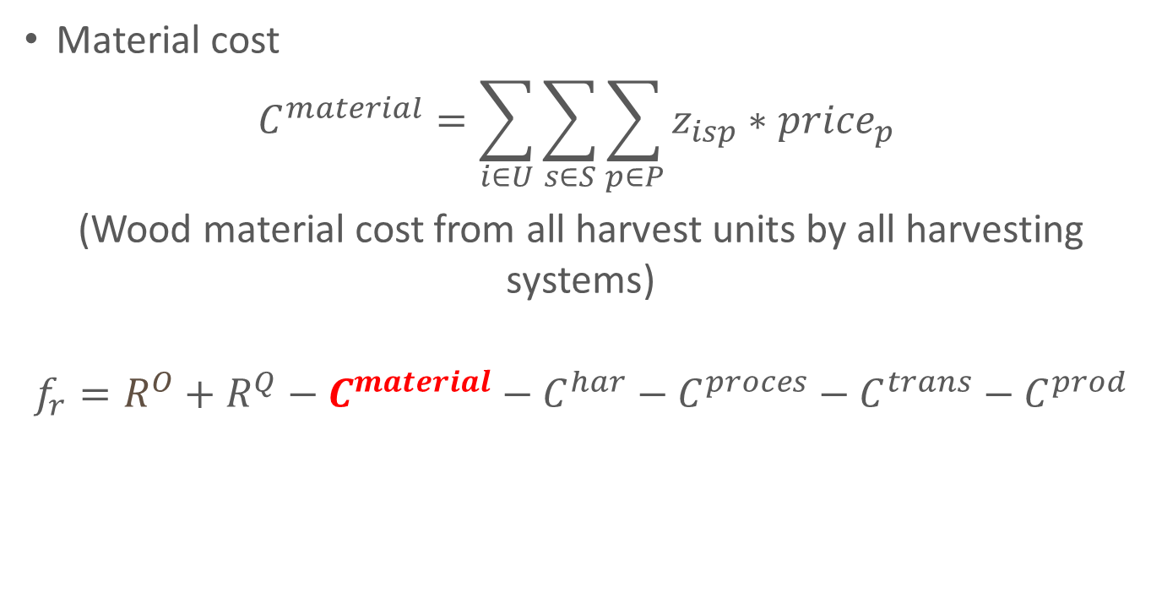
Economic Objective Component
Material cost
$$C^{material}=\sum_{i∈U}{\sum_{s∈S}{\sum_{p∈P}{z_{isp}}}∗{price}_{p}}$$
(Wood material cost from all harvest units by all harvesting systems)
$$f_{r}=R^{O}+R^{Q}−C^{material}−C^{har}−C^{proces}−C^{trans}−C^{prod}$$

Slide 25
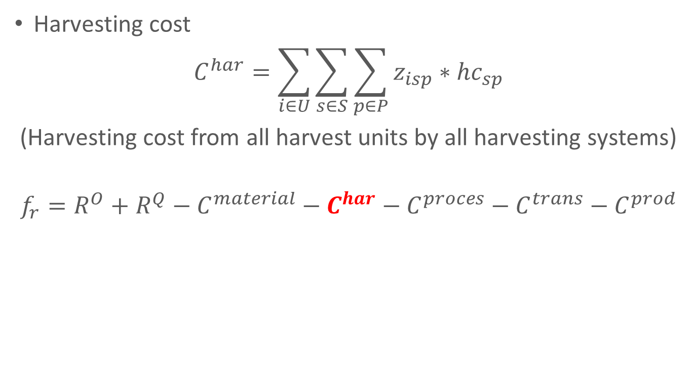
Economic Objective Component
Harvesting cost
$$C^{har}=\sum_{i∈U}{\sum_{s∈S}{\sum_{p∈P}{z_{isp}}}∗{hc}_{sp}}$$
(Harvesting cost from all harvest units by all harvesting systems)
$$f_{r}=R^{O}+R^{Q}−C^{material}−C^{har}−C^{proces}−C^{trans}−C^{prod}$$

Slide 26
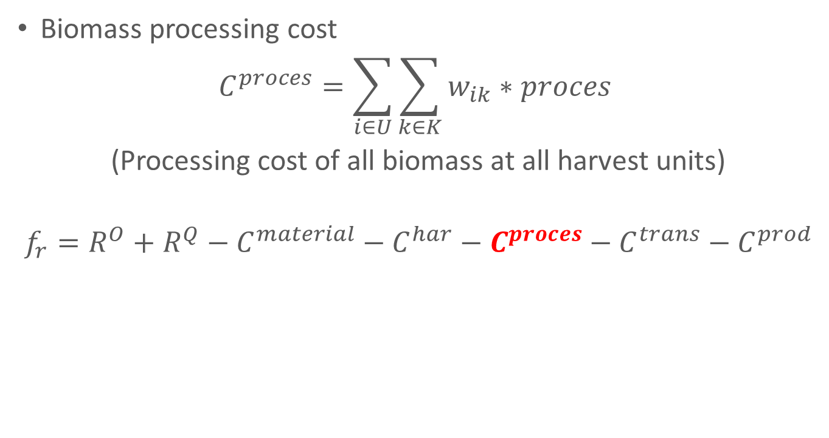
Economic Objective Component
Biomass processing cost
$$C^{proces}=\sum_{i∈U}{\sum_{k∈K}{w_{ik}∗proces}}$$
(Processing cost of all biomass at all harvest units)
$$f_{r}=R^{O}+R^{Q}−C^{material}−C^{har}−C^{proces}−C^{trans}−C^{prod}$$

Slide 27
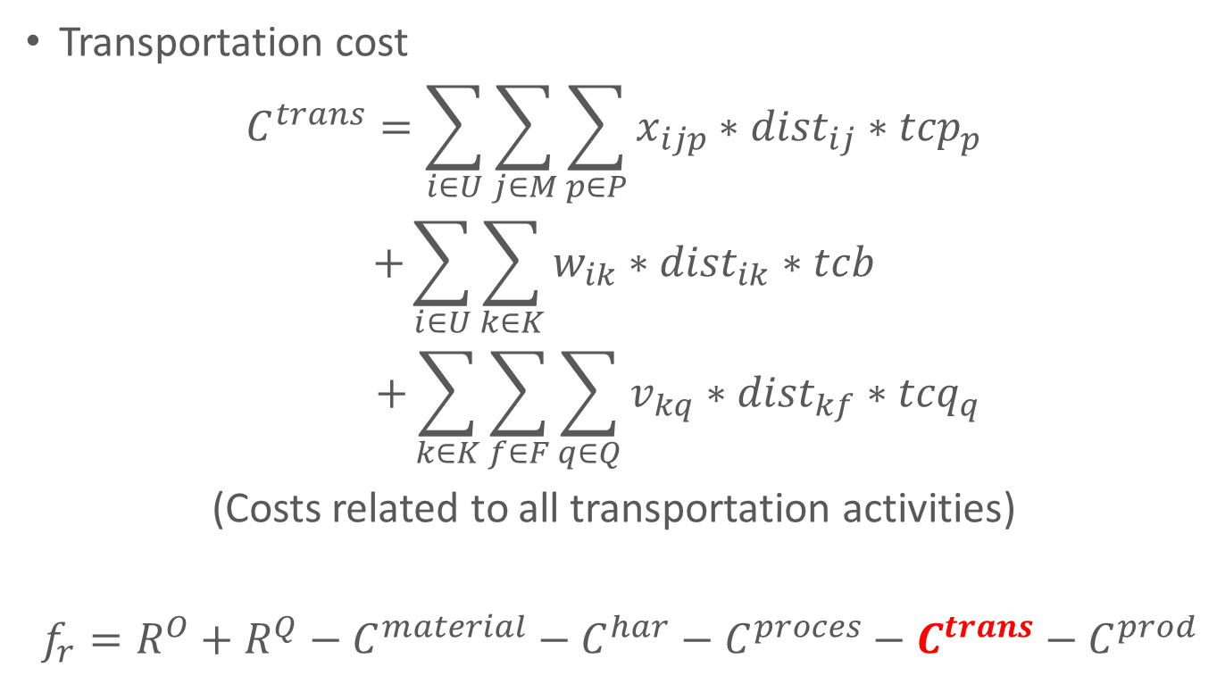
Economic Objective Component
Transportation cost
$$C^{trans}=\sum_{i∈U}{\sum_{j∈M}{\sum_{p∈P}{x_{ijp}}∗{dist}_{ij}}}∗{tcp}_{p}$$
$$+\sum_{i∈U}{\sum_{k∈K}{w_{ik}∗{dist}_{ik}∗tcb}}$$
$$+\sum_{k∈K}{\sum_{f∈F}{\sum_{q∈Q}{v_{kq}∗{dist}_{kf}∗{tcq}_{q}}}}$$
(Costs related to all transportation activities)
$f_{r}=R^{O}+R^{Q}−C^{material}−C^{har}−C^{proces}−C^{trans}−C^{prod}$

Slide 28
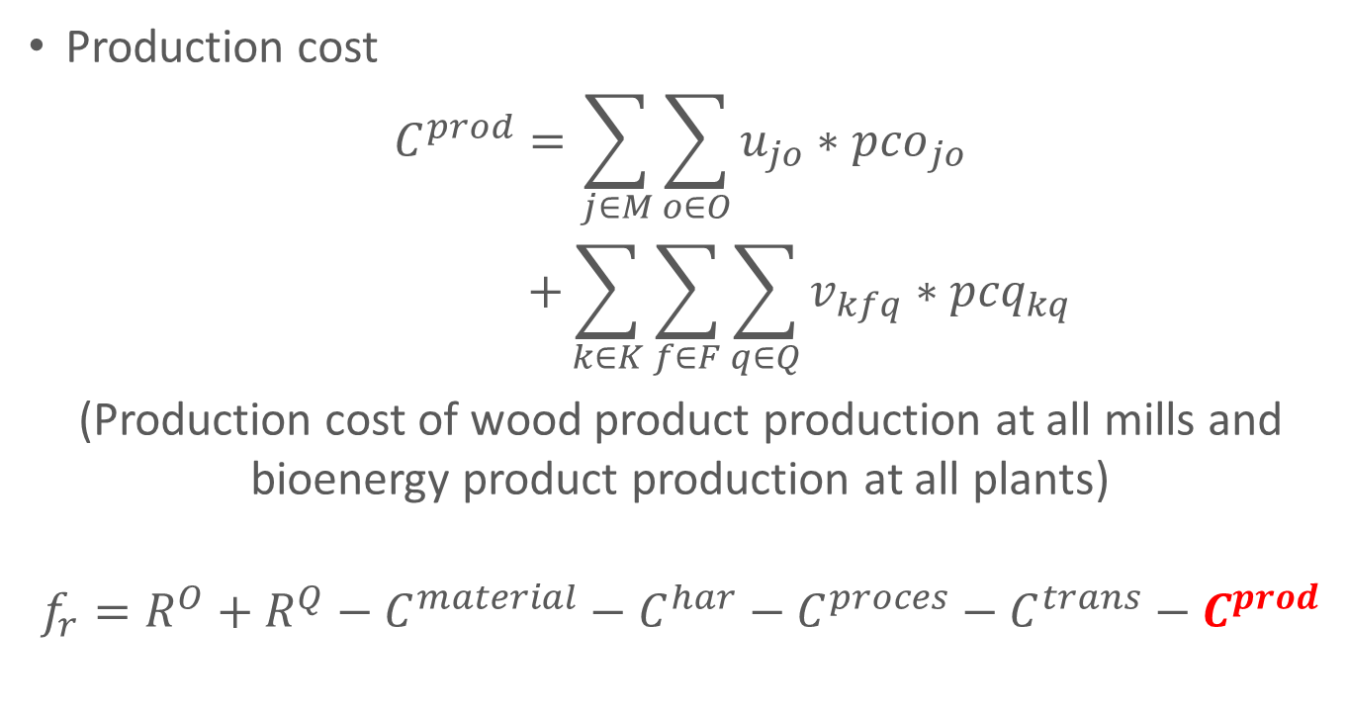
Economic Objective Component
Production cost
$$C^{prod}=\sum_{j∈M}{\sum_{o∈O}{u_{jo}∗{pco}_{jo}}}$$
$$+\sum_{k∈K}{\sum_{f∈F}{\sum_{q∈Q}{v_{kfq}∗{pcq}_{kq}}}}$$
(Production cost of wood product production at all mills and bioenergy product production at all plants)
$$f_{r}=R^{O}+R^{Q}−C^{material}−C^{har}−C^{proces}−C^{trans}−C^{prod}$$

Slide 29
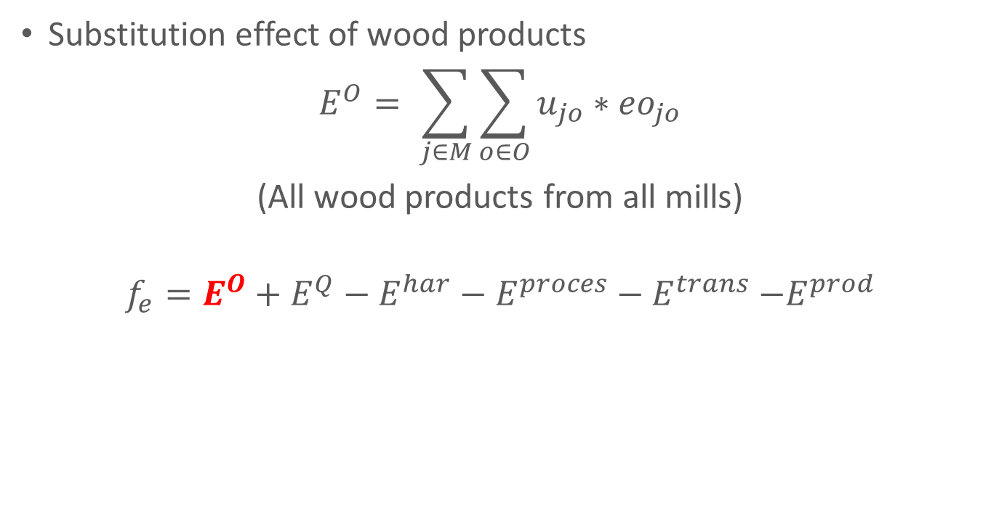
Environmental Objective Component
Substitution effect of wood products
$$E^{O}= \sum_{j∈M}{\sum_{o∈O}{u_{jo}∗{eo}_{jo}}}$$
(All wood products from all mills)
$$f_{e}=E^{O}+E^{Q}−E^{har}−E^{proces}−E^{trans}{−E}^{prod}$$

Slide 30
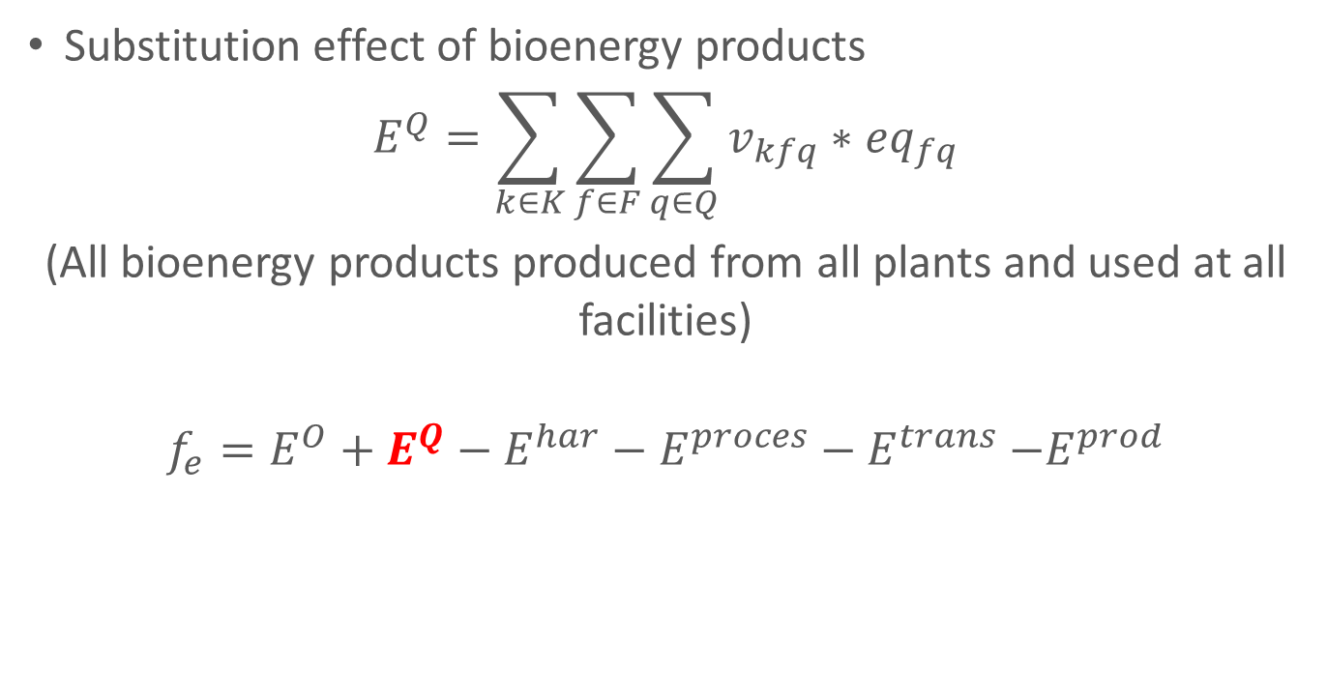
Environmental Objective Component
Substitution effect of bioenergy products
$$E^{Q}=\sum_{k∈K}{\sum_{f∈F}{\sum_{q∈Q}{v_{kfq}∗{eq}_{fq}}}}$$
(All bioenergy products produced from all plants and used at all facilities)
$$f_{e}=E^{O}+E^{Q}−E^{har}−E^{proces}−E^{trans}{−E}^{prod}$$

Slide 31
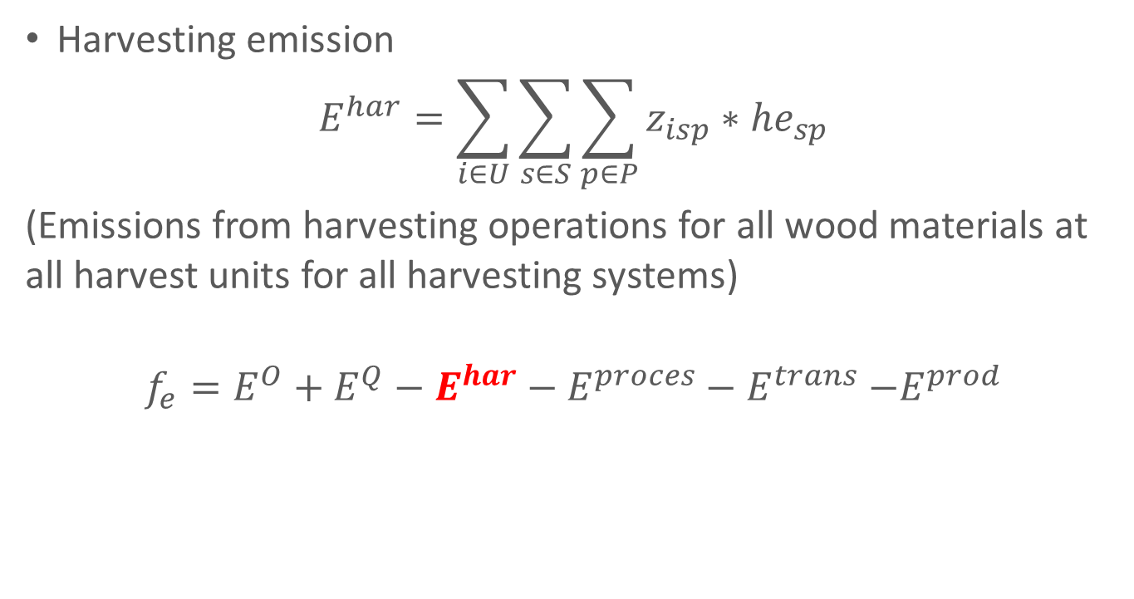
Environmental Objective Component
Harvesting emission
$$E^{har}=\sum_{i∈U}{\sum_{s∈S}{\sum_{p∈P}{z_{isp}}∗{he}_{sp}}}$$
(Emissions from harvesting operations for all wood materials at all harvest units for all harvesting systems)
$$f_{e}=E^{O}+E^{Q}−E^{har}−E^{proces}−E^{trans}{−E}^{prod}$$

Slide 32
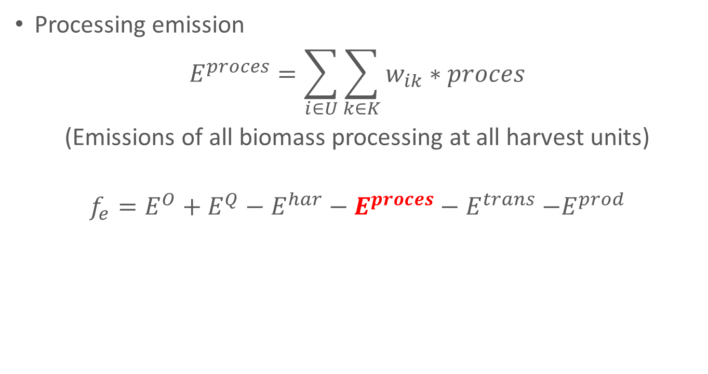
Environmental Objective Component
Processing emission
$$E^{proces}=\sum_{i∈U}{\sum_{k∈K}{w_{ik}∗proces}}$$
(Emissions of all biomass processing at all harvest units)
$$f_{e}=E^{O}+E^{Q}−E^{har}−E^{proces}−E^{trans}{−E}^{prod}$$

Slide 33
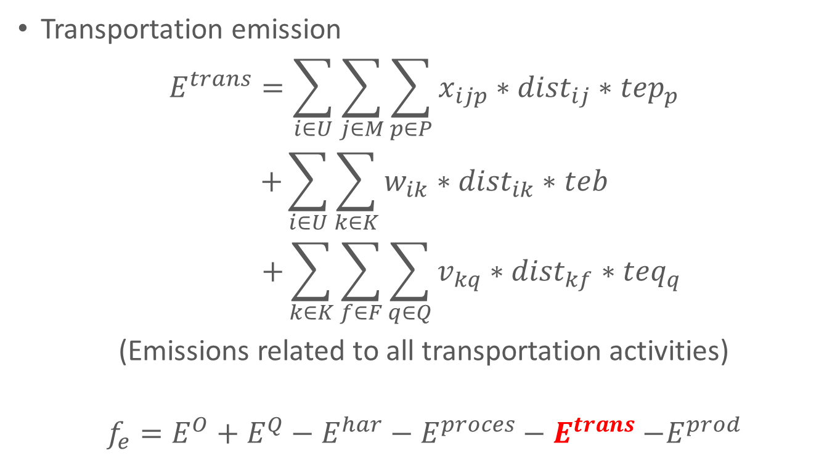
Environmental Objective Component
Transportation emission
$$E^{trans}=\sum_{i∈U}{\sum_{j∈M}{\sum_{p∈P}{x_{ijp}}∗{dist}_{ij}}}∗{tep}_{p}$$
$$+\sum_{i∈U}{\sum_{k∈K}{w_{ik}∗{dist}_{ik}∗teb}}$$
$$+\sum_{k∈K}{\sum_{f∈F}{\sum_{q∈Q}{v_{kq}∗{dist}_{kf}∗{teq}_{q}}}}$$
(Emissions related to all transportation activities)
$$f_{e}=E^{O}+E^{Q}−E^{har}−E^{proces}−E^{trans}{−E}^{prod}$$

Slide 34
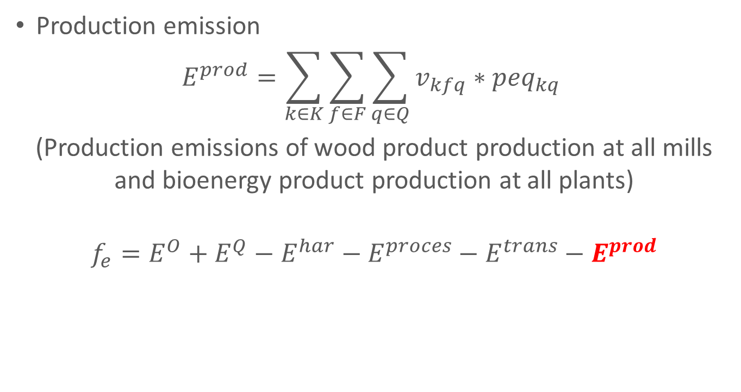
Environmental Objective Component
Production emission
$$E^{prod}=\sum_{k∈K}{\sum_{f∈F}{\sum_{q∈Q}{v_{kfq}∗{peq}_{kq}}}}$$
(Production emissions of wood product production at all mills and bioenergy product production at all plants)
$$f_{e}=E^{O}+E^{Q}−E^{har}−E^{proces}−E^{trans}−E^{prod}$$

Slide 35
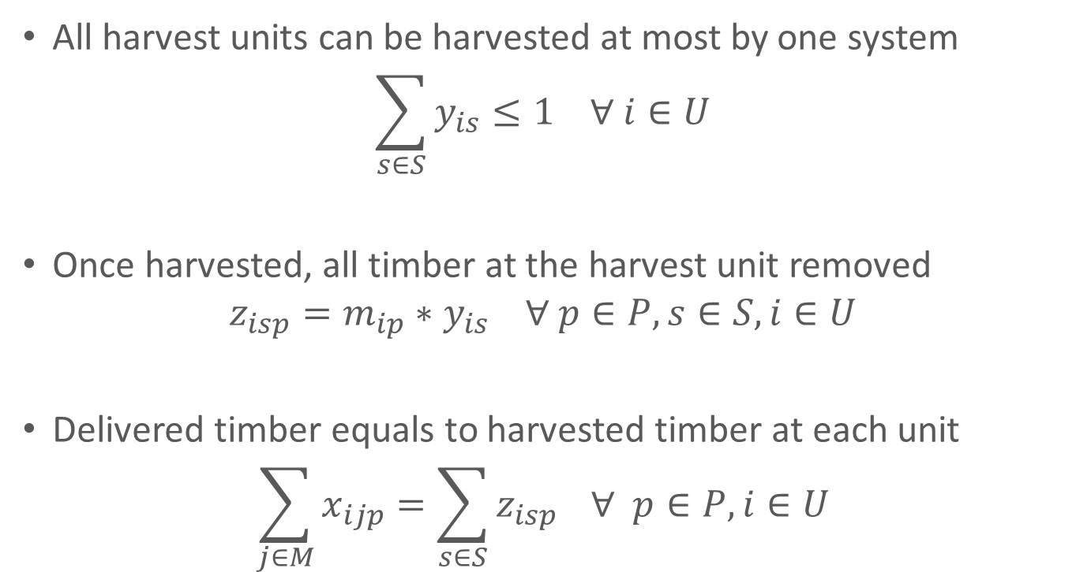
Constraints
All harvest units can be harvested at most by one system
$$\sum_{s∈S}{y_{is}}≤1 ∀ i∈U$$
Once harvested, all timber at the harvest unit removed
$$z_{isp}=m_{ip}∗y_{is} ∀ p∈P, s∈S, i∈U$$
Delivered timber equals to harvested timber at each unit
$$\sum_{j∈M}{x_{ijp}}=\sum_{s∈S}{z_{isp}} ∀ p∈P,i∈U$$

Slide 36
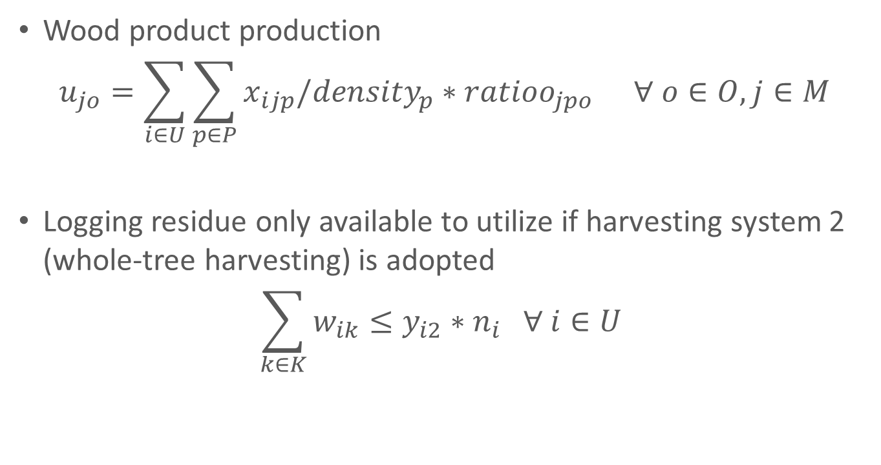
Constraints
Wood product production
$$u_{jo}=\sum_{i∈U}{\sum_{p∈P}{x_{ijp}/{density}_{p}∗{ratioo}_{jpo}}} ∀ o∈O, j∈M$$
Logging residue only available to utilize if harvesting system 2 (whole-tree harvesting) is adopted
$$\sum_{k∈K}{w_{ik}}≤y_{i2}∗n_{i} ∀ i∈U$$

Slide 37
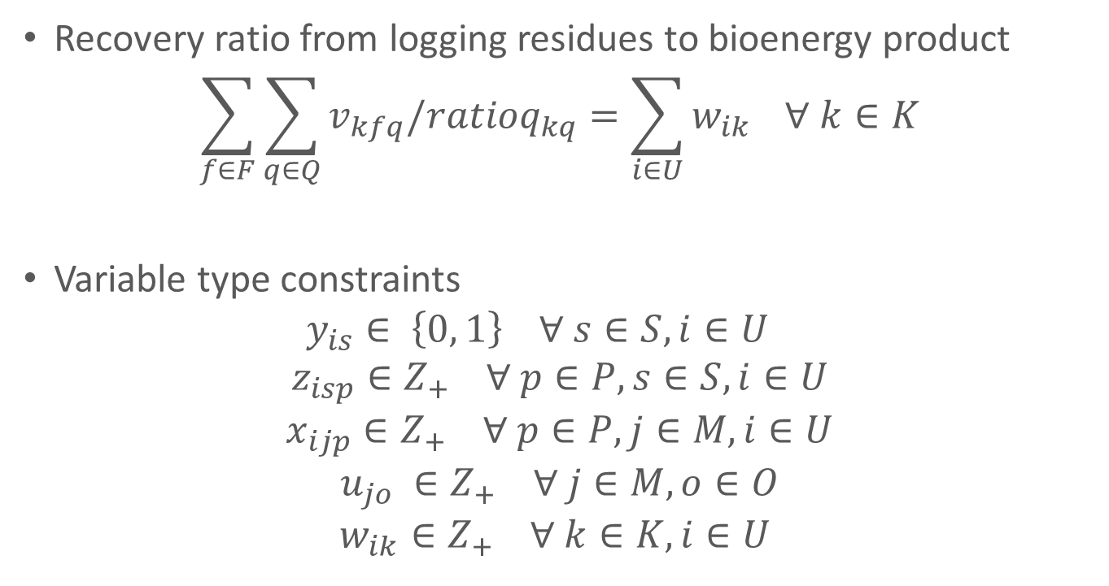
Constraints
Recovery ratio from logging residues to bioenergy product
$$\sum_{f∈F}{\sum_{q∈Q}{v_{kfq}/{ratioq}_{kq}}}=\sum_{i∈U}{w_{ik}} ∀ k∈K$$
Variable type constraints
$$y_{is}∈ \left\{0, 1\right\} ∀ s∈S, i∈U$$
$$z_{isp}∈Z_{+} ∀ p∈P, s∈S, i∈U$$
$$x_{ijp}∈Z_{+} ∀ p∈P, j∈M, i∈U$$
$$u_{jo} ∈Z_{+} ∀ j∈M, o∈O$$
$$w_{ik}∈Z_{+} ∀ k∈K, i∈U$$

Slide 38
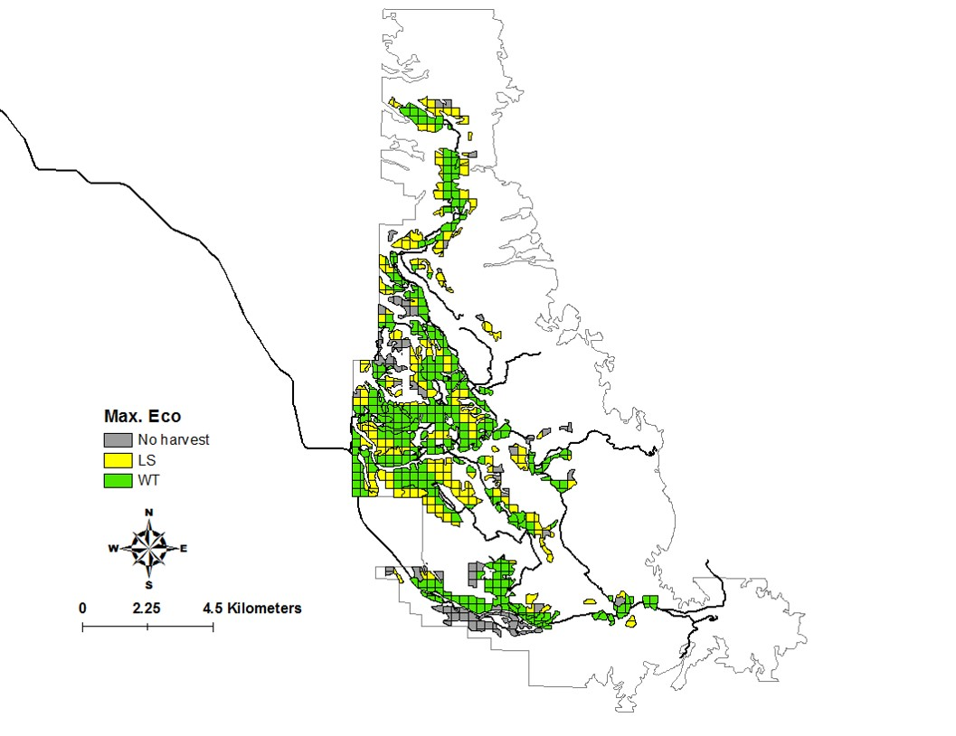
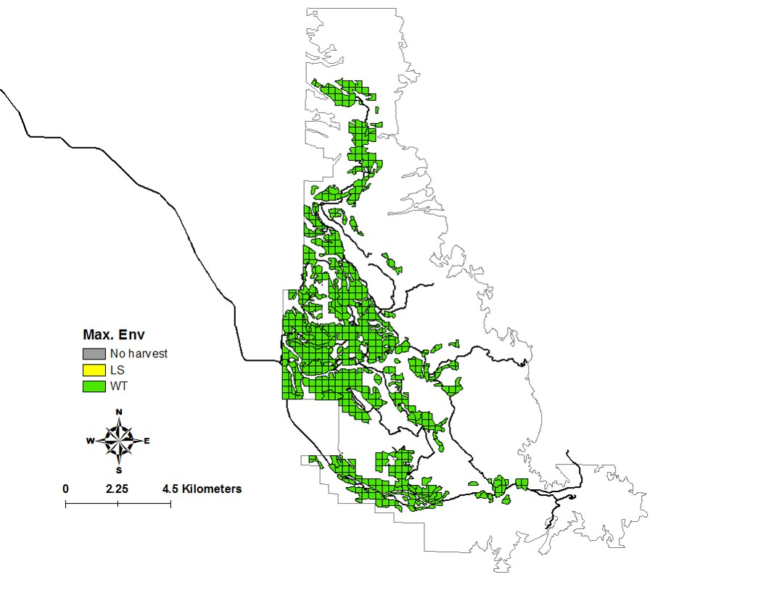
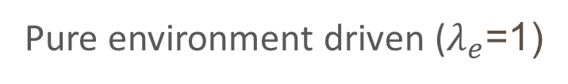
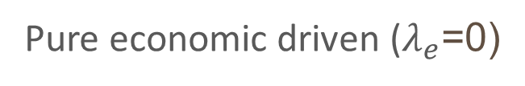
Results
Pure economic driven ($λ_{e}$=0)
Pure environment driven ($λ_{e}$=1)
Net revenue: $4.42 million VS $3.19 million
Carbon reduction:166 kton CO₂-eq VS 211 kton CO₂-eq

Slide 39

Harvest Decisions in Different Scenarios

Slide 40
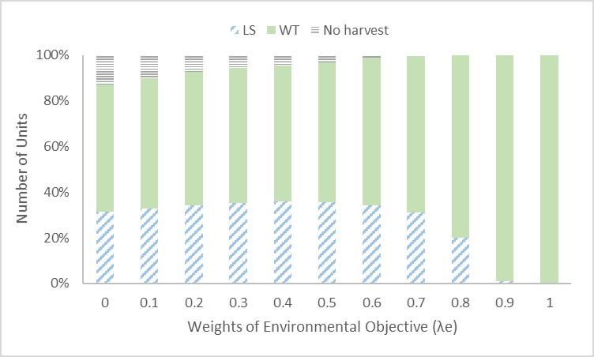
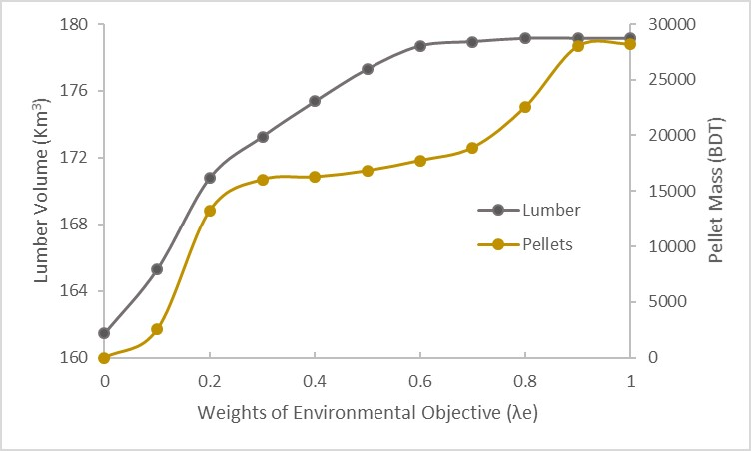
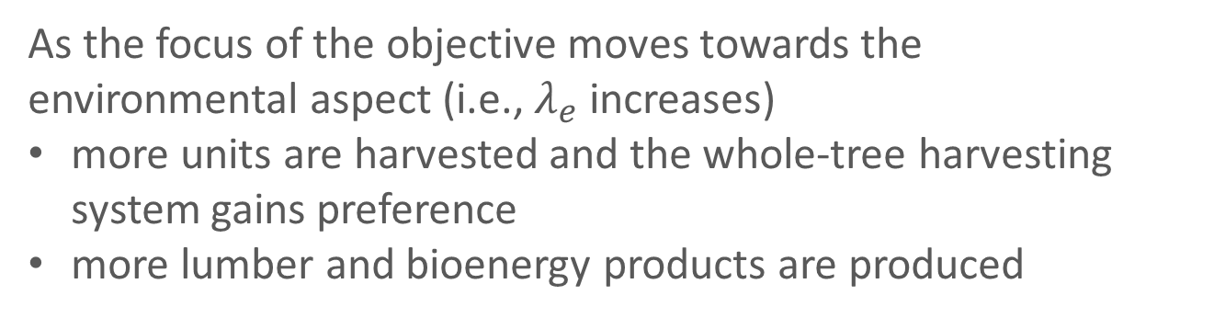
Harvest and Production
As the focus of the objective moves towards the environmental aspect (i.e., $λ_{e}$ increases)
more units are harvested and the whole-tree harvesting system gains preference
more lumber and bioenergy products are produced

Slide 41
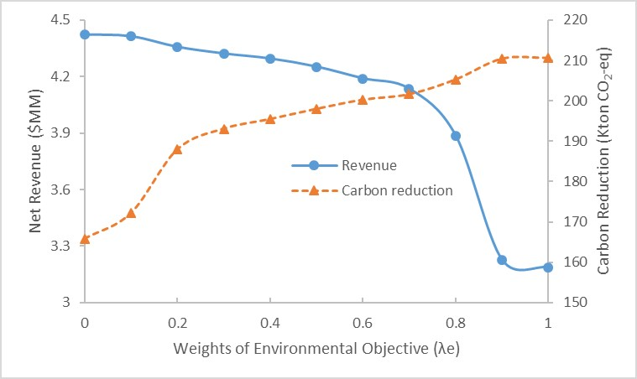
Changing Objectives
27.8 percent reduction in net revenues
27.1 percent increase in amount of carbon reduction

Slide 42

Pareto Curve

Slide 43

Trade-offs between Objectives
When the objective switches from being fully “economic” to fully “environmental”, the marginal loss in economic objective trades for the marginal gain in environmental objective
Changes in marginal rate are inconstant across the range of objective weights
When $λ_{e}$ is between 0 and 0.2, the environmental objective improves quickly, whereas the economic objective declines moderately.
Carbon reduction more than 200 kton CO₂-eq requires a large reduction in net revenue

Slide 44
Application – Carbon Credit
To constrain excessive carbon emissions and to create economic incentives for business involved in renewable energy and carbon reduction, the concept of carbon tax/credit has been introduced and discussed (Metcalf, 2009).
In Colorado, the carbon credit program is suggested to initiate with the range of $5-25/ton CO₂-eq.

Slide 45

Modifications on Model
Objective function
$Maximize z=f_{r}+f_{e}∗carbon price$
Examining range
$0-40/ton CO₂-eq
Step increment
$2/ton CO₂-eq

Slide 46

Results – Carbon Credit

Slide 47
Results – Carbon Credits
Significant positive effect on carbon reduction in the range of $0-8/ton CO₂-eq
Minimal negative impact on net revenue from timber and biomass production.
Further improvement on carbon reduction beyond this range becomes marginal, but at the large expense of net revenue.

Slide 48
Acknowledgement
This research was supported by the Agriculture and Food Research Initiative Competitive Grant no. 2013-68005-21298 from the USDA National Institute of Food and Agriculture.

Slide 49

Thank you!

