Slide 1
Sustainability Impact Assessment of Bioenergy Generation from Logging Residues in Canada
Dr. Marian Marinescu, Sr. Researcher,
FPInnovations, Vancouver, BC, Canada
IEA Bioenergy Workshop, Vancouver, BC – September 22, 2016

Slide 2
Overview
Introduction
Methodology
Case Study
Data Input
Results
Conclusions

Slide 3
Introduction
Forest sustainability evolution:
  Sustained yield → Sustainable Forest Management
Forest management → multi-criteria in nature → sustainability indicators:
  Revenue/profit, employment, riparian management area, wildlife habitat, soil disturbance, recreation potential, green house gas emissions, etc.
Sustainability indicators → inputs in sustainability assessment models:
  Trade-off analyses to support various policies at national, state/provincial, and local levels
  Sustainable forest management → impacts on downstream processes (sawmilling, value-added, pulp and paper, bio-products, energy)
  Company certification, carbon foot print reduction, positive public image, carbon offsets, or just meeting legislated sustainability constraints.
Objectives: to assess sustainability impacts of generating electricity from forest biomass residuals in and, in one study, to also compare them with a similar case in Finland

Slide 4
Methodology
Tool for Sustainability Impact Assessment (ToSIA) → developed by the European Forest Institute (EFI), Joensuu, Finland → dynamic calculation of material flows and the associated environmental, economic, and social indicator values along Forest Wood Chains (FWC), from the forest to the end-of-life of products
Scale of analysis: local → (inter-) continental
Target users: scientists, consultants, policy makers, forestry practitioners
Tool package contains:
  Database with an interface for designing FWC topologies and chain related data entry.
  Multi-criteria analysis (MCA) module
  Cost-benefit analysis (CBA) module
Validated in numerous cases → tosia.efi.int
  Technological innovation in forest value chains in Germany
  Consumption growth in the pulp and paper industry in Portugal and Spain
  Attaining the 2020 emissions target by using forest-based biomass in Finland
  Reorganizing the sawmilling industry in Norway
  Increasing protected forest areas on the EU forest products trade

Slide 5
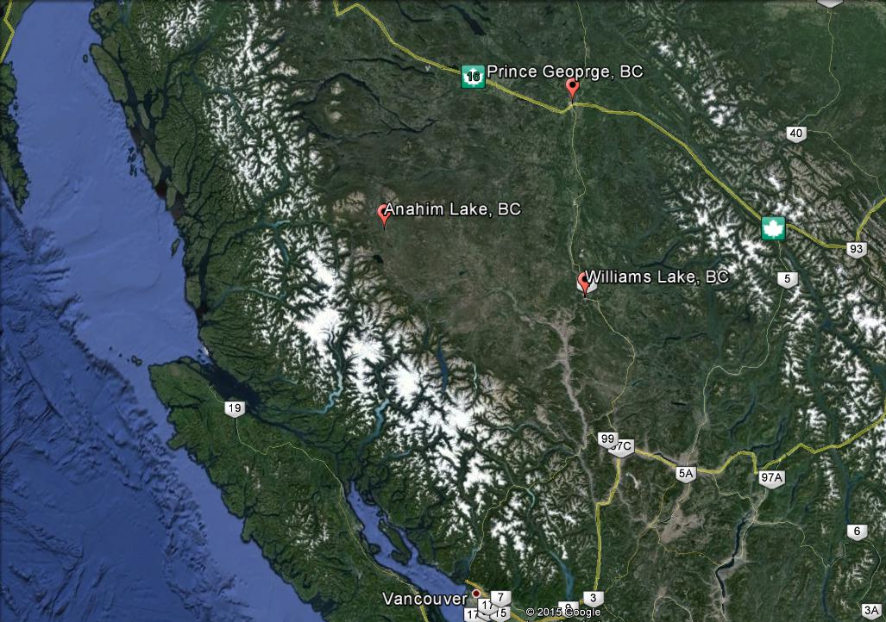
Case Study
240 km
300 km
1,000 Ulkatcho FN inhabitants
Off-grid community
2 MW diesel generators @ sawmill
3 MW diesel generators @ community
150,000 ODt logging residues/annually
550 km

Slide 6
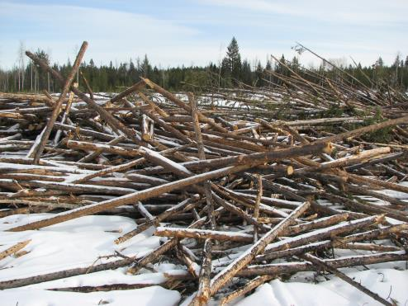
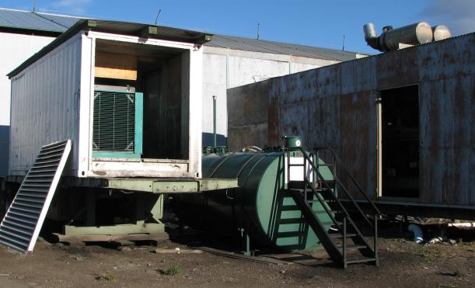
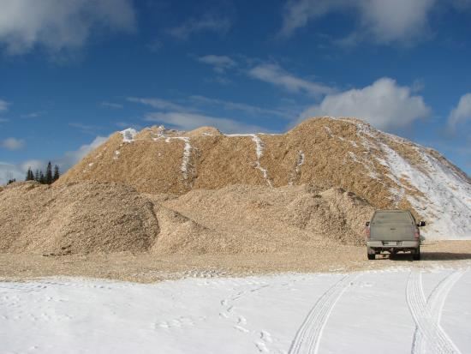
Case Study
Logging and sawmilling activities → jobs and income
FPInnovations studies:
  75,000 ODt /year logging residues @ 50$/ODt
  40,000 ODt wood chips at cost (when sawmill running)
5 MW biomass power plant would require approx. 45,000 ODt/year biomass
Due to location, social and economic realities (unemployment, high energy cost) and availability of biomass, Anahim Lake is a prime location for locating a biomass power plant
FPInnovations studies → feasible
But how sustainable it is?

Slide 7
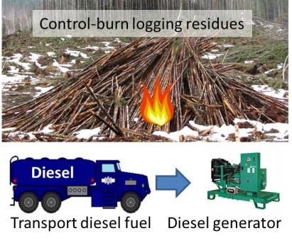


Case Study
Three scenarios were developed:
Assumptions:
No harvesting costs were transferred to logging residues.
No operational costs inside the biomass or diesel generation plants were included.
Scenario 1 – Base Case (current situation)
Scenario 2 – Canadian Biomass Supply Chain
Scenario 3 – Nordic Biomass Supply Chain

Slide 8
Data Input
Biomass/diesel fuel inputs and emission factors
Cost of biomass pre-processing equipment
Transportation costs of biomass and diesel
Costs of slash burning activities

Slide 9
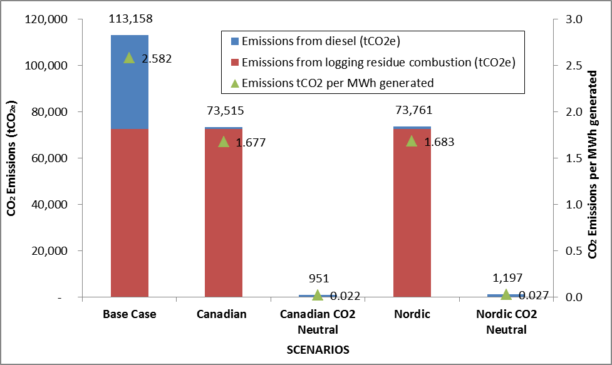
Results
GHG Emissions

Slide 10
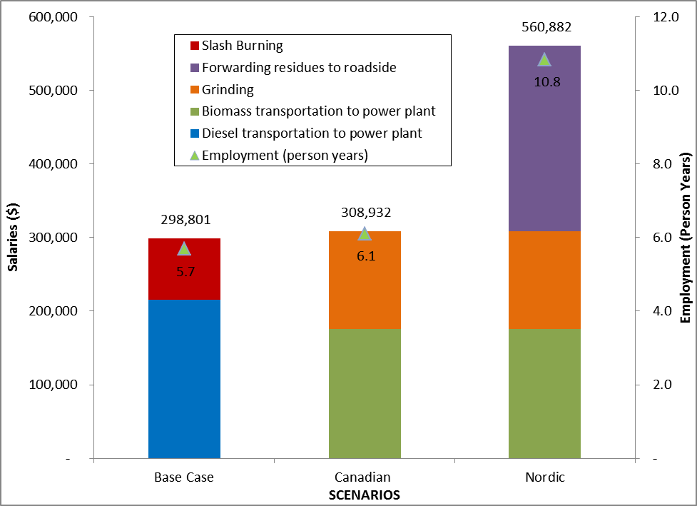
Results
Salaries and Employment

Slide 11
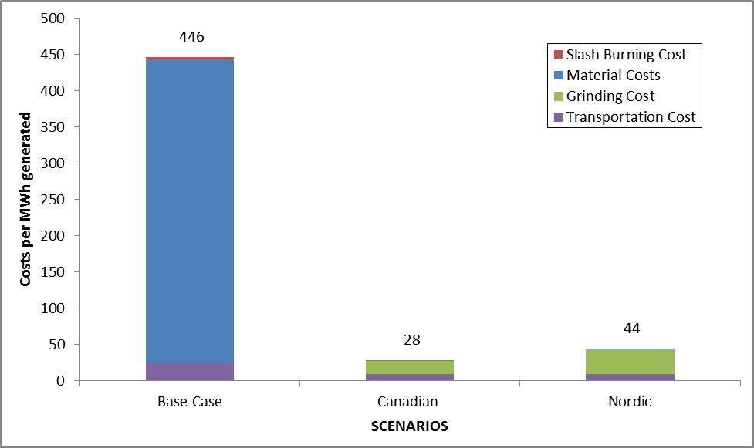
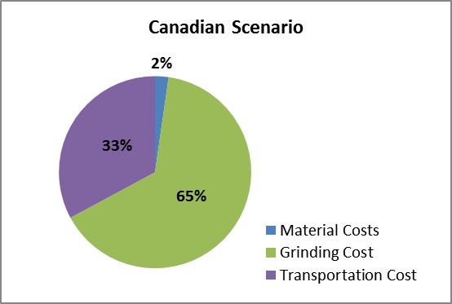
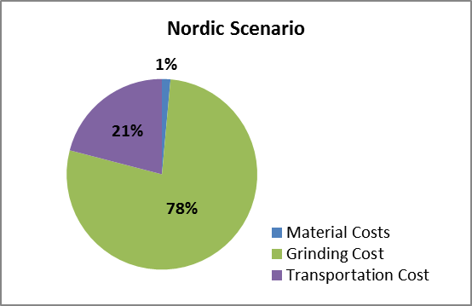
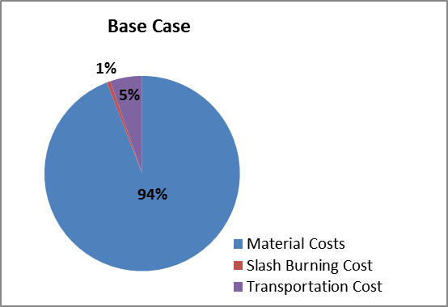
Results
Costs

Slide 12
Conclusions
Two FPInnovations technical and economic studies have contended that, in addition to significant economic benefits, a fossil fuel replacement project that utilized logging and sawmilling residues to generate heat and/or electricity in Anahim Lake would have other beneficial sustainability impacts to the community.
The results and the sustainability impact analysis proved without doubt that major benefits would be achieved by each sustainability indicator, environmental, social, and economic, by the Canadian and Nordic scenarios.
Future research may be required to include additional sustainability indicators that could bring more conclusiveness to this study. For example, differentiating further between the Canadian and Nordic scenarios may require the addition of soil impact indicators.
Other two sustainability impact studies using ToSIA:
  Mechanized firewood operation using logging residues in a FN community in BC
  Utilizing forest biomass residuals to replace fossil fuels in a cement plant in Quebec

Slide 13
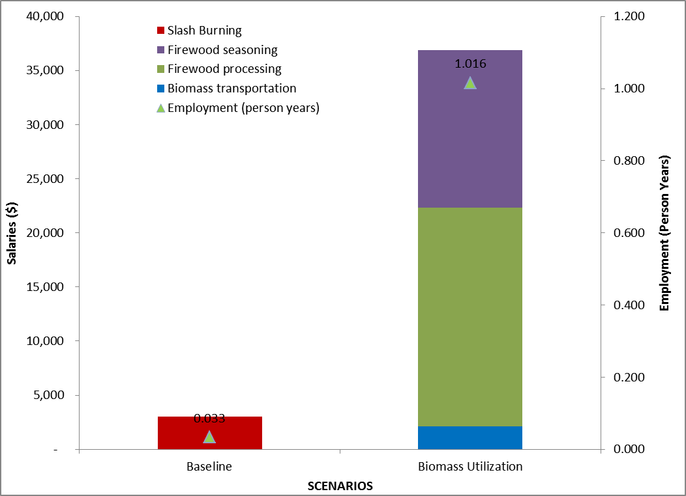
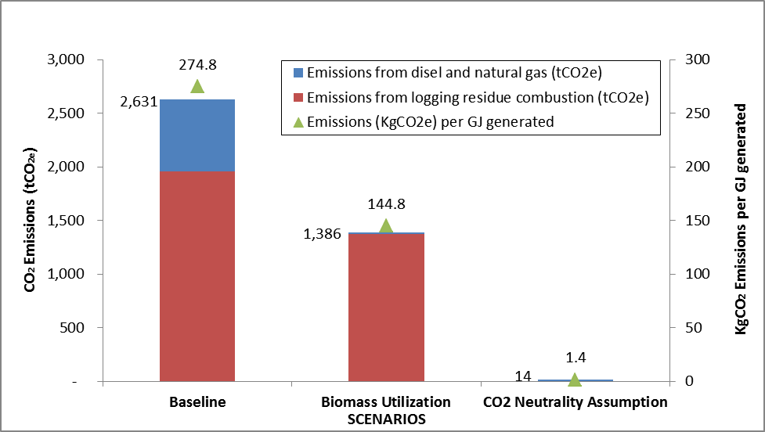
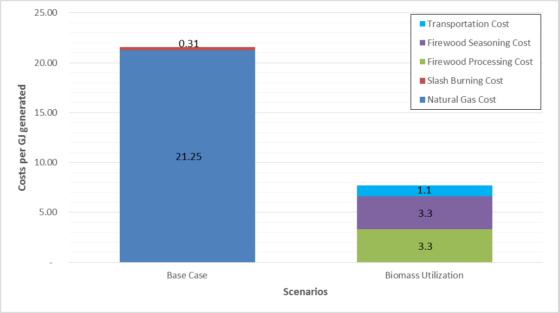
Cheakamus Community Forest Mechanized Firewood Operation

Slide 14
For more information contact:
Marian Marinescu, Sr. Researcher
FPInnovations Canada, 2665 East Mall, Vancouver BC V6T 1Z4, 604 222 5609, marian.marinescu@fpinnovations.ca

