Slide 1
A northern biorefinery in Canada
Chibougamau, Quebec
Alexandre Moreau^{1,2}
Pierre-Olivier Lemire¹
Clément Villemont¹
Benoit Delcroix^{1,2}
¹University of Québec at Trois-Rivières
²International summer school on renewable energy 2016

Slide 2
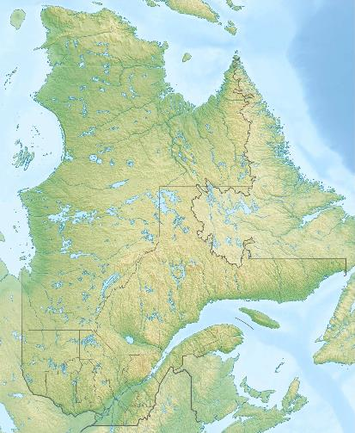
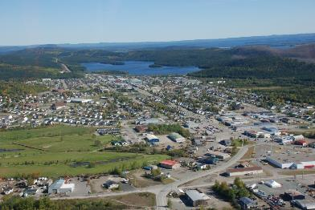

Where is Chibougamau?
Population: 7555 (2014)
Coordinates:
49° 53’ 21.58’’ N
74° 20’ 15.42’’ W

Slide 3
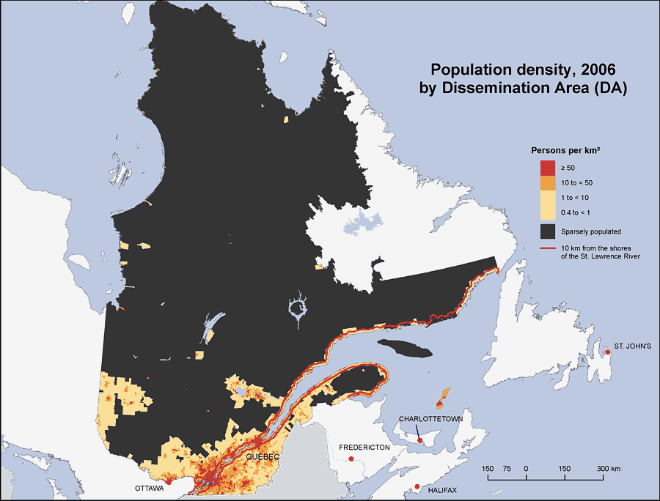
Where is Chibougamau?
Source.: Statistics Canada

Slide 4
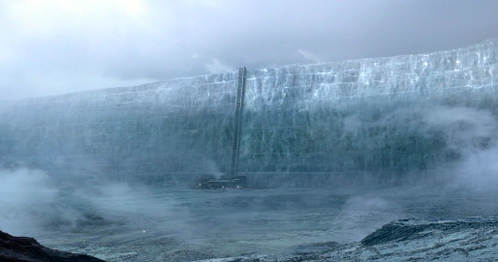

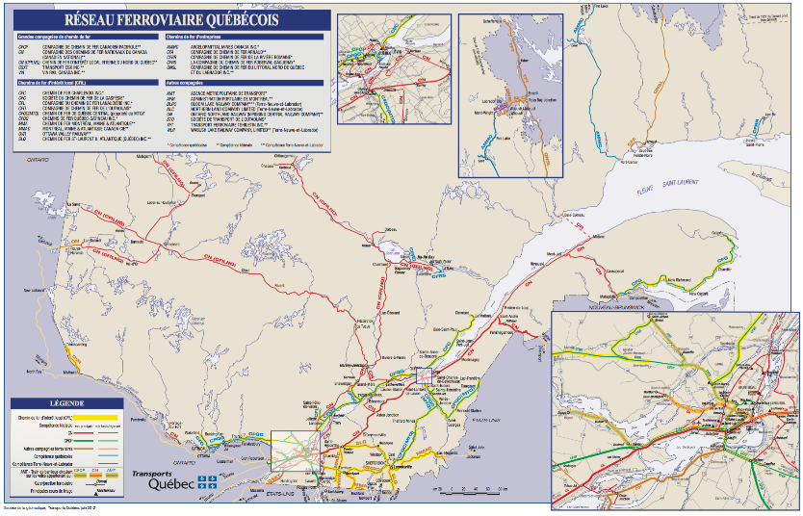
Specificity of Chibougamau
Bio-diesel is coming

Slide 5
Specificity of Chibougamau
Situated in northern region
Point of services:
  “Village-relais”
  Point of distribution of goods and services for northern communities
Accessible by train, airplane and roads
Forest and mining industries as principal economic activities
Bioenergy production is already on site in city only.

Slide 6
What are the needs?
Sorry, too far from the electric grid…
  $$$ to connect new projects in remote area
  Diesel generator used instead
  Cost of energy can be multiplied by 10
Energy cost is a major obstacle to economic development for northern and remote communities
Affaires autochtones et Développement du Nord Canada et Ressources naturelles Canada, État de la situation des collectivités éloignées/hors réseau au Canada, 2011.

Slide 7
Here we come!
In this project:
Definition of the market
Inventory of the available biomass
Technological choices for biomass energy conversion
Potential production and benefits

Slide 8
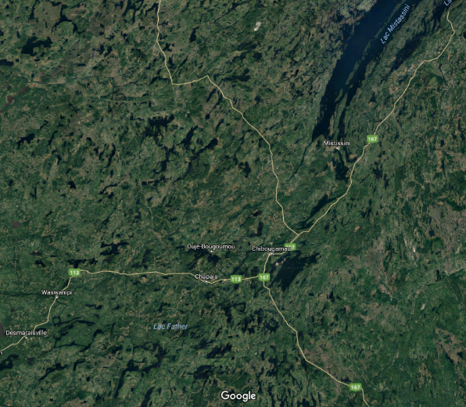
Hot Spots
200 km
Public forest sources
Wood process plan
Opportunity:
145 000 metric tons per year of unused, residual wood from public forest only
100 km
Source.: Ministère des ressources naturelles du Québec (2012)

Slide 9
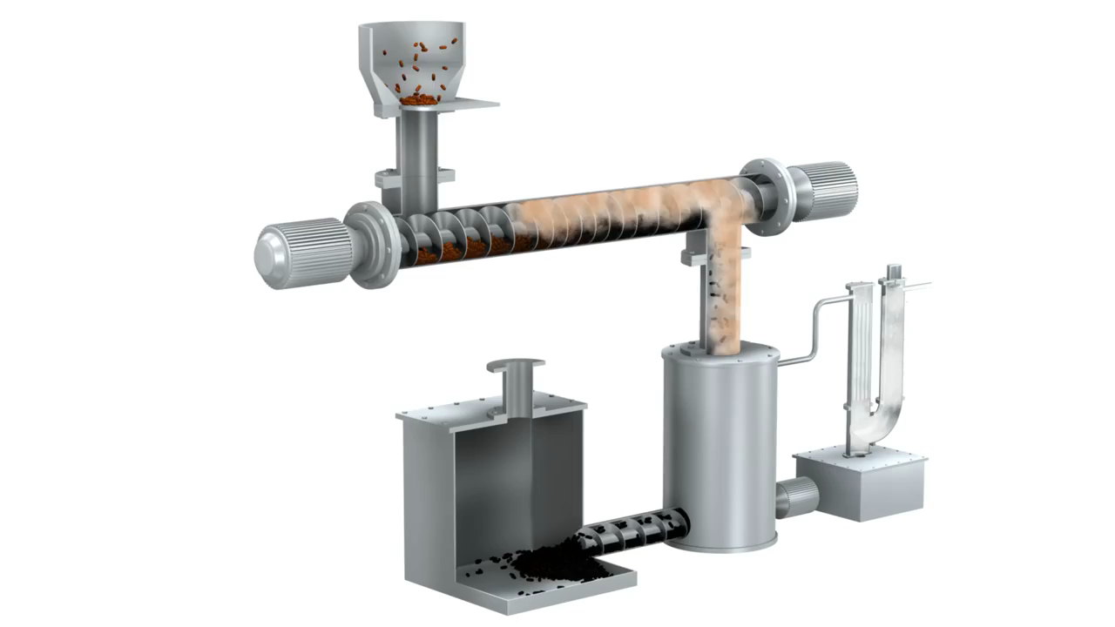
The tech: Catalytic Pyrolysis

Slide 10
Forest residues collection
145 000 t/ye (400 t/day)
Project Diagram
Sources
Loss factor: 20 %
Transport 320 t/d
Loss factor: 5 %
Loss factor: 5 %
Storage
Residues
Grinding / Drying (Kinetic Disintigration System - Micronex)
Wood powder
Catalytic pyrolysis (Fraunhofer – Thermo-Catalytic Reformer)
12 T/h
9 T/h
2.5 T/h
Wood powder
19800 T
Biochar (15 %)
10700 T
Bio-oil
(55 %)
39200 T
Syngas (30 %)
21380 T
Regional biorefinery
Mining site capping; reduction of humidity of other local residues for pyrolysis; additive for forest roads
Activated char for treatment of mining wastewater or air
Renewable biofuel or green diesel
Combined Heat & Power (CHP)
LOCAL applications

Slide 11
Equipment cost
Grinder and Dryer
  Capacity needed: 12 tons/hour
  Purchase cost: 1 500 000 $
  Operation cost: 10 $/ton
  Cost model: Micronex - Kinetic Disintigration System
Thermo-Catalytic Reformer
  Capacity needed: 9 tons/hour
  Purchase cost: 45 000 000 $
  Operation cost: 8 000 000 $/year
  Cost model: Fraunhofer – Thermo-Catalytic Reformer

Slide 12

Product cost and values
unused, residual wood from public forest:
  Quantity available: 145 000 t/ye (400 t/day)
  Purchase cost: 50 $/ton
  transport cost: ~10 $/ton
Products:
  Wood powder 250 $/ton
  Biochar 200 $/ton
  Bio-Oil at 0.50 $/l 590 $/ton
  Syngas 233 $/ton
    electricity + heat 0.075 $/kWh

Slide 13
Project economic value
Biomass input capacity: 145 000 tons/year
Capital expenditure (CAPEX): 100 000 000 $
Operational expenditure (OPEX): 17 570 400 $/year
Revenues: 35 000 000 $/year

Slide 14
Socio-economic impacts
Community scale biorefinery with products usable locally
May attract new businesses or spin-offs in the area to manufacture or to use the products
Gives a role to first nations in biorefining activities
Creates bound between the forest and the mining industries
Fits perfectly with the Plan Nord of Quebec government!

