Slide 1


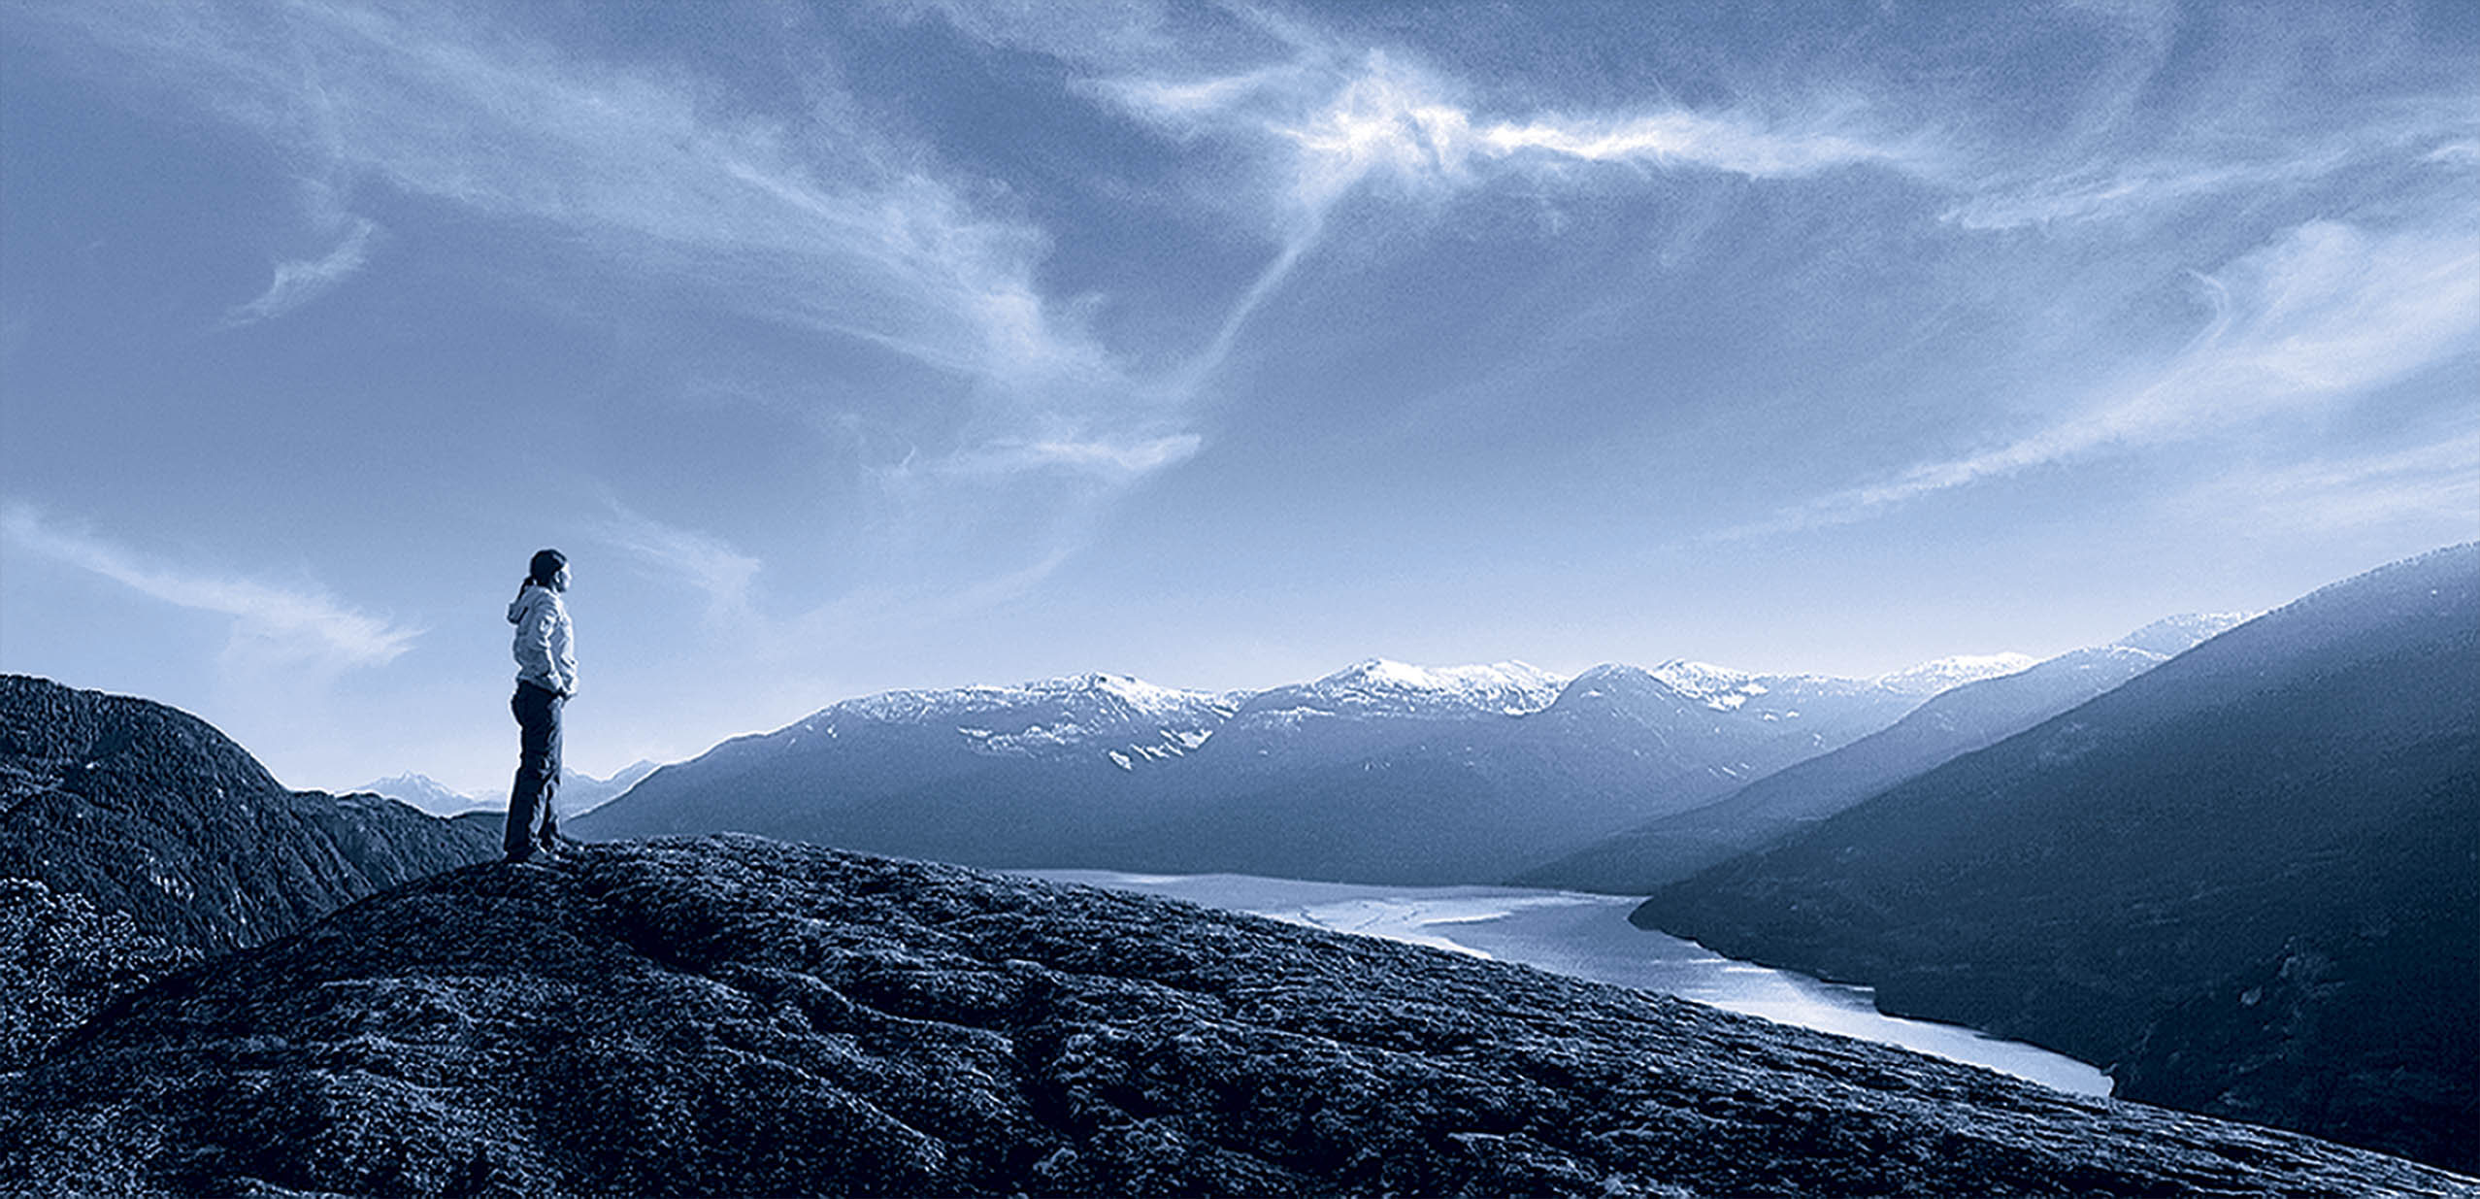
Logistics of supplying wood pellets to the coal-fired power plants in Alberta
Dr. Mahmood Ebadian, Ryan Jacobson, Dr. Fahimeh Yazdanpanah, Dr. Shahab Sokhansanj
Biomass and Bioenergy Research Group
Chemical and Biological Engineering Department, UBC
Mobilisation of Forest Biomass to Produce Bioenergy, Biofuels and Bioproducts: Challenges and Opportunities
September 22, 2016
Vancouver, BC

Slide 2
Decarbonization of the electricity generation in Alberta
G of Alberta
Reduce the carbon intensity of the power fleet
Minimize the social and economic costs of the Climate Leadership Plan
Coal Power Fleet
Avoid unnecessarily stranding capital
Local communities
Stabilize the job market in the small towns that have economies based around coal mines and their associated power plants
Maintain the reliability of the electricity grid and the stability of prices for consumers
Forest Sector
Maximize the value extracted from wood fibre
Create jobs in local communities
Create new income streams and stay competitive in demotic and international markets
Diversity market/product
Stay competitive in the electricity market
Find less carbon intensive disposal solutions for their logging residues
Notes:
- Once I finish talking about this, mention how cofiring can be a viobale options
- Mention about the cofiring scenario has synergies with government and forest industry mission to maximize the value extracted from wood fibre: other avenues
- Provincial legislation is favorable toward removing and utilizing sustainable quantities of forest biomass for bioenergy and biofuels
- Transportation infrastructure to the power plant includes rail (both commercial and industrial), service roads, and access to highways. Biomass and pellets could be delivered to Wabamun by rail (to Wabamun CN station) and truck. Rail infrastructure to Wabamun exists both north-south and east-west. Also, good highway and road infrastructure exists to Wabamun from all directions. As a result, minimal investments would be required to modify the existing transportation infrastructure to support the delivery of large biomass quantities.
Cofiring is a viable alternative for GHG emissions reduction
Lower levels of technical and commercial risks. The case studies and country reports show that through the years, a great experience has been gained with biomass cofiring in various types of power plants and with various types of biomass fuels. These projects show that the technical risk areas have been managed successfully and that the plant availability and efficiency levels after conversion have been acceptable.
Cofirig could be used to extend the life of the plants for a short period of time without needing to install significant capitals
Proven biomass technologies reduce risks. Utilities are risk adverse and prefer technologies which have been proven already at the commercial scale.

Slide 3
Facts about cofiring
A viable alternative for GHG emissions reduction
Lower levels of technical and commercial risks compared to other methods to decarbonize power generation
234 coal-fired power plants have been retrofitted globally to co-fire with biomass on a commercial basis, with a majority cofiring at rates below 15% (IEA, 2009)
Different types of biomass (e.g. white wood pellet, black wood pellet, wood chips, agricultural residues, dedicated energy/biomass crops and dried sewage sludge)

Slide 4
Factors impacting the cofiring fraction
Biomass supply security and price stability
Type of biomass
Existing logistics infrastructure to handle biomass
Capital and operating costs to modify the existing on-site equipment
Regulatory compliance
Supporting policies and finical incentives
On-site characteristics of the power plant (e.g. milling capability)
Degree of tolerance for modifications (derate of the power plant)
Notes:
normally involves lower levels of technical and commercial risk, principally because significant use is being made of the existing infrastructure, operating permits and skilled staff.
Site-specific factors
The site-specific factors, i.e. the types of coal mill, the arrangement of the installed coal firing systems, etc., and

Slide 5
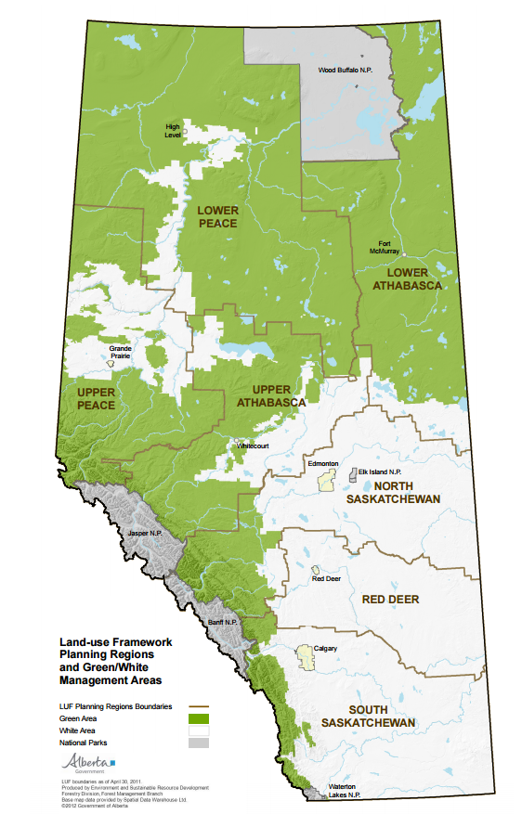
Forestlands in Alberta
In Alberta, forest lands cover about 35 million hectares (Green Area).
Out of which, 13 million hectares (37.47%) are available for timber harvest.
Average AAC and annual timber harvest are 28.31 million m³ and 22.54 million m³ in the period of 2003-2013, respectively.
Notes:
Alberta ranks fourth in Canada for volume and area of forest harvested in 2009 (19.8 million m3 ; 71,249 hectares) (Natural Resources Canada 2011b). Bradley (2010) estimates that Alberta has about one-quarter of the amount of roadside residues in British Columbia.
Alberta’s forest industry generates approximately $2.2 billion in revenue and contributes approximately 15,000 jobs to the Alberta economy Source: Alberta Forest Products Association. March 7th, 2012.
The AFPA notes that the industry employs 15,000 people directly in 70 communities in the province, while 30,000 additional jobs are dependent on industry activities.

Slide 6
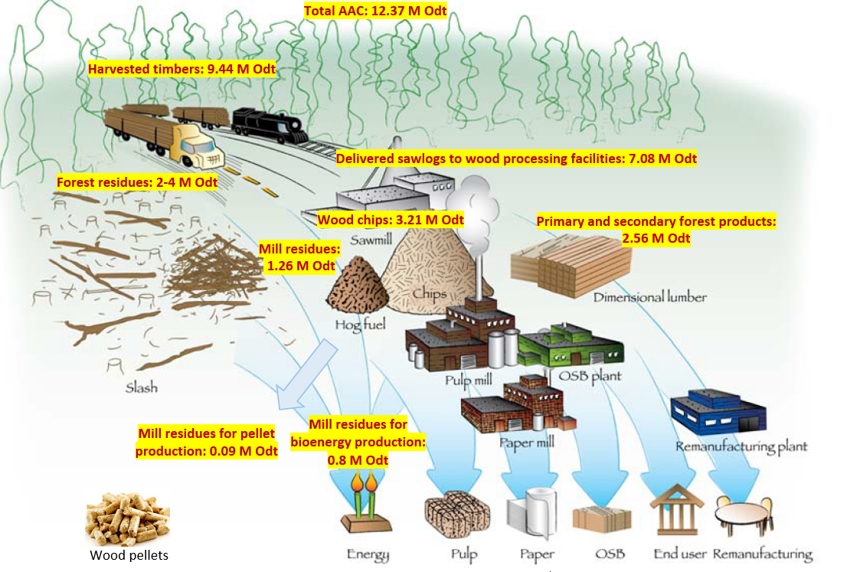
Flow of wood fibre in Alberta
Unharvested standing timbers: 2.93 M odt
Logging residues:
2-4 M odt
Source: Government of Alberta, 2014; FPInnovations, 2010; JACOBS Consultancy, 2013.
Notes:
Mention: maximum the value of fibre by diversifying the market/products
When I bring the biomass flow map first mentioned several sectors have been working together and there is still romm available to maximizie the value extacted from wood fibre without creating any competition in the whole ecosystem. Emntion an ecosystem has ebeen created from several conomies.

Slide 7
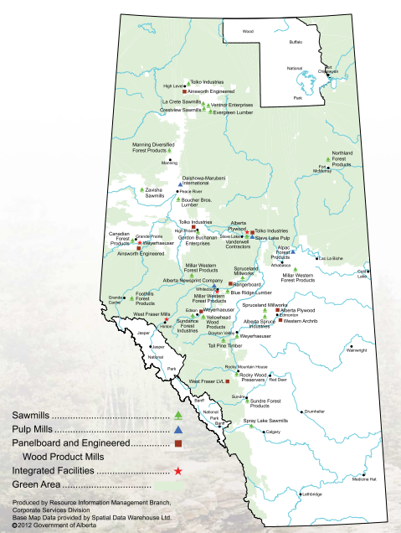
Forest Industry in Alberta
7 pulp mills (4 kraft pulp mills, 2 Bleached Chemi-Thermomechanical Pulp (BCTMP) and one newsprint mill)
24 sawmills
6 panelboard mills
one laminated veneer lumber facility
one veneer sawmill
one fiberboard mill
Source: Government of Alberta, 2014; FPInnovations, 2010; JACOBS Consultancy, 2013.
Notes:
Alberta ranks fourth in Canada for volume and area of forest harvested in 2009 (19.8 million m3 ; 71,249 hectares) (Natural Resources Canada 2011b). Bradley (2010) estimates that Alberta has about one-quarter of the amount of roadside residues in British Columbia.
Alberta’s forest industry generates approximately $2.2 billion in revenue and contributes approximately 15,000 jobs to the Alberta economy Source: Alberta Forest Products Association. March 7th, 2012.
The AFPA notes that the industry employs 15,000 people directly in 70 communities in the province, while 30,000 additional jobs are dependent on industry activities.

Slide 8
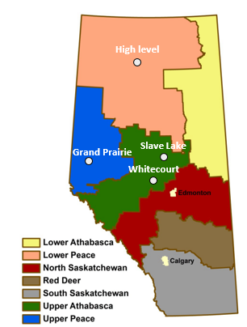
Availability of wood fibre in Alberta
2.26
2.13
1.65
0.93
0.64
0.27
0.003
Total availability of underutilized sources of woody biomass including standing timbers and forest residues is estimated to be 7.88 M Odt.
Source: Government of Alberta, 2010, 2014; FPInnovations, 2010; JACOBS Consultancy, 2013.

Slide 9
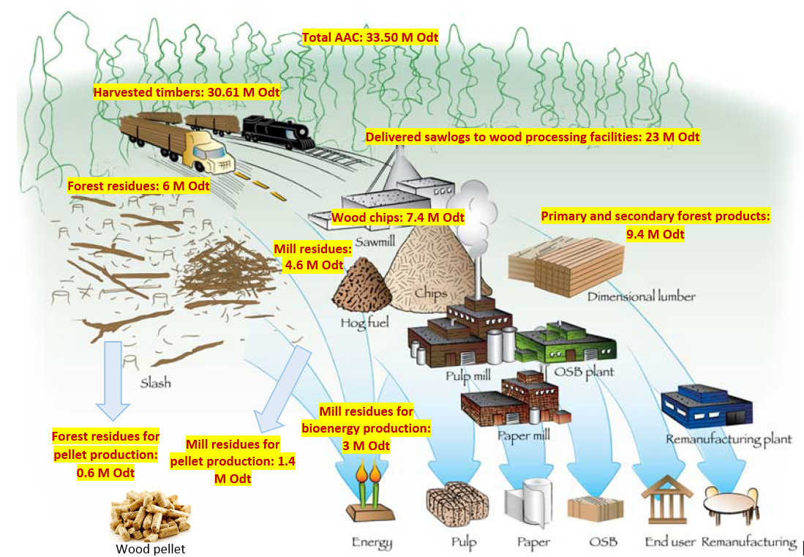
Flow of wood fibre within the BC forest industry
Unharvested standing timbers: 2.9 M odt
Logging residues:
5.4 M odt
Source: Roach and Berch, 2014; Industrial Forestry Service Ltd. et al., 2013; AEBIOM et al., 2013; FPInnovations, 2010; Bradburn, 2014; PricewaterhouseCoopers, 2007
Notes:
These timbers are not utilized by forest companies for different reasons. Some of these timbers are located in long distances from the marketplace. In addition, some of the unharvested timbers are the tree species that have low quality for lumber manufacturing such as Hemlock and Balsam in the BC Coast. Other reasons are steep terrains, expensive harvesting operation and the current market price of forest products that make a portion of the standing timbers commercially unattractive to harvest.

Slide 10
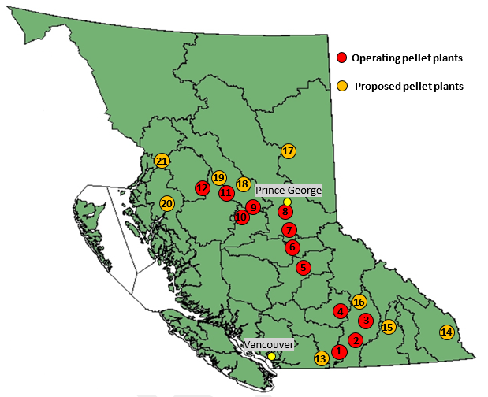
Wood pellet plants in BC
There are currently 12 pellet plants in BC with the annual production capacity of 2.2 million tons.
The annual production level of wood pellets in BC is over 1.7 million tonnes.
Primary feedstocks for pellet production are mill residues (1,185,500 Odt) and low-grade logs (435,750 Odt).
Prince Rupert
Source: Canadian Biomass Magazine, 2015.
Notes:
Collect some information about the history of pellet industry in Canada and BC
About 95% of the produced wood pellets in BC is currently exported to the EU, USA, and Asia and 5% is consumed in the domestic market.

Slide 11
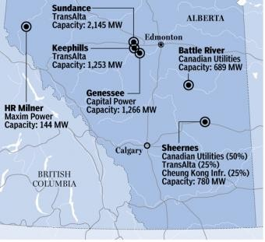
Alberta’s Coal-fired Power Fleet
Station Unit | Capacity (MW) | Year Completed (Age)
Battle River 3 4 5 | 150 150 389 | 1969 (46) 1975 (40) 1981 (34)
Genesee 1 2 3 | 410 410 495 | 1989 (26) 1994 (21) 2005 (10)
HR Milner 1 | 158 | 1972 (43)
Keephills 1 2 3 | 396 396 495 | 1983 (32) 1983 (32) 2011 (4)
Sheerness 1 2 | 390 390 | 1986 (29) 1990 (25)
Sundance 3 4 5 6 | 408 386 386 386 | 1976 (39) 1977 (38) 1978 (37) 1980 (35)
Alberta’s coal-fired power plants
Source: Environment Canada, 2013; IPPCA, 2015; Barr and Morgan, 2015-National Post
Notes:
What is the total capacity? Their share of electricity?

Slide 12
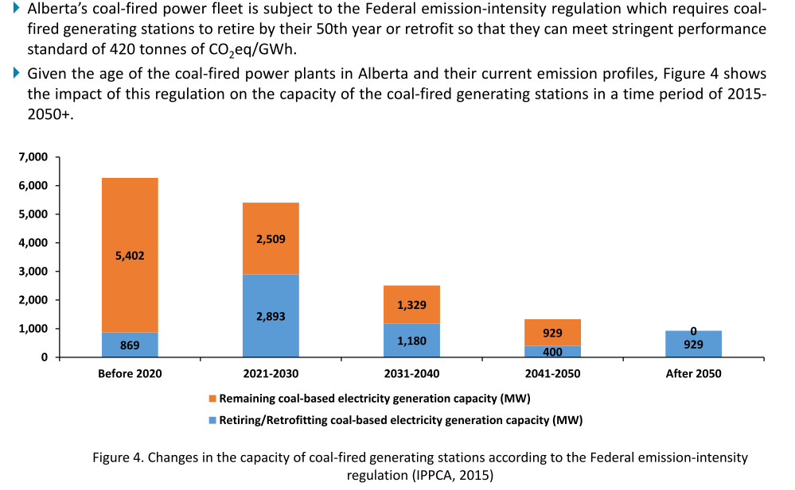
Alberta’s Coal-fired Power Fleet
Alberta’s coal-fired power fleet is subject to the Federal emission-intensity regulation which requires coal-fired generating stations to retire by their 50th year or retrofit so that they can meet stringent performance standard of 420 tonnes of CO₂-eq/GWh.
Changes in the capacity of coal-fired generating stations according to the Federal emission-intensity regulation (IPPCA, 2015)
Notes:
Given the age of the coal-fired power plants in Alberta and their current emission profiles, Figure 4 shows the impact of this regulation on the capacity of the cos-fired generating stations in a time period of 2015-2050+.

Slide 13
Upstream Logistics Network
Front End Loader/Conveyor
Sawmill residues
Road Transportation
Logging residues
Pile
Roadside Chip
Road Transportation
Pellet
Mill
Rail/Road transportation
Power Plant
Non-merchant standing timbers
Logging and Loading
Road transportation
Notes:
Mention about that pellet mill should be close to the biomass source
Mention that some pellet plants are currently using

Slide 14
Potential locations for wood pellet production
High Level
Peace River
Slave Lake
Boyle
Grand Prairie
Edson
1
2
5
3
4
6
Potential locations for wood pellet production
Coal Power Plants in Wabamun area
Map Source: Government of Alberta, 2014.
Notes:
Bring the list of candidates (mention why this locations, close to the existing wood processing facilities), wood fibre and access to rail network)

Slide 15
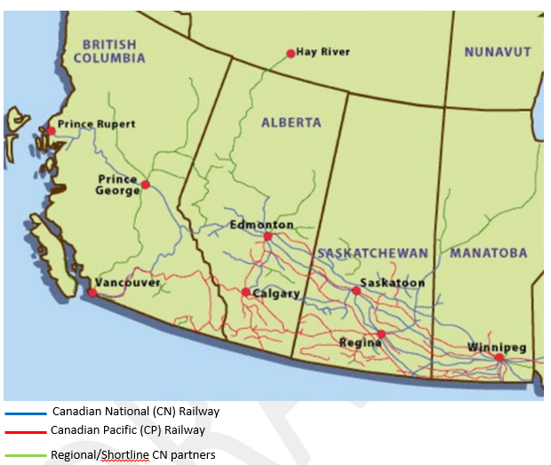
Railway network in Western Canada
Source: Canadian National Railway, 2013
Notes:
Talk about pellet industry
Talk about the just-in-time delivery and the simplicity of the supply chain compared to global supply chains

Slide 16
Rail transportation costs ($/tonne)
Origin | Destination | Transportation Distance (km) | Transportation Cost ($/tonne)
High Level, AB | Wabamun, AB | 879 | 33.89
Peace River, AB | Wabamun, AB | 565 | 23.39
Slave Lake, AB | Wabamun, AB | 325 | 15.37
Boyle, AB | Wabamun, AB | 204 | 11.34
Grande Prairie, AB | Wabamun, AB | 602 | 24.63
Edson, AB | Wabamun, AB | 137 | 9.08
Prince George, BC | Wabamun, AB | 715 | 28.40
Quesnel, BC | Wabamun, AB | 840 | 32.60
William Lake, BC | Wabamun, AB | 956 | 36.47

Slide 17
Delivered costs at the gate of a power plant in Wabamun area
Cost component | Sawmill residues | Logging residues | Non-merchant standing timbers
Feedstock cost at the pellet plant ($/dry tonne) | 30-35 | 60-80 | 75-150+
Pellet price at the pellet mill ($/tonne) | 105-145
Pellet transportation-rail ($/tonne) | 9-36.5
Delivered cost- power plant ($/tonne) | 130-170
Delivered cost-power plant ($/GJ) | 7.07-9.25
Notes:
Logging residues: different road classes

Slide 18
Cofiring scenarios for coal-fired power fleet in Alberta
Technical and Cost Data
Plant Capacity (MW) | 400.0
Heat Rate (GJ/MWh) | 10.0
Capacity Factor (%) | 90.0
Coal heat content (GJ/tonne) | 20
Cost of coal ($/GJ) | 1.3
Base CO₂-eq intensity (tonne/MWh) | 1.0
Wood pellet heat content (GJ/tonne) | 18.0
CO₂-eq reduction/cofiring ratio (%) | 0.9-1.0
Biomass Processing Data
Capital Cost ($/kW) | 500
Fixed O&M Cost (% of capital cost) | 2
Capital Recovery Factor | 0.11
Derate Factor (%) | 3
Operational O&M and transmission ($/MWh) | 20
60% cofiring fraction to reach the GHG emission intensity of a natural gas combined cycle unit.
100% cofiring.

Slide 19
Wood pellet consumption rate- 400 MW Power Plant
NG combined cycle units
Notes:
Check Pembina reseach on the percentage of wood pellet emission???
Roughly speaking, every 1% increase in biomass co-firing reduces the requirement to capture 1% less of the total CO 2 .
Older coal units usually produce about 1.0-1.2 t/MWh. Newer coal units can achieve a much lower 0.89-0.9 t/MWh.
Combined cycle units would achieve a 0.42 t/MWh emission intensity. simple cycle units were set at their historical 0.50-0.55 t/MWh

Slide 20
Employment- Wood Pellet Logistics System
Wood Pellet Plant Configuration
Production Capacity (tonne/yr) | 200,000
Number of employees | 26
Pellet-to-feedstock ratio | 0.8
Feedstock composition | 70% logging residues and 30% standing timber
Supply radius (km) | 100-150
60% Cofiring
Required Wood Pellet (million tonne/year) | 1.03
Number of wood pellet plants | 5
Required feedstock (dry tonnes/year) | 1,287,500
100% Cofiring
Required Wood Pellet (million tonne/year) | 1.72
Number of wood pellet plants | 9
Required feedstock (dry tonnes/year) | 2,150,000
Notes:
100% Residue
4 Person Logging Crews
26 People per Pellet Mill
200,000 tonnes per Pellet Mill
60%- 6 Pellet Mills
80%- 7 Pellet Mills
100%- 9 Pellet Mills

Slide 21
Employment- Wood Pellet Logistics System
Notes:
100% Residue
4 Person Logging Crews
26 People per Pellet Mill
200,000 tonnes per Pellet Mill
60%- 6 Pellet Mills
100%- 9 Pellet Mills

Slide 22
Avoided CO₂ Costs
87.19
70.01
72.87
Notes:
What percentage is fuel cost??

Slide 23
Selling Price of Power ($/MWh)- 60% Cofiring
85.00
86.67
81.68
83.34
76.69
78.35
80.02
73.36
75.03
Notes:
What percentage is fuel cost??

Slide 24
Selling Price of Power ($/MWh)- 100% Cofiring
121.09
123.89
115.48
118.28
109.87
112.67
104.25
107.06
101.45
Notes:
What percentage is fuel cost??

Slide 25
Sensitivity analysis- Capital Cost ($/KW)
Capital Cost ($/KW) | 250 | 500 | 750
60% Cofiring
Avoided CO₂ Cost ($/tonne) | 77.30 | 81.46 | 85.80
Selling Price of Power ($/MWh) | 77.60 | 80.02 | 82.53
100% Cofiring
Avoided CO₂ cost ($/tonne) | 77.30 | 81.46 | 85.80
Selling Price of Power ($/MWh) | 108.59 | 112.67 | 116.92
*Pellet Cost at the gate of the power plant is assumed to be 150 $/tonne in this sensitivity analysis.
Notes:
What percentage is fuel cost??

Slide 26
Carbon Tax ($/MWh)

Slide 27
Summary
 | 60% Cofiring | 100% Cofiring
Potential availability of woody biomass in Alberta (public and private forest lands) | ~10 million dry tonnes
Potential availability of woody biomass in BC | ~8 million dry tonnes
Required biomass to retrofit a 400 MW power facility | 1.29 million dry tonnes | 2.15 million dry tonnes
Potential number of retrofitting coal-fired power plants | 14 | 8
Potential number of pellet plants with a capacity of 200,000 tonnes/year | 70-72
Potential number of employment | 8,500-8,800
Pellet cost at the gate of the power plant ($/GJ) | 7.07-9.25
Avoided CO₂ Cost ($/tonne) | 70-93
Selling price of power ($/MWh) | 73-89 | 101-124
Notes:
The existing produced pellets are not considered.
No carbon tax are considered.

Slide 28
Summary
Every power plant is unique
Securing stable, reliable feedstock is critical
  Fuel costs dominate the expenses of conversion to wood pellets
Logistics management is important
Significant carbon emissions reductions
Actual cost of power production on par with solar and wind
  Can provide baseload electricity

Slide 29
Acknowledgments
Dave Butler, Canadian Clean Power Coalition.
Robert Tarcon, Premium Pellet Ltd.
Toso Bozic, Alberta Agriculture and Forestry.
Dominik Roser & Charles Friesen and Marian Marinescu: FPInnovations.
Brent Boyko and MARSHALL Les Marshall, OPG.
Joerg Goetsch, Daishowa-Marubeni International Ltd.
Gordon Murray, WPAC.
Vaughan Bassett, Pinnacle Renewable Energy Group.
Trevor Reid, Foothills Forest Products Inc.
John Unger, La Crete Sawmills Ltd.
Geoff Clarke, Alberta-Pacific Forest Industries Inc.

Slide 30

Thank You for your attention
Q&A

