Slide 1
Managing the Moisture Content of Wood Biomass for the Optimisation of Ireland's Transport Supply Strategy to Bioenergy Markets and Competing Industries.
Dr Ger Devlin
IEA Task 43 Team Leader
UCD Forestry
University College Dublin
Belfield
Dublin 4
Ireland

Slide 2
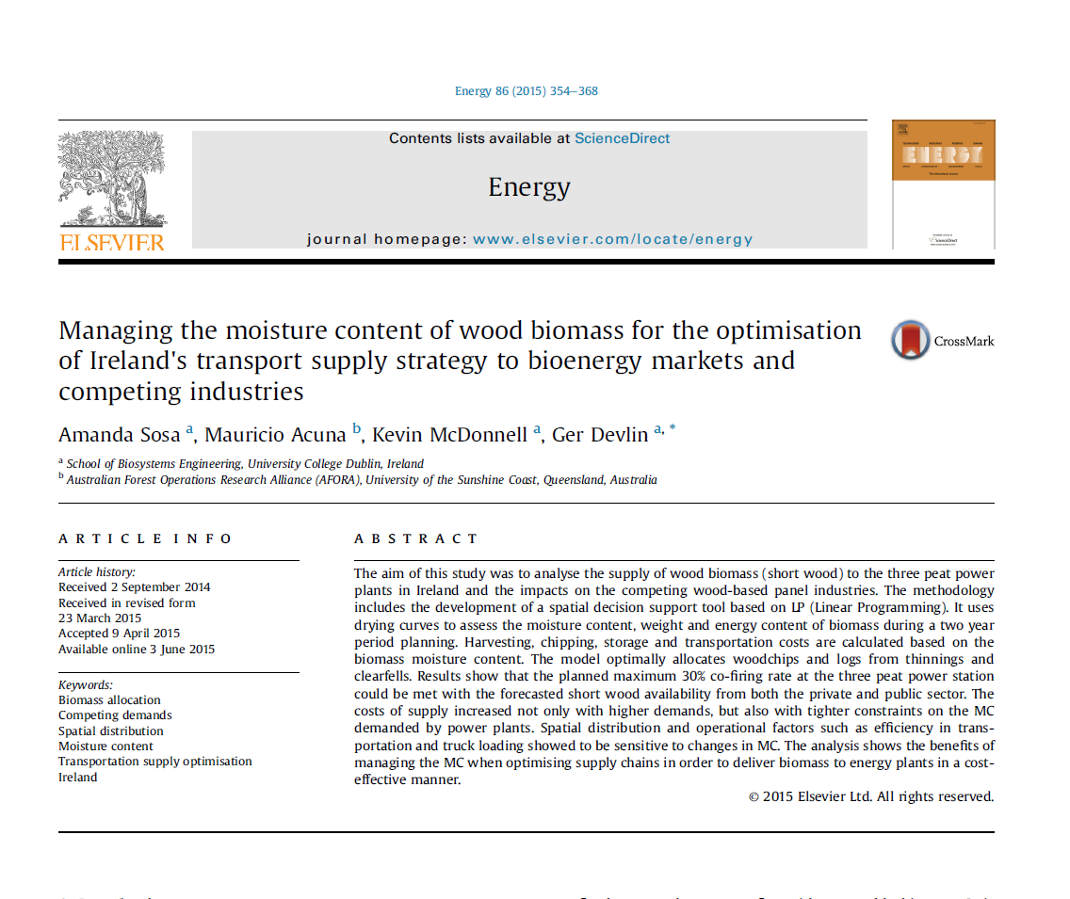

Slide 3


Irish Government Policy
White Paper
Set a target of 30% co-firing in the 3 peat stations by 2015.
NREAP
Generation of 1,006 GWh from bioenergy in 2020, of which 687 GWh from solid biomass

Slide 4
Peat Fired Stations
3 peat fired power stations
  Edenderry Power (2000)
    BNM (128 MWe)
  Lough Ree Power (2004)
    ESB (100 MWe)
  West Offaly Power (2005)
    ESB (150MWe)
Total annual electricity output of 378 MWe.
6% of Ireland’s total primary requirement (TPR)

Slide 5
…
4 M tonnes of milled peat harvested annually from 20,000 ha peatland.
Approx 3.08 M tonnes used in the Power Stations.
2.8 M tonnes of C02 / annum.
4.1% of Ireland’s GHG emissions.
Edenderry now increasing the use of biomass through co-firing.

Slide 6
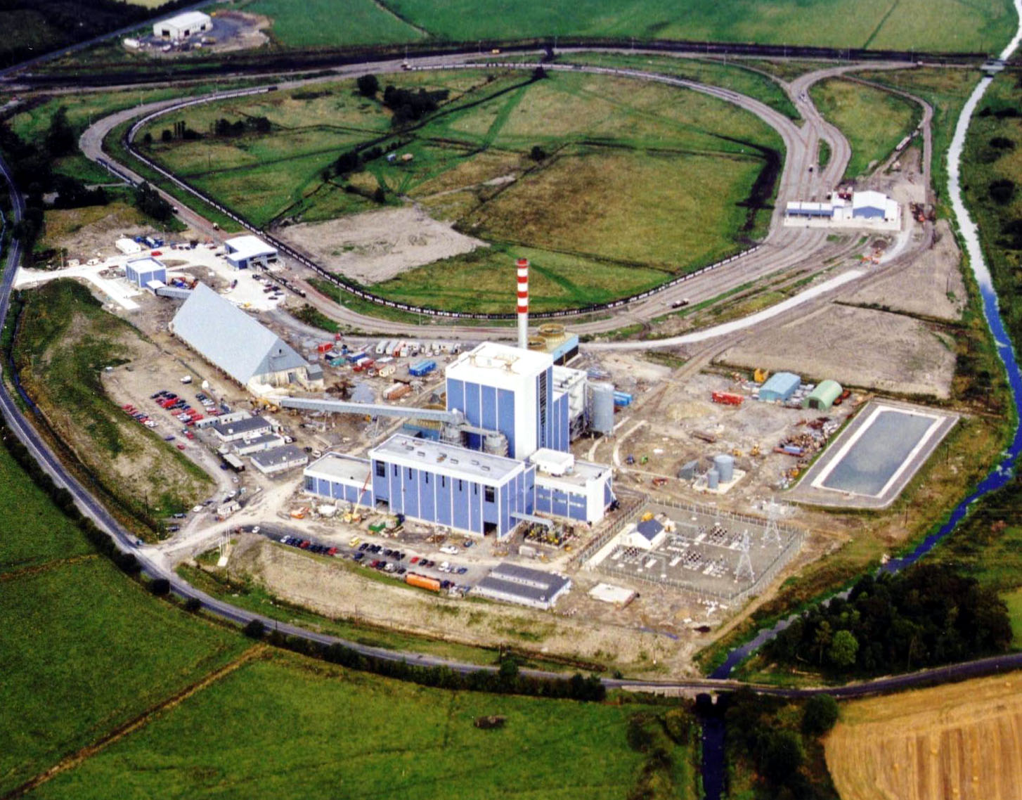
Edenderry Power (128MWe)

Slide 7
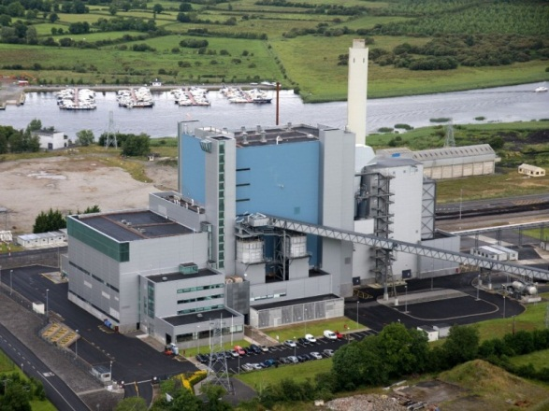
Lough Ree (100MWe)

Slide 8
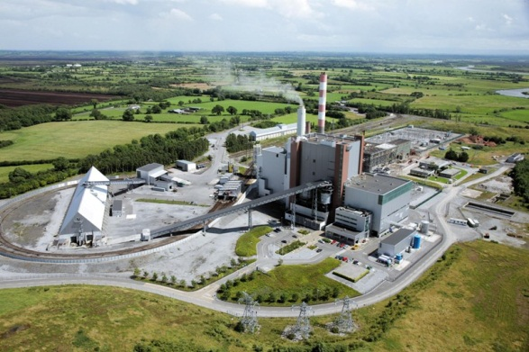
West Offaly (150 MWe)

Slide 9
Edenderry Volumes & Specification
Biomass Required
(kt)
2008 20
2009 72
2010 110
2011 150
2012 180
2013 220
2014 260
2015 300
2020 500
Quality Specification
Moisture 10 – 60%
Wt. Av. m.c. >45%
Ash <5%
Size <40mm
Gross CV >18 GJ/t
Chlorine <0.1%
Ash Deform. >1000 ºC

Slide 10
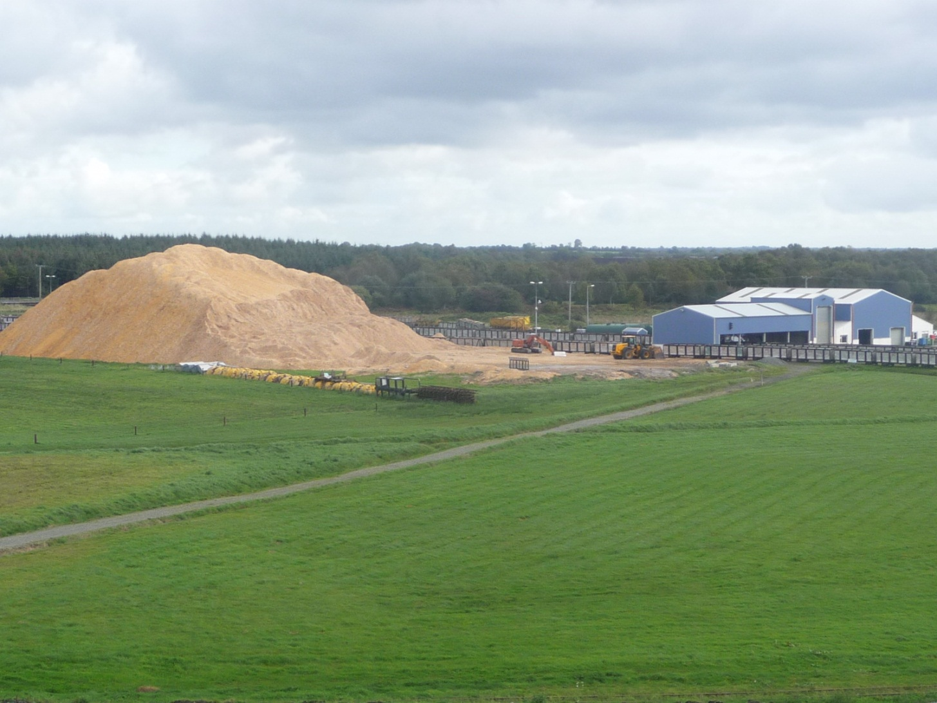
Biomass Stockpile

Slide 11
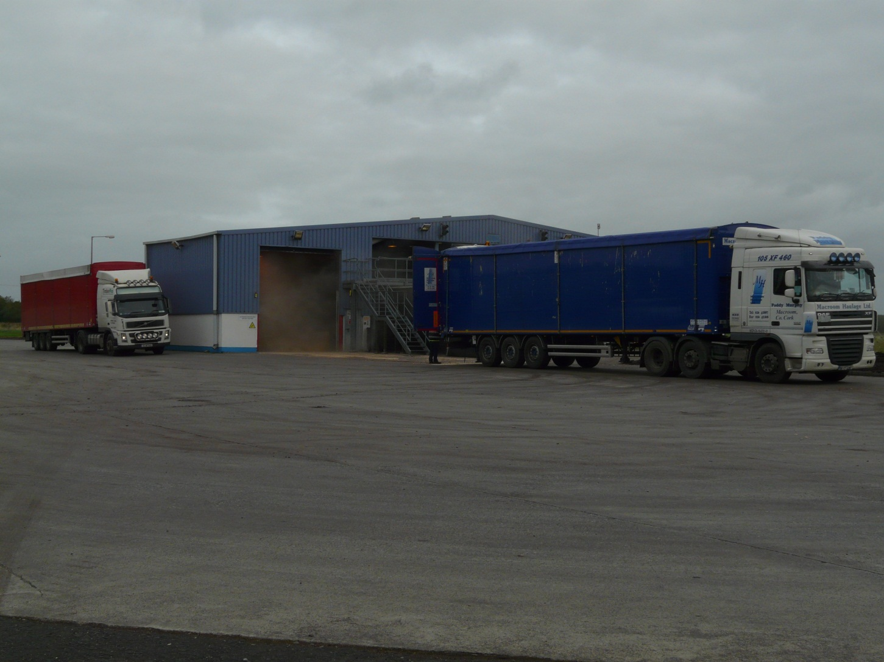
Biomass Unloading Area

Slide 12
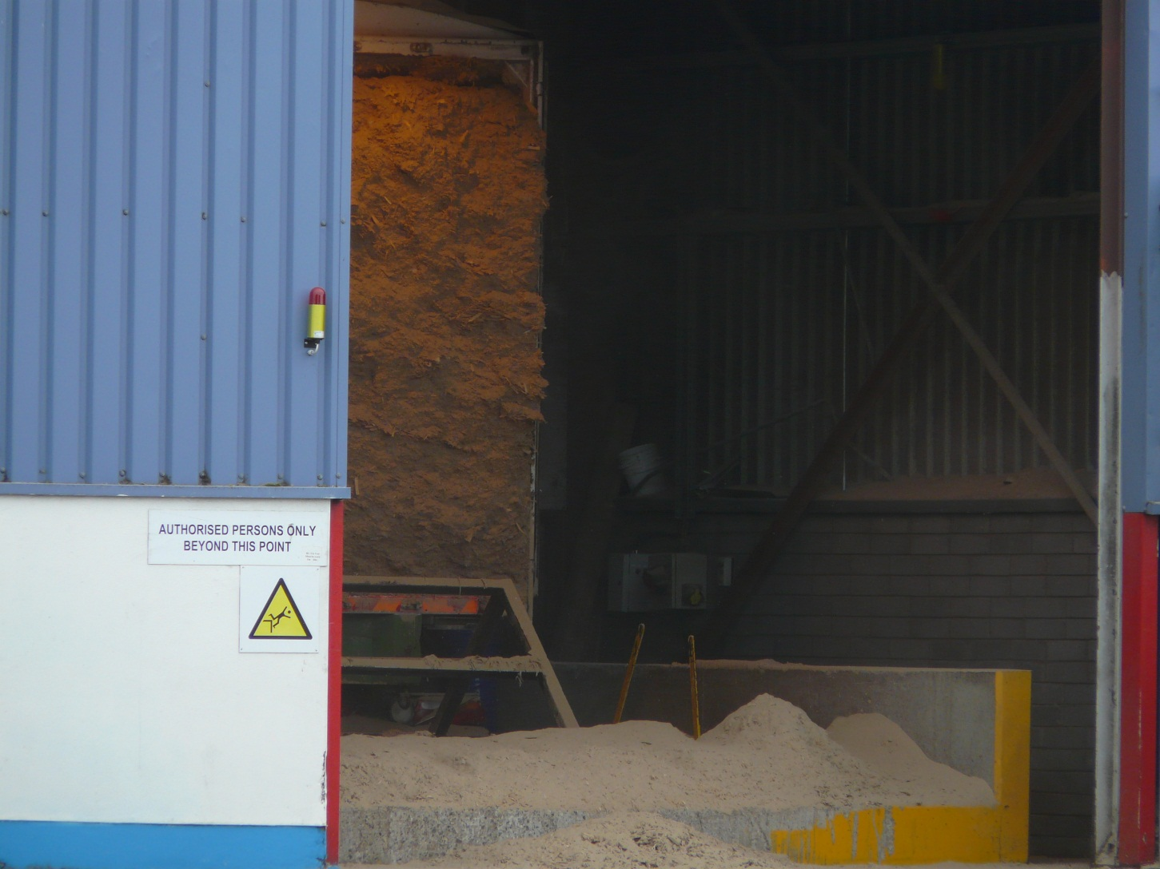
Walking floor trailer

Slide 13
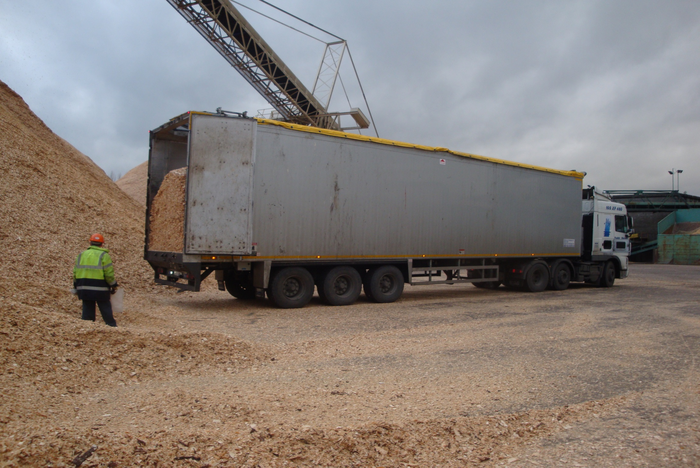

Slide 14
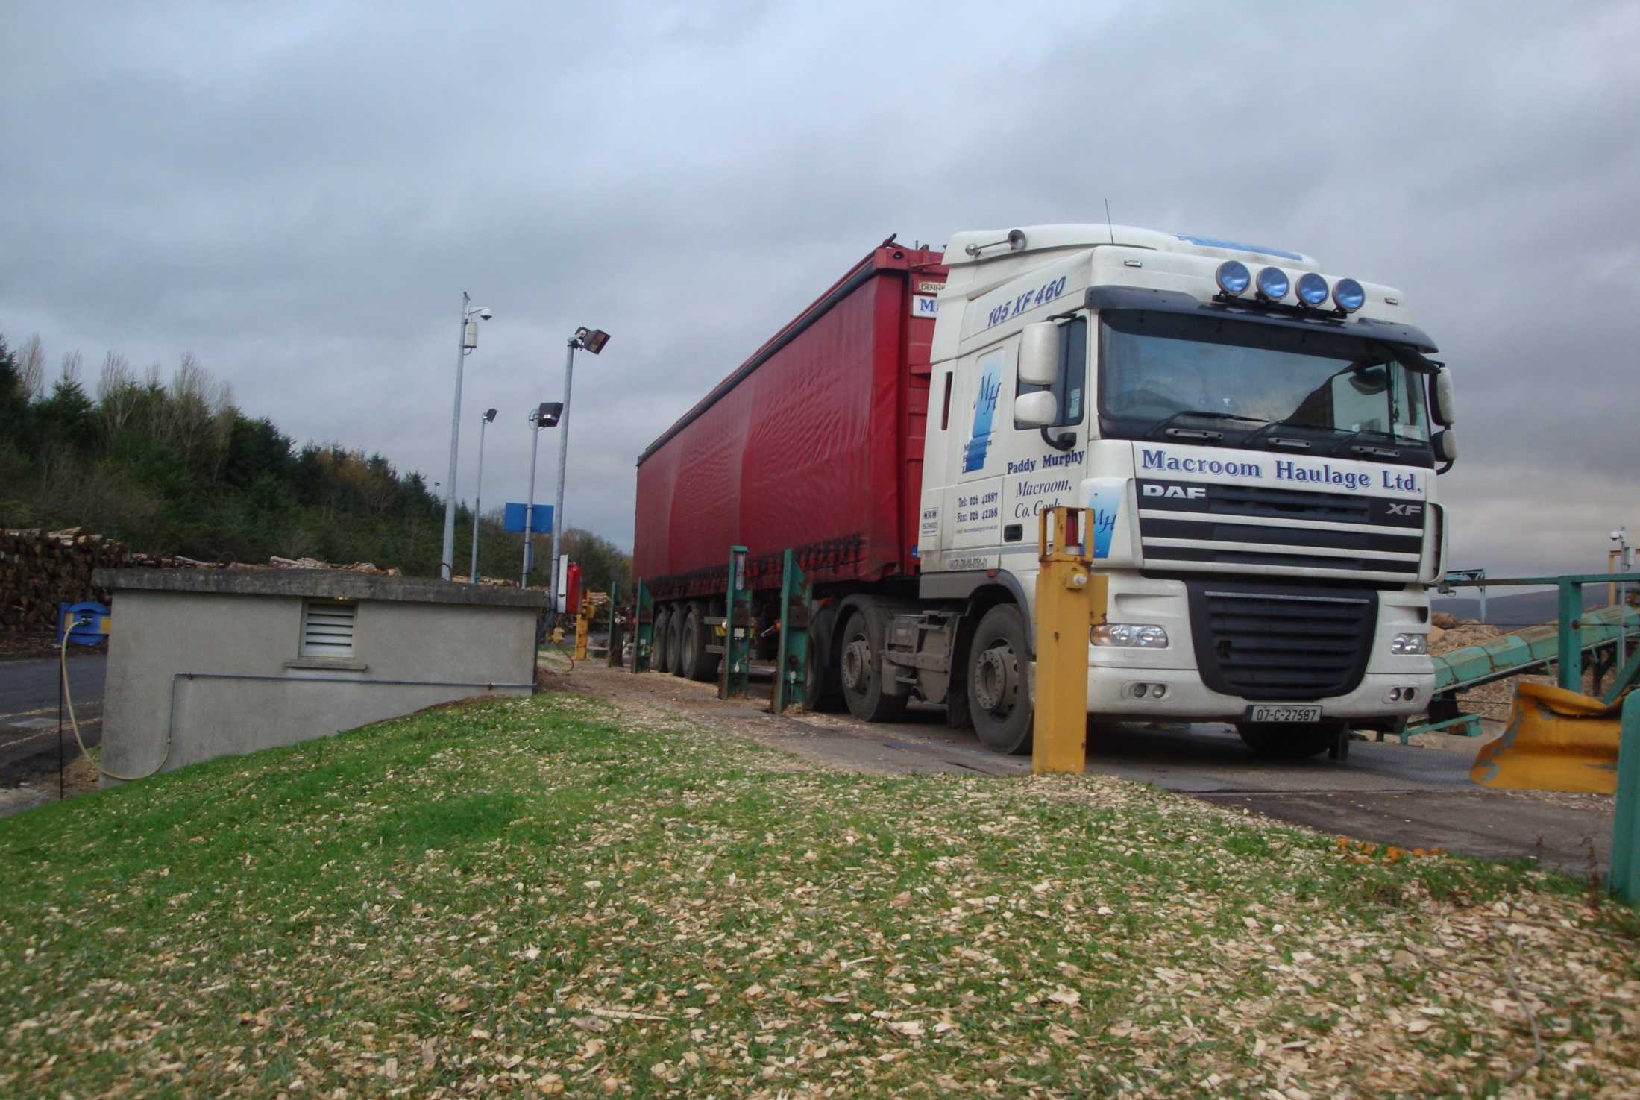

Slide 15
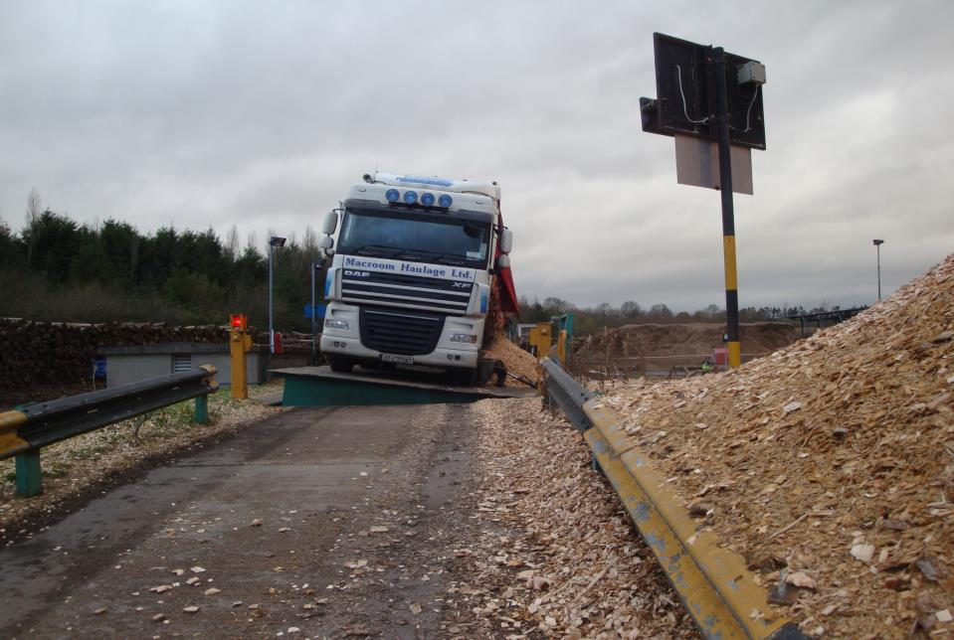

Slide 16
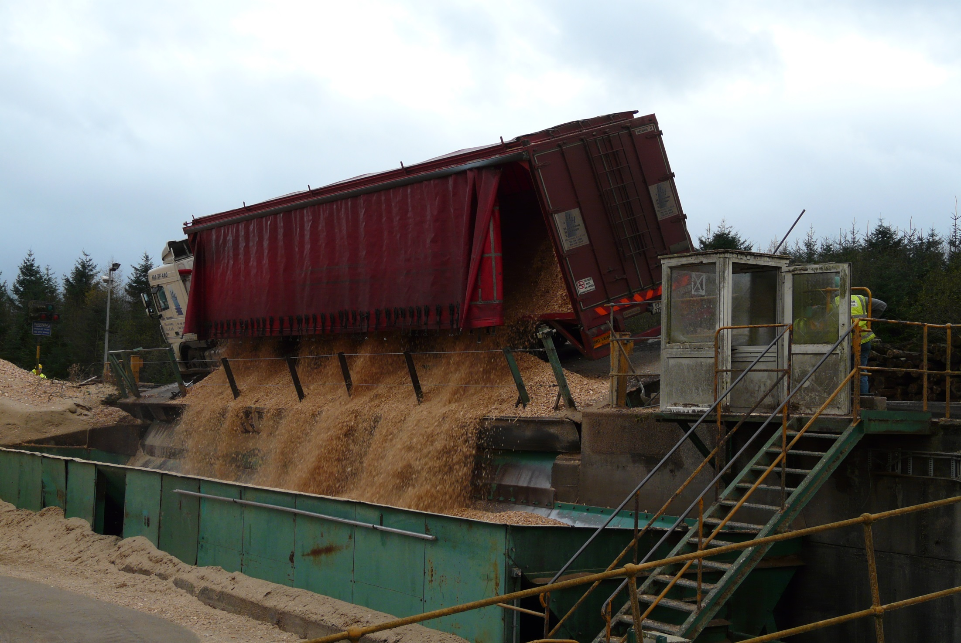

Slide 17
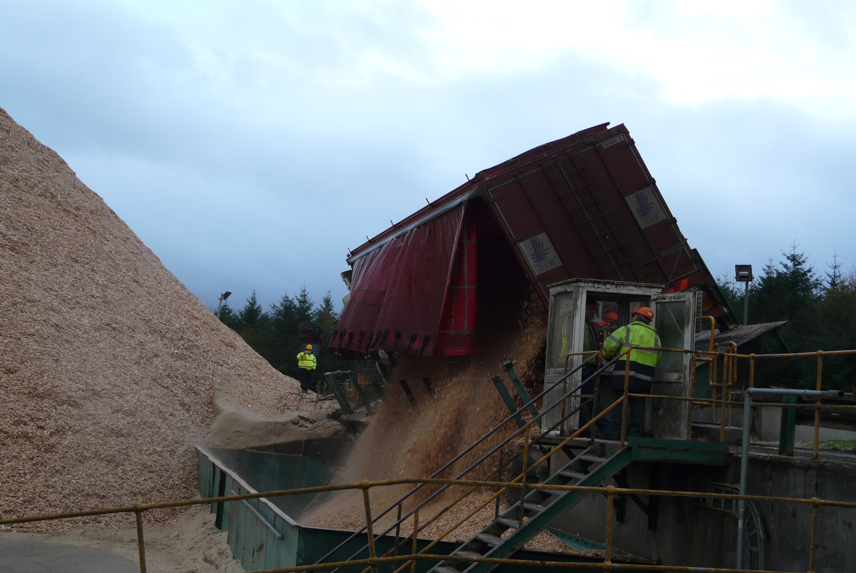

Slide 18
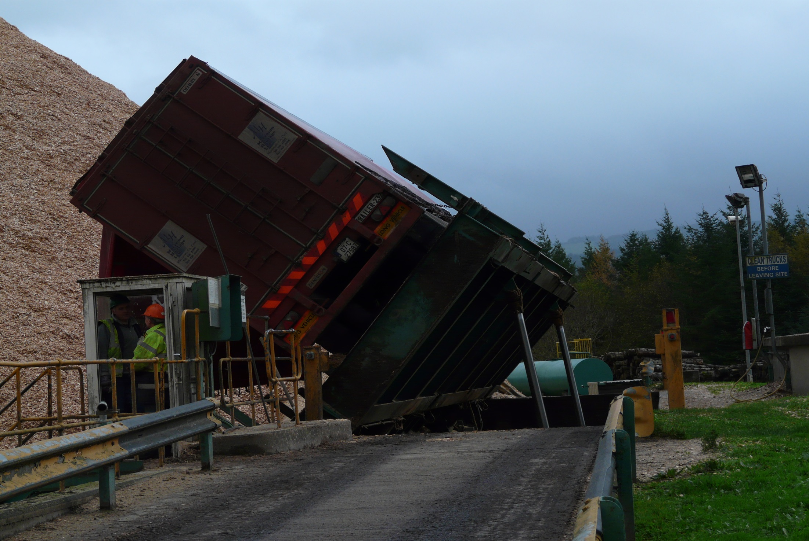

Slide 19
Aims / Highlights
Linear programming model was developed to optimise biomass supply chain in Ireland – BioPLAN II
Drying curves to assess the moisture, weight, energy of biomass over two years.
Harvesting, chipping, storage, transportation costs were examined based on moisture.

Slide 20
…
Supply impacts of competing markets for biomass were analysed with varying moisture.
Model aids decision making on harvest, storage and optimal truck loads for dispatch.

Slide 21
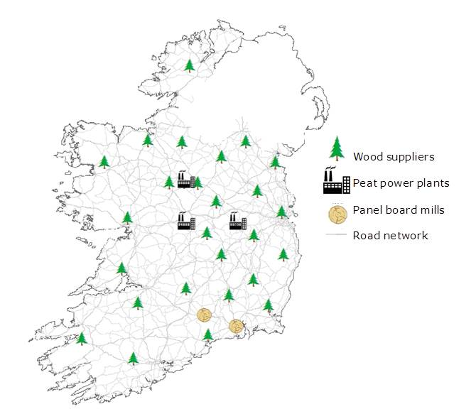
Site Description
Supply and Demand Points
3 Peat Power plants
  P1 (120MWe - 22% co firing)
  P2 (150MWe)
  P3 (100MWe)
2 Panel Mills
  1.28 Mm³ demand
  M1 (MDF)
  M2 (OSB)
Wood Suppliers

Slide 22
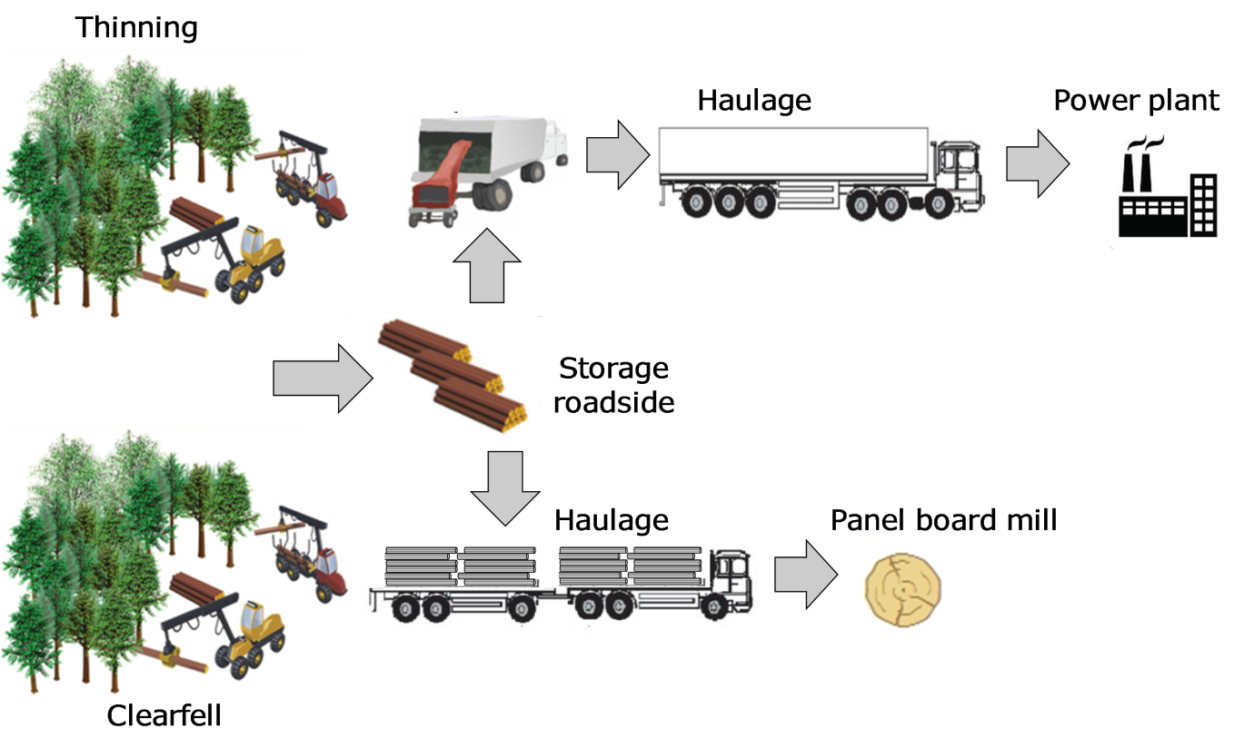
Supply Chain Schematic

Slide 23
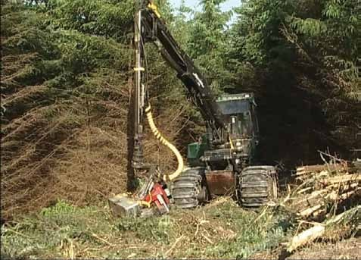
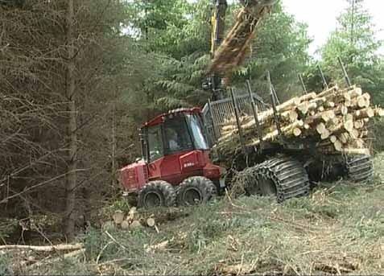
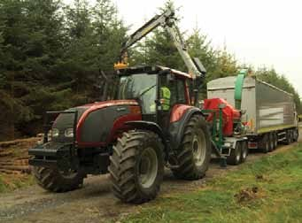
HARVESTING
Silvatec C 856
EXTRACTING
Valmet 840 forwarder
CHIPPING
MusMax T8 drumchipper
Valtra tractor

Slide 24
Model Parameters
Parameters and conversion factors | Peat power | Panel mills
Net Calorific Value at 0% MC (GJ/t) | 19.10
Basic density (kg/m³) | 377 | 377
Bulk-stacked density (kg/m³) | 130 | 252.59
Bulk/solid volume conversion factor | 2.90 | 0.67
Truck maximum legal payload 6 axle (kg) | 27,500 | 27,500
Truck maximum loose volume capacity (m³) | 95 | 69
Material loss rate (kg m-³ year ¹) | 0.059 | 0.059
Interest rate %/month | 0.39 | 0.39

Slide 25
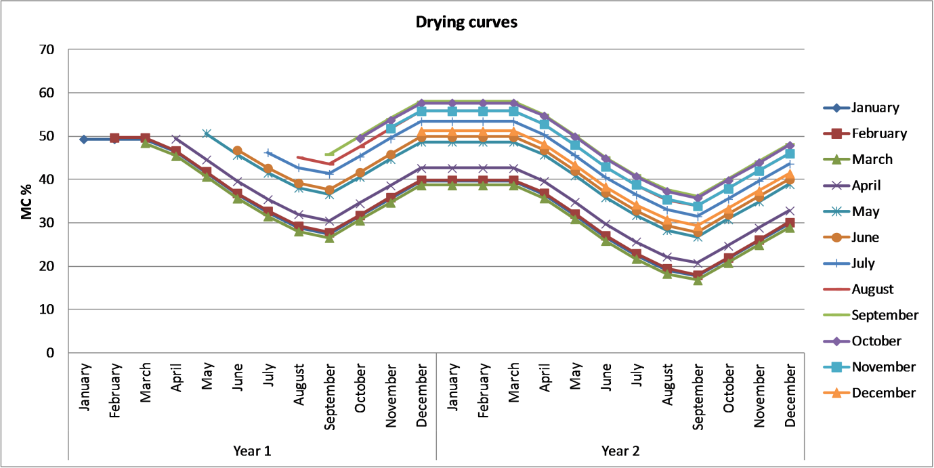
Biomass Drying Curves

Slide 26
5 Scenarios
S1: P1's demand increases its current 22% co-firing to the national target of 30%. P2 and P3 plants start co-firing at 10%.
  The panel board mills (M1 and M2) demand must be also satisfied.
S2: This scenario is similar to scenario 1, but in this case the MC of the biomass arriving at the power plants was constrained to be equal to or less than 40%.
  The demand at the panel board mills remains the same.

Slide 27
…
S3: P1 meets the demand at the 30% co-firing target while P2 and P3 increase their demand so they co-fire at 15%.
  The demanded volume from the panel board mills remains the same.
S4: Similar to scenario 3, but as in scenario 2 the biomass demanded at the peat plants must arrive with a MC equal of less than 40%.
  The demand at panel board mills remains the same.
S5: The three peat power plants demand enough biomass to reach their 30% co-firing target.
  The demand from the panel mills remains the same.

Slide 28
Results
64.6% of the potential supply can satisfy the demand in scenario S1 and S2.
S3 and S4 consumed 71.9% of the available supply.
S5 all the plants met their 30% co-firing target with 94.2% of the available short wood supply.

Slide 29
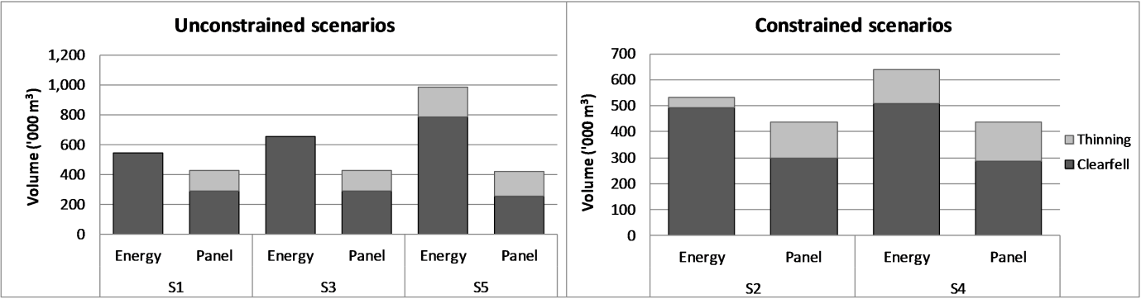
Supply Volume Breakdown

Slide 30
Results
Supply costs for unconstrained S1 and S3 were comprised mainly of
  harvesting costs (avg. 57%)
  chipping costs (avg. 18%)
  transportation (avg. 19%)
  storage costs (avg.1%).

Slide 31
…
When constraining the MC of the wood biomass supplied to the power plant (scenario S2 and S4),
  harvesting, chipping, transportation, and storage costs accounted for 61%, 15%, 17%, and 3%, respectively.
Supply costs to the mills consisted mainly of harvesting (avg. 83%), transportation (avg. 16%), and storage (avg. 1%).

Slide 32
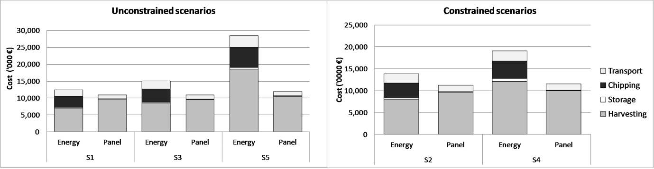
Supply Cost Breakdown

Slide 33
Average Production Costs
 | Energy plants |  |  | Panel mills
Scenario | €/m³ solid | €/t | €/Mwh | €/m³ solid
S1 | 22.53 | 33.34 | 3.48 | 23.50
S2 | 25.37 | 40.66 | 3.84 | 23.64
S3 | 22.85 | 33.69 | 3.53 | 23.65
S4 | 29.27 | 46.95 | 4.44 | 23.55
S5 | 28.83 | 42.44 | 4.46 | 26.16

Slide 34
Spatial Supply Map
Energy Plants
Panel Mills

Slide 35
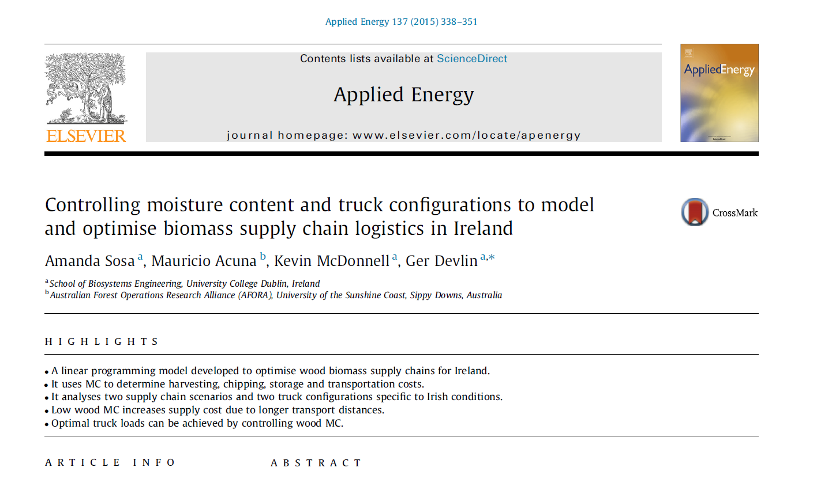
Follow the story…

Slide 36
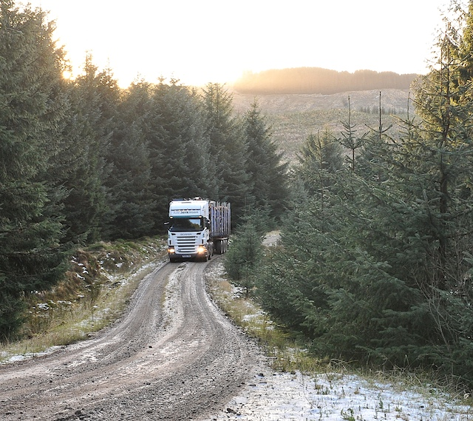
Thank You…

