Slide 1




Forest biorefinery project in La Tuque – Challenges & Opportunities
IEA-BFN Workshop – Mobilization of forest biomass to produce bioenergy, biofuels and bioproducts: challenges and opportunities
Vancouver, BC, Canada, September 22th 2016
Benoit Delcroix, Postdoctoral Fellow
Supervised by Patrice Mangin & Simon Barnabé, Professors
Industrial Research Chair on Regional Bioeconomy/Bioenergy
Université du Québec à Trois-Rivières

Slide 2
Content
Context – Forest biorefinery project in La Tuque, QC
Main challenges
Global value chain
Biomass collection
Pretreatment & Densification
Main conversion at the biorefinery
Products / Market
Conclusion

Slide 3
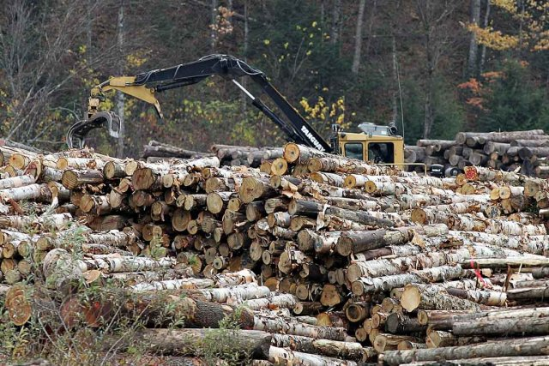
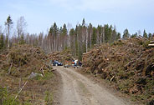
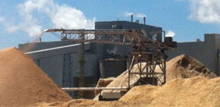
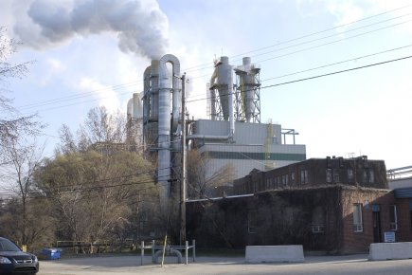
Context – Forest industry in La Tuque
Difficulties:
  Region strongly depending on the forest industry
  Forest industry in restructuration (mill closures)
Assets of the region:
  Experience in the forest industry
  High forest resources on a territory of 30000 km² (forest residues: about 1200000 GMT/year)
  Presence of infrastructures

Slide 4
Context – La Tuque project: Key numbers
For a biorefinery converting 1 200 000 GMT/year:
3 333 GMT/day – Moisture content: 40%
Production of 233.3 MW biodiesel / 350 MW forest residues
  207 ML/year of biodiesel
  4.3 % transport diesel consumption in Québec
Potential revenue of 175 M$/year
Job creation: 295 (direct); 490 (direct and indirect)
Reduction of CO₂ emissions: 575 000 T/year (143 750 vehicles/year)

Slide 5
Context – Main challenges
Supply of low-cost forest biomass?
  Cost?
  Security of supply (25 years)?
Best technologies to convert the biomass:
  Technology readiness level?
  Compatibility between technologies?
Final products?
  Biofuels? Need for regulations!
  Coproducts? Yes but no hurry!

Slide 6

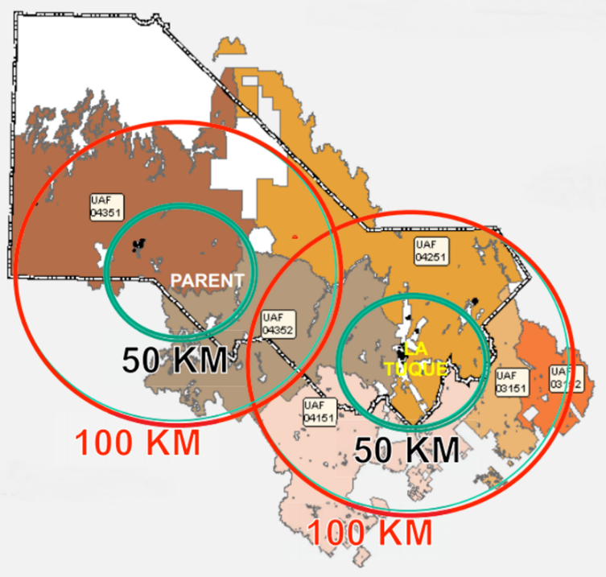

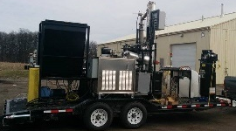
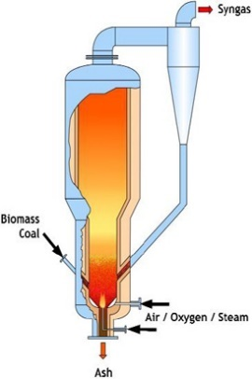
La Tuque Project – Global Value Chain
Biomass collection
Highly dispersed forest biomass
Pretreatment & Densification
Main conversion
Note:
La Tuque project: ± 3500 bpd
Comparison with refineries:
  Valero (Lévis, QC): ± 265 000 bpd
  Suncor (Montréal, QC): ± 160 000 bpd
Market

Slide 7
Biomass collection
Principle
Target for the supply:
4-5 $/GJ or
60-75 $/DMT
@ the biorefinery

Slide 8
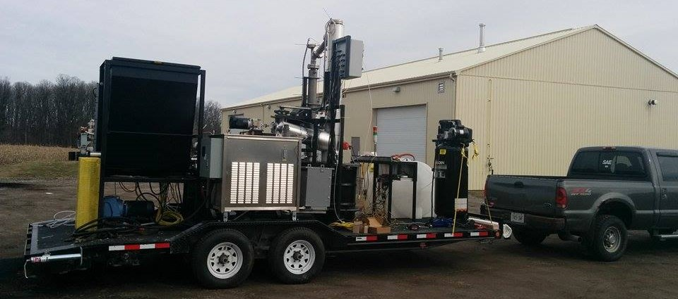
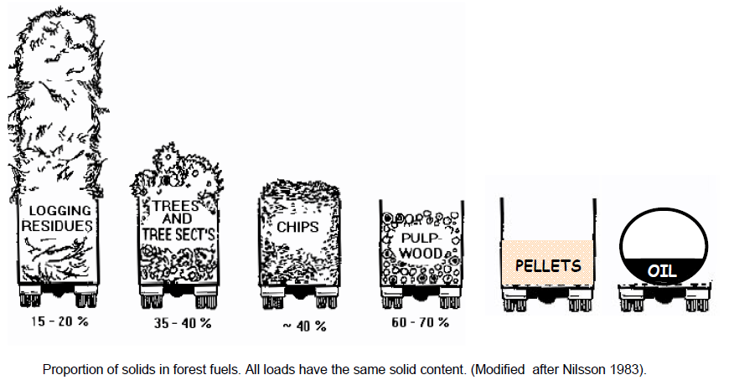
Pretreatment & Densification
ICFAR/WOU MFR Pyrolysis Unit
Pretreatment:
  Cleaning
  Size reduction
  Drying
Densification:
2.5 T/day
-
Densification
+
1.
2.
3.
4.
+
Simplicity
-
Size reduction
Pelletization
Torrefaction
Pyrolysis

Slide 9
Gasification and the following units
Waste
stream
Conceptual flowchart
Densified
biomass
Syngas
85%
Gas cleaning & conditioning
Gasification
Biochar
10%
Bio-oil
5%
Cleaned
Syngas
Synthesis
Chemicals
Biofuels
For example:
Fischer-Tropsch process:
(n/2 + m) H₂ + m CO → C_{m}H_{n} + m H₂O
Methanol synthesis:
2 H₂ + CO → CH₃OH

Slide 10
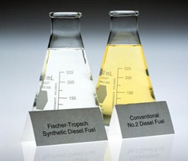
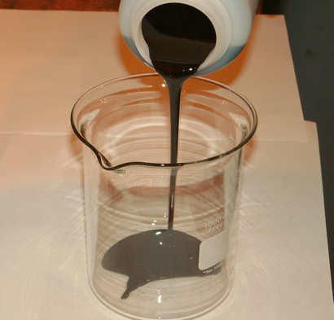
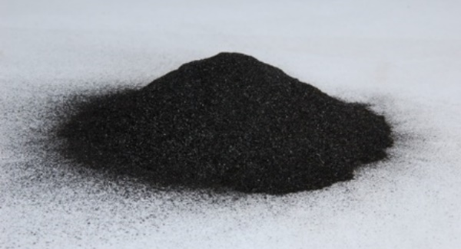
Market – Biofuels & coproducts
Biofuels:
  Diesel
  Gasoline
  Biojet fuel
Coproducts:
  Heavy fractions of the oil:
    Bitumen,
    Pesticides,…
  Biochar:
    Amendment,
    Activated coal,
    Energy,…

Slide 11
Where are we now?
Kick-off meeting in September for different studies:
  Supply chain logistics,
  Environmental impacts,
  Technology assessment,
  Techno-economic analysis,
  Risk analysis / management,…
A big team with experts coming from:
  FPInnovations
  VTT Technical Research Centre of Finland
  Université Laval
  École Polytechnique de Montréal
  Université du Québec à Trois-Rivières
  CanmetENERGY

Slide 12
Conclusion
La Tuque project:
  Large scale forest biorefinery project
  Thermochemical pathway
  Production of:
    Biofuels (short term)
    Other bioproducts (long term)
Main challenges:
  Minimizing biomass supply cost → Densification
  Technology assessment (maturity and compatibility)
  Economics and regulation

Slide 13

Thank you for your attention!

