Slide 1
Bioenergy and Food Security
Approach and Rapid Appraisal
An Option for Sustainable Bioenergy Policy Formulation
Luis Rincon and Irini Maltsoglou
Climate and Environment Division, FAO
Workshop “Biomass Production in Sustainably Managed Landscapes”
Vancouver, 21 September 2016

Slide 2
Outline of the presentation
The Bioenergy and Food Security (BEFS) Approach
BEFS Rapid Appraisal Tools
BEFS RA implementation Examples
Challenges found during implementation
Upcoming Activities BEFS project
Potential Areas of Development

Slide 3
☞ the 4 dimensions of food security
Food Security
….exists when all people, at all times, have physical and economic access to sufficient safe and nutritious food that meets their dietary needs and food preferences for an active and healthy life.
1996 World Food Summit held in Rome
AVAILABILITY - Physical AVAILABILITY of food
ACCESS - Economic and physical ACCESS to food
UTILIZATION - Food UTILIZATION
STABILITY - STABILITY of the dimensions
Notes:
AVAILABILITY: Food availability addresses the “supply side” of food security and is determined by the level of food production, stock levels and net trade. However, an adequate food supply at the national or international level does not guarantee household level food security.
ACCESS:Access to food is influenced by market factors and the price of food as well as an individual’s purchasing power, which is related to employment and livelihood opportunities.
UTILIZATION:Utilization is commonly understood as the way the body makes the most of various nutrients in the food. This food security dimension is determined primarily by people’s health status. General hygiene and sanitation, water quality, health care practices and food safety and quality are determinants of good food utilization by the body.
STABILITY: Stability refers to stability of the other three dimensions over time. The phrase “at all times” refers to the stability dimension of food security. It emphasizes the importance of having to reduce the risk of adverse effects on the other three dimensions: food availability, access to food or food utilization.

Slide 4

Linkages: Bioenergy and Food Security
Bioenergy
Food Utilization (Nutrition)
Food Availability
(Supply)
Food Access
(Income and prices)
Which options might be viable?
To be defined:
Environmental sustainability, social acceptability,
and economic viability of the bioenergy sector “setup”

Slide 5
FAO’s Bioenergy and Food Security
(BEFS) Approach
Stakeholder Dialogue and Capacity Building
Assisting countries with the development of a sustainable, food secure bioenergy sector that integrates the agricultural sector
Six areas of support
Risk Prevention, Management and Investment Screening
  BEFS Rapid Appraisal
Sustainable
Bioenergy
Assessment
Support to
Policy Formulation
Impact Monitoring, Evaluation and Response
Scoping
  BEFS Detailed Analysis
Notes:
Modern bioenergy development can create both risks and opportunities for food security
To help countries assess and manage these risks and opportunities, FAO has developed the Sustainable Bioenergy Toolkit

Slide 6
How does BEFS RA account for food security and sustainability?
Food Security
  Identify key food staples in the country
  Strive for feedstock production that is additional to current uses
  Consider options for income generation, employment and potential tradeoffs (feedstock level, processing level)
  Sustainable use of natural resources
  intensification of agricultural production as preferred option
  forestland and protected areas excluded
  current/planned uses of residues excluded
  importance of residues for soil fertility and structure considered
  Economic and social sustainability
  competitiveness
  financial viability
  outgrowers’ inclusion

Slide 7
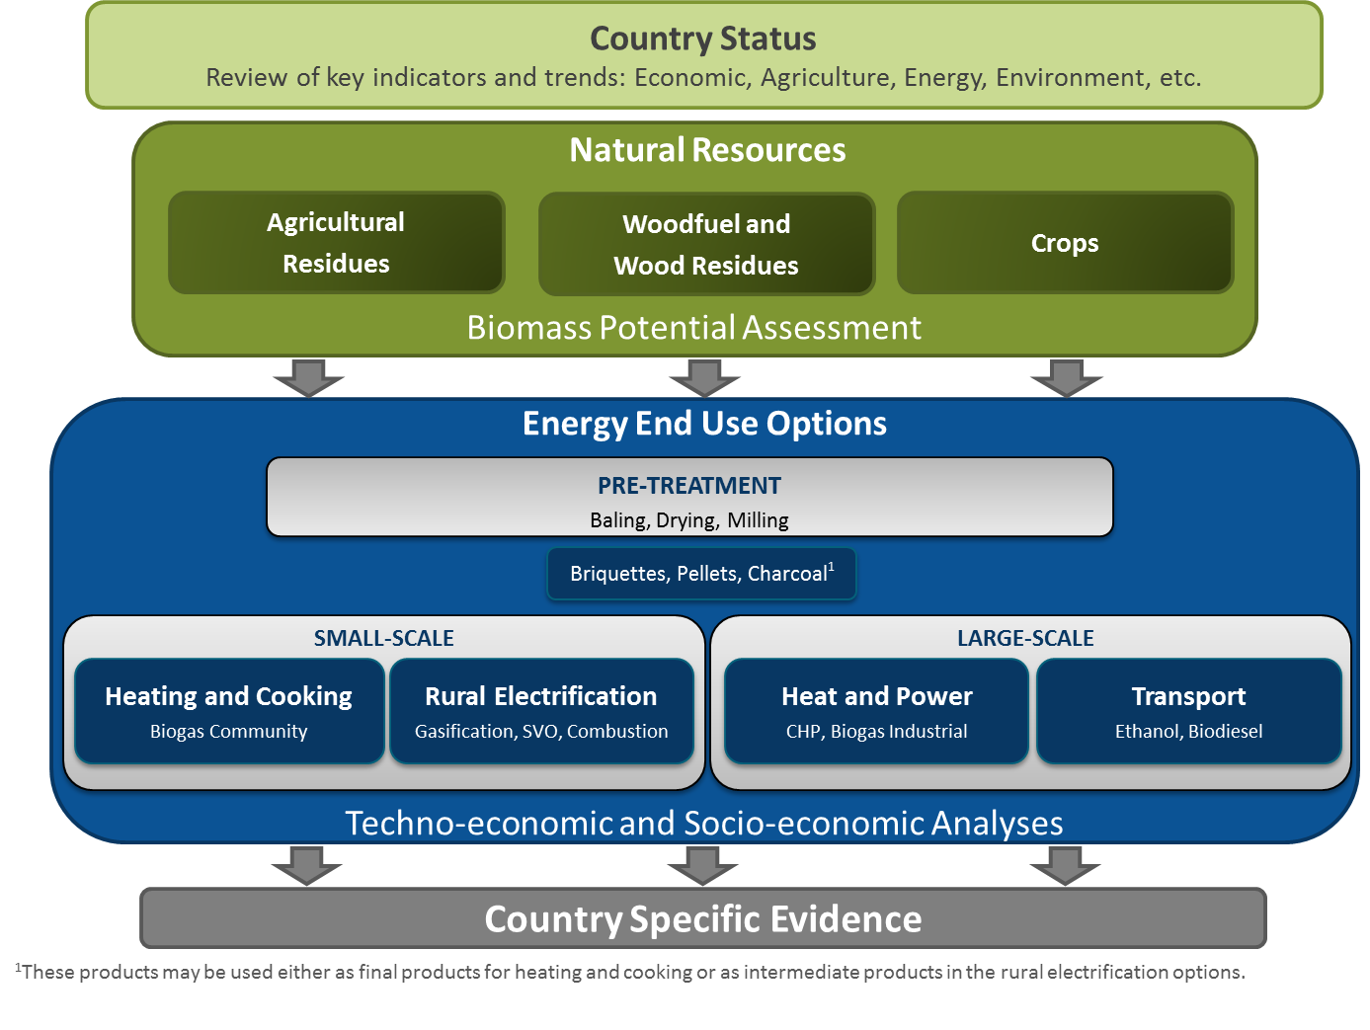
The BEFS Rapid Appraisal

Slide 8
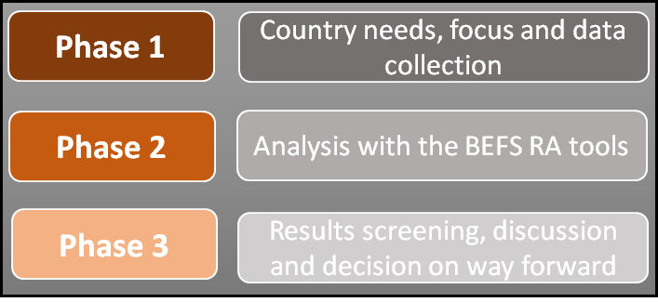
Phases of implementation of the BEFS RA
Phase 1: country needs, focus (stakeholder discussions) and data collection
Phase 2: analysis with the BEFS RA tools
  Country status, natural resources and energy end use options
Phase 3: results screening, discussion and decision on way forward
Timing
4 to 6 months

Slide 9
Challenges: Uncertainty levels in results
Specific Technical Values and Detailed User Inputs
Default Technical Values and Minimal User Inputs
35-60%
5-15%
Default Technical Values and Detailed User Inputs
15-25%
25– 35%
Default Technical Values and Inputs
EFFORT, TIME, RESOUCES…..

Slide 10
BEFS Rapid Appraisal
Characteristics:
  Excel based set of tools
  globally applicable, national (subnational) level assessment
  implementable in a relatively short time
  can be used with limited user defined data,
  default values are provided as an option
  analysis can focus on country needs
  allows to limit the scope of detailed analysis
Limitations:
  Accuracy of results depend on the accuracy of the data
    Default data, user defined data
  Further detailed analysis would be required for actual policy formulation, so this is the initial step. A sub-national level BEFS RA could be an option.

Slide 11
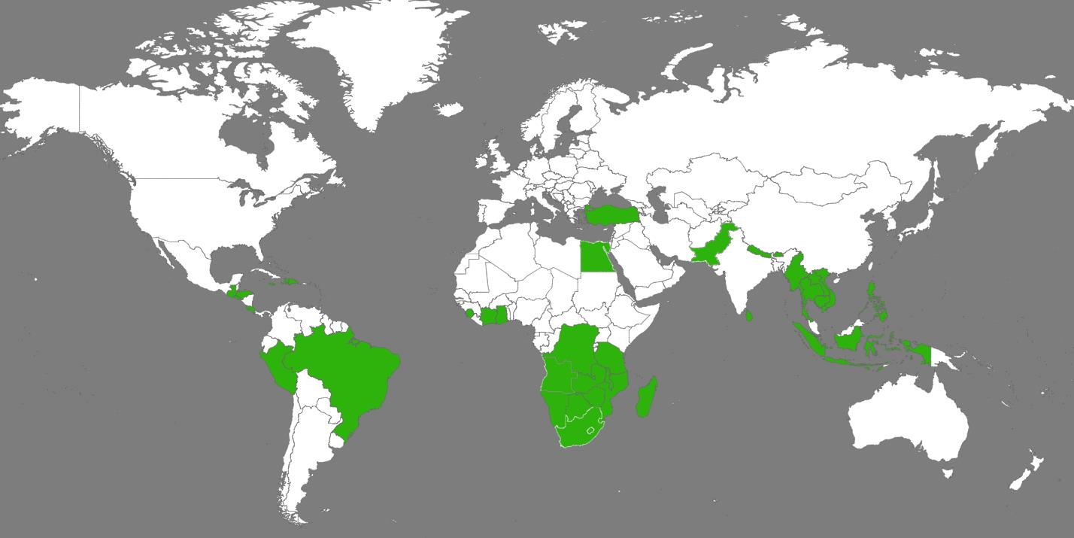
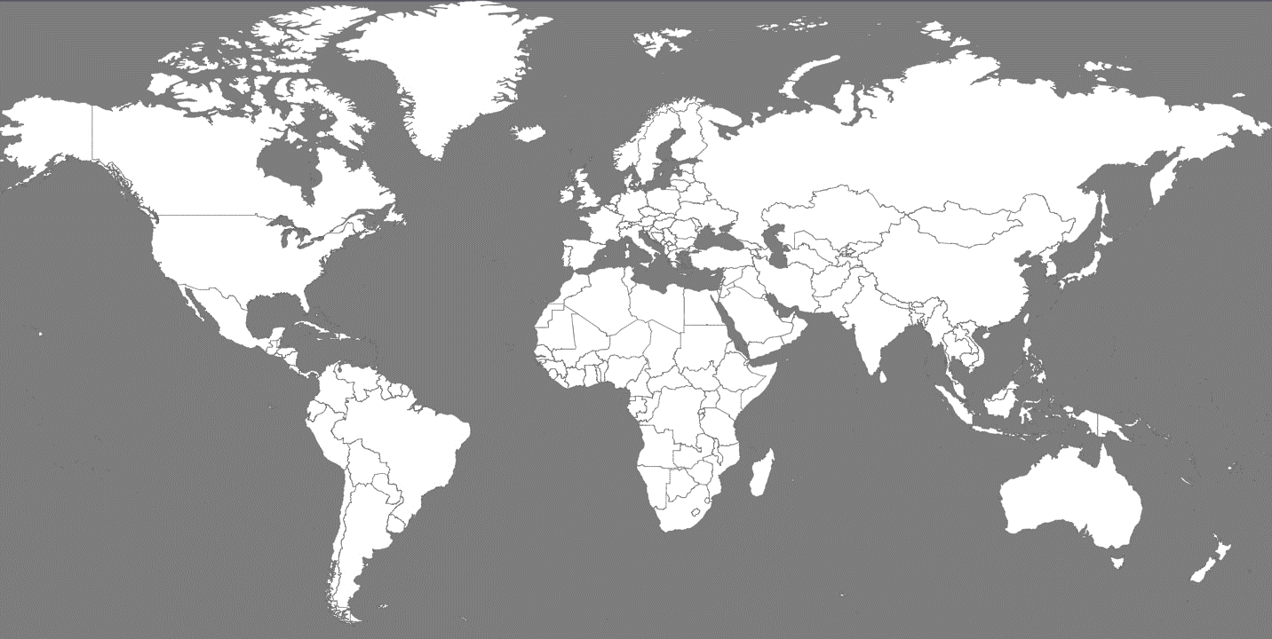





Countries where BEFS has carried out activities
Africa
SADC (Southern African Development Community)
Cote d’Ivoire
Egypt
Malawi
Sierra Leone
South Africa
Tanzania
America
OAS (The Organization of American States)
  Brazil
  Costa Rica
  Peru
  El Salvador
  Jamaica
  Honduras
  Guatemala
  Haiti
  Dominican Republic
Asia
ASEAN (Association of Southeast Asian Nations)
Bhutan
Cambodia
Indonesia
Pakistan
Philippines
Sri Lanka
Thailand
Turkey
Most results obtained can be found available online in BEFS web page

Slide 12
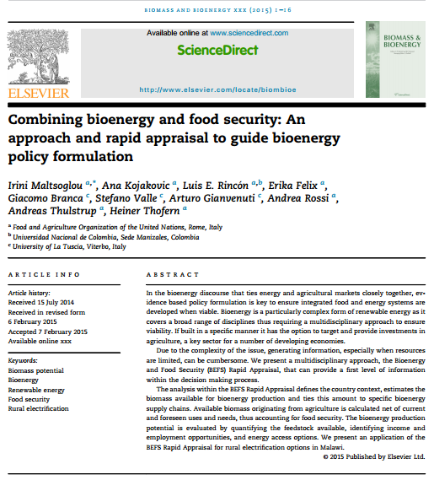
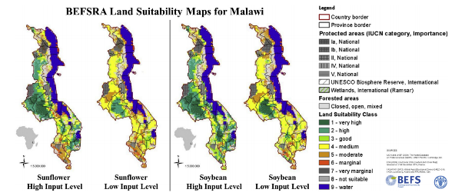
Example 1: BEFS RA MALAWI
Features:
National Level Analysis, intended to establish a bioenergy road map
Natural Resources Tools : Crops, Agriculture Residues, Forestry
Energy End Use Tools : Heating and Cooking, Rural Electrification and Transpot

Slide 13
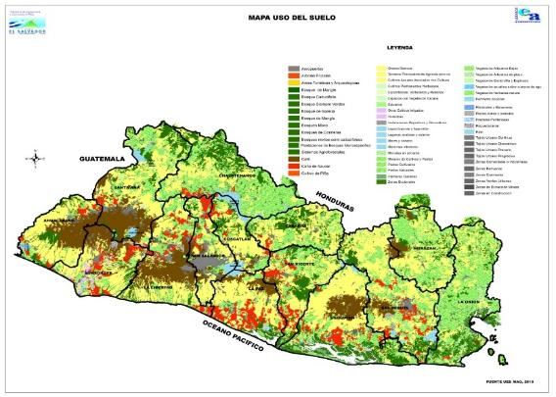
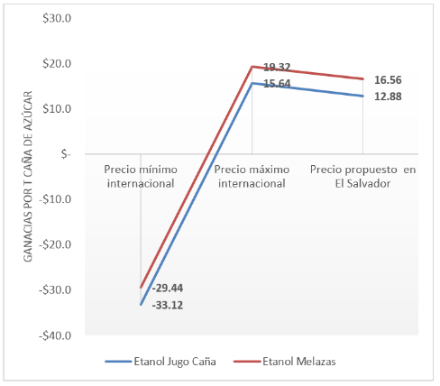
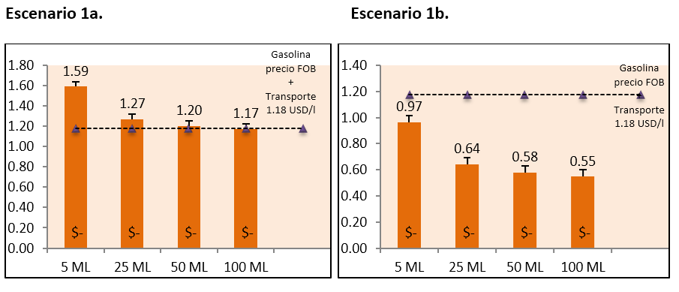
Example 2: BEFS RA El Salvador
Features:
Comparative analysis to understand how fuel ethanol industry should be developed
Natural Resources Tools : Crops
Energy End Use Tools : Transport and Molasses Ethanol tools

Slide 14
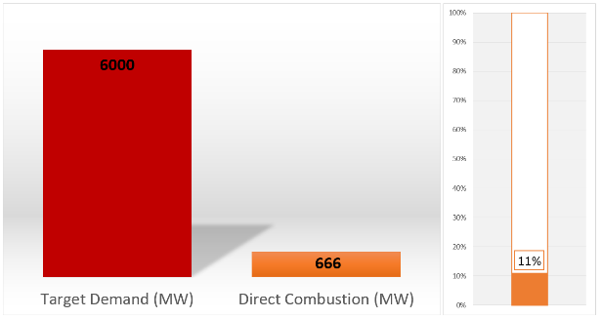
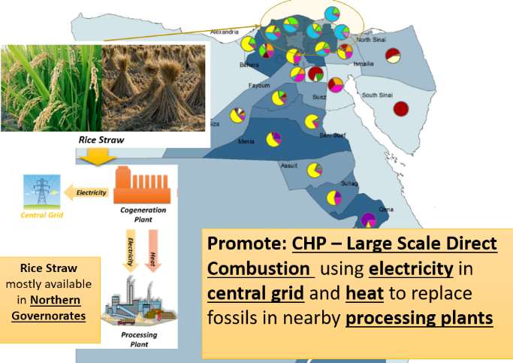
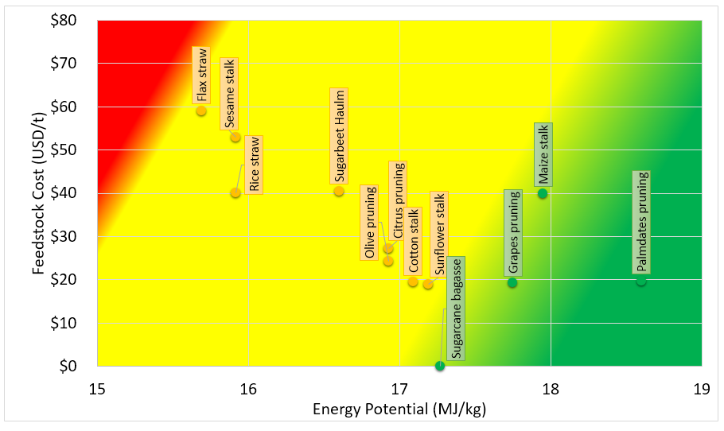
Example 3: BEFS RA Egypt
Features:
To estimate the potential of agricultural residues for bioenergy production, and profitable production conditions, as well as the geographical distribution within Egypt
Natural Resources Tools : Agriculture Residues
Energy End Use Tools : Briquettes, Pellets, CHP and Biogas Industrial

Slide 15
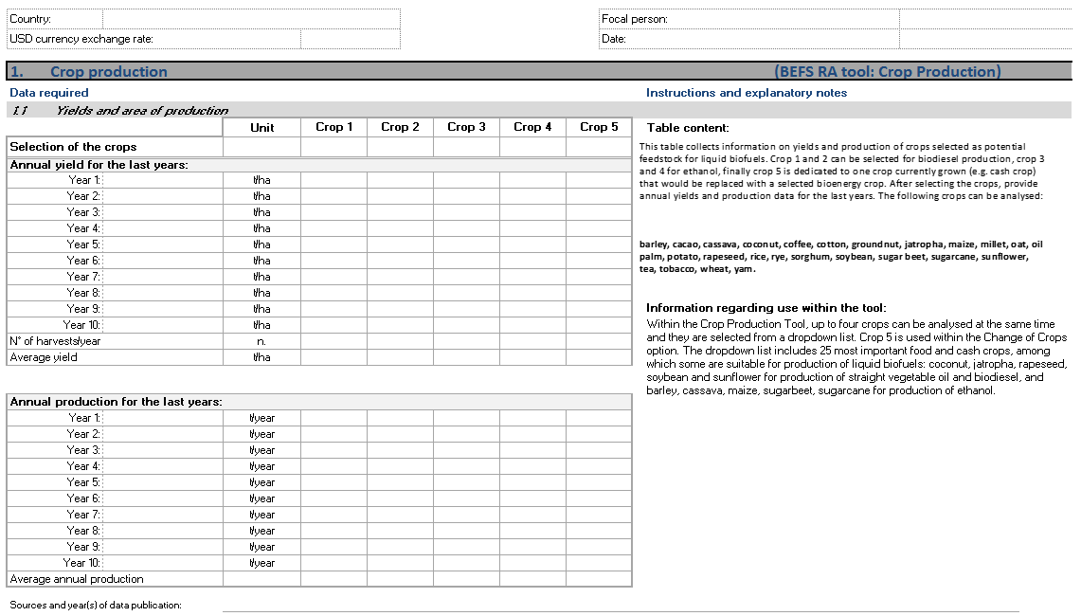

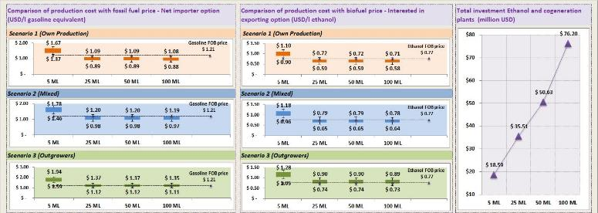

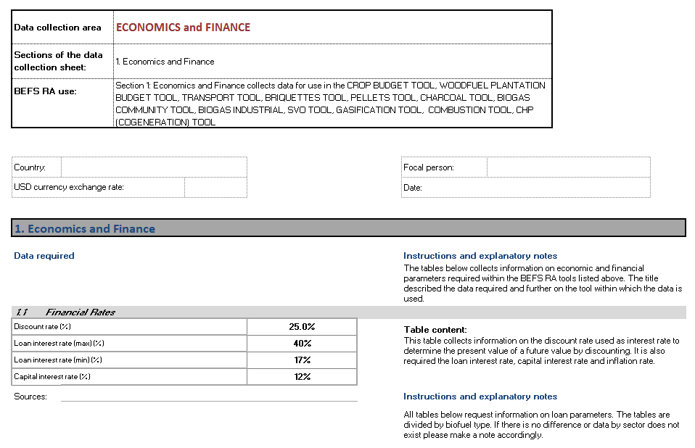

Main Challenges Found
Data Availability and Collection
False expectations about results.
Willingness of stakeholders to move to next phase of analysis and implementation
BEFS Results

Slide 16
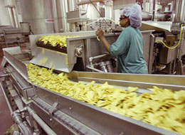
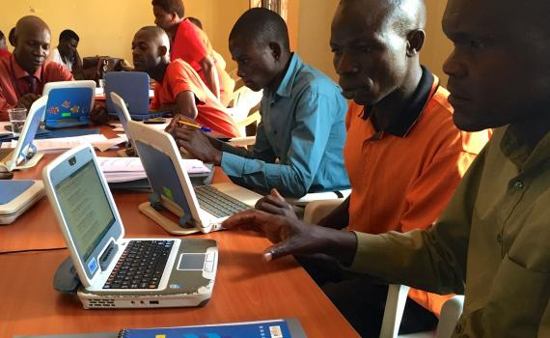
Upcoming Activities
Opportunities to reuse the potato residues and/or the waste oil to produce energy in Rwanda Potato Chip Companies
Capacity building on the BEFS Approach and Rapid Appraisal and dissemination and training for African experts with the Energy Institute Hrvoje Požar (Croatia)

Slide 17

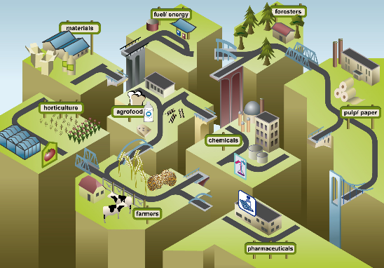
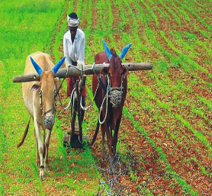
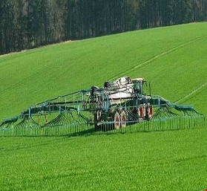
Potential areas for further development
Further differentiation at the agriculture production level eg large scale versus small-scale production levels
Integration of a comparison of bioenergy versus other renewable energy alternatives
Further refinement on the biomass mobilization aspects of the bioenergy supply chain

Slide 18
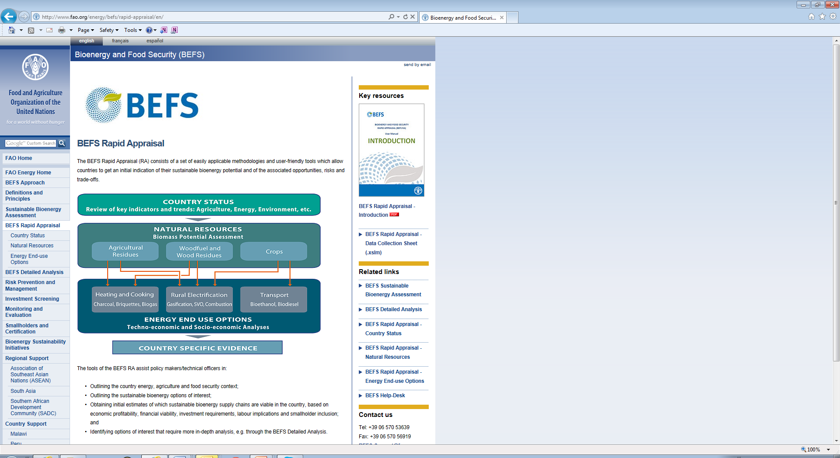
Where to find all the information
www.fao.org/energy/befs/rapid-appraisal/en/
BEFS Approach
Introduction to BEFS RA
BEFS RA
Data collection sheets
BEFS RA
Tools and Manuals

Slide 19
Thank You http://www.fao.org/energy/befs/en/
PLEASE DO NOT HESITATE TO CONTACT US:
E-mail: BEFS-Support@fao.org

Slide 21
Country Status
Review information about the country and context in the relevant sectors:
General Information – Population, Land use/Land cover
State of Economy – GDP, Value-added Agriculture
Poverty and Energy Access
Food Security and Agriculture – Main Staple and Export Commodities
Energy – Energy Access, Energy Balance, Energy Demand

Slide 22
Natural Resources Analysis
Agriculture
Residues
Woodfuel and
Wood Residues
Crops
Preliminary indication of potential feedstock availability:
How much crop residue and livestock residue is available?
How much harvesting residue and wood processing residue is available?
What are the options for increasing the production of crops and
how much of this production could be used for bioenergy purposes?
t/year of Biomass
Potentially Available for Bioenergy Production
Heating and Cooking
Charcoal, Briquettes, Pellets,
Biogas – Small-Scale
Electricity and/or Heat
Gasification, SVO, Combustion, CHP, Biogas - Industrial
Transport
Ethanol, Biodiesel
Notes:
The Natural Resources (NR) Module of the BEFS Rapid Appraisal is used to assess the availability of bioenergy feedstock originating from crop production, agricultural residues and forestry. The Module is divided into three components, according to the biomass sources: Agricultural Residues Component, Fuelwood and Wood Residues Component, Crops Component.

Slide 23
Energy End Use Option Analysi
Can biofuels be produced profitably and competitively?
What are the investment requirements?
To what degree can smallholders be involved?
What are the labour implications?
Heating and Cooking
Charcoal, Briquettes, Biogas
Rural Electrification
Gasification, SVO, Combustion
Transport
Bioethanol, Biodiesel
Predefined Plant Sizes/Technologies
OUTPUTS:
Production costs under different feedstock production schemes
Cost comparison with alternative energy sources
Economic profitability and financial viability
Land and labour requirements

Slide 24
Components and Tools of the NR Module
Notes:
The components are defined based on the biomass source/feedstock type.
There is one Excel file for each component and each component includes two or three tools.

Slide 25
Crops Component - Structure
Natural Resources
Biomass Potential Assessment
Potential for Additional Production
(Assessment on the Country/Subnational level)
Production Costs, Gross/Net Margin and Labour Requirements
(Assessment per Hectare)
Manuals - 1
Excel File (.xlsm) - 1
Tools - 2
Country Level Default Values
Notes:
The Crops Component includes the Crop Production Tool and Crop Budget Tool. The Crop Production Tool is used to assess the potential for the additional production of oilseed, sugar and starch crops, which can later serve as feedstock for straight vegetable oil (SVO), biodiesel and ethanol. While, the Crop Budget Tool allows for the assessment of profitability, costs and labour requirements of crop production per hectare.
Another part of the Crops Component consists of the BEFS Rapid Appraisal Land Suitability Maps. These are country level maps for 10 crops that are suitable for the production of liquid biofuels. They are generated using Global Agro-Ecological Zoning layers on land suitability and productivity (FAO, IIASA, 2012), the global land cover map GlobCover 2009 (ESA, 2012), and the World Database on Protected Areas (IUCN and UNEP, 2009). They serve to support the analysis on Crops Production.
Note: The 10 crops covered in the BEFS Rapid Appraisal Land Suitability Maps are: cassava, maize, sorghum, sugarbeet, sugarcane, jatropha, oil palm, rapeseed, soybean and sunflower.

Slide 26
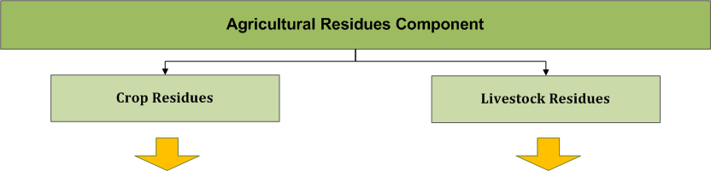
Agricultural Residues Component - Structure
Crop Residues Available for Bioenergy Production based on Crop Production
(Assessment on the Country/Subnational level)
Manure Potentially Available for Biogas Production based on the Number of Animal Heads
(Assessment on the Country/Subnational level)
Manuals - 1
Excel File (.xlsm) - 1
Tools - 2
Country Level Default Values
Notes:
The Agricultural Residues Component encompasses tools to assess the availability of crop and livestock residues. Crop residues are suitable feedstock for the production of solid biofuels (briquettes and pellets), while livestock manure is suitable for the production of biogas. Through gasification and combustion, these biofuels can be used for heating and cooking or for electricity generation.

Slide 27
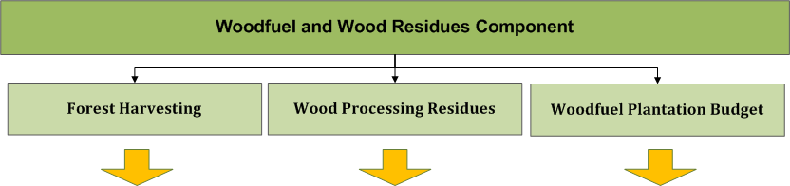
Woodfuel and Wood Residues Component - Structure
Potential for Additional Forest Harvesting
Forest Harvesting Residues Available for Bioenergy based on Roundwood Production
(Assessment on the Country/Subnational level)
Wood Processing Residues Available for Bioenergy based on Roundwood Production
(Assessment on the Country/Subnational level)
Potential Availability of Harvestable Wood Volume from Dedicated Plantations
Costs and Benefits of Plantation Investments
(Analysis per Hectare)
Manuals - 2
Excel File (.xlsm) - 1
Tools - 3
Country Level Default Values
Notes:
The Woodfuel and Wood Residues Component includes three tools: Forest Harvesting, Wood Processing Residues and Woodfuel Plantation Budget. These tools assess the potential for additional harvesting of fuelwood from production forests, in addition to the availability of forest harvesting residues and wood processing residues.
The Woodfuel Plantation Budget Tool evaluates the potential availability of harvestable wood volume from dedicated woodfuel plantations. It also analyzes the costs and benefits per hectare of establishing such plantations.

Slide 28
Country level support and Evidence:
BEFS Approach (contd.)
Stakeholder Dialogue and Capacity Building
Establish/work with existing inter- ministerial working group
Country review: stakeholder mapping, agriculture, energy, food security, environment context etc.
Identification of country needs, focus areas, concerns
Train working group on bioenergy and food security linkages and on the BEFS Approach
Definition and agreement of next steps
Scoping

Slide 29
Country level support and Evidence:
BEFS Approach (contd.)
Country level evidence as basis for policy formulation process
Two levels of analysis: initial appraisal followed by in-depth analysis
Training of assessment methodologies
Sustainable
Bioenergy
Assessment

Slide 30
Country level support and Evidence:
BEFS Approach (contd.)
Discuss results generated by the BEFS Assessment at both technical and policy levels
Review of regulatory framework for bioenergy and relevant sectors
Support Ministerial and Parliamentary discussions
Support to
Policy Formulation

