Slide 1
WP1: Landscape management and design for bioenergy and the bio-economy
WP1 aims at supporting landscape management and design for bioenergy and the bio- economy, by expanding the knowledge base required for sustainable expansion of biomass production systems that also contribute positively to biodiversity and the generation of other ecosystem services.
The work takes a landscape level approach to deployment of biomass production for bioenergy and integration of this objective with ownership and societal objectives for existing land use and associated systems.

Slide 2
WP1: Workshops and other events
Workshop: Sustainable landscape management and design for food, bioenergy and biomaterials. March 15-16, Göteborg, Sweden
Workshop: The world needs more land use change. EUBCE, June 7, Amsterdam, The Netherlands.
Workshop: Landscape Management and Design for Bioenergy and the Bioeconomy, September 21, Vancouver, Canada.
Call for contributions: Landscape Management and Design for Bioenergy and the Bioeconomy, Winter 2017?
Workshop: Title TBC, Spring 2018, somewhere in Europe.
Special Issue in suitable journal?
Task 43 report
Inter-Task reports
IEA Bioenergy Conference 2018

Slide 3
WP1: Activities and deliverables
Atlas of attractive systems for bioenergy feedstock production in sustainably managed landscape
  Biomass for Bioenergy on the Map
  H2020 proposal: Magisc
ToSIA as a tool for guiding bioenergy development – case studies and synthesis
Thiffault & Schweinle
Additional Task 43 countries & European Forest Institute?
Linkages with inter-Task project
Economic performance of biomass from sustainably managed landscapes
Brown & Berndes
Optimising lignocellulosic energy crop cultivation in terms of socioeconomic and environmental sustainability
Dimitriou, Mola & Berndes
Stakeholder perceptions on bioenergy feedstock production
Kulisic, Dimitriou, Mola & Busch
SNAPP grant: bioenergy and ecosystem services
Dale, Kline & Berndes

Slide 4
WP1: Landscape management and design for bioenergy and the bio-economy
WP2 – Developing effective supply chains for sustainable bioenergy deployment
Economic performance of biomass from sustainably managed landscapes
WP3 – Governing land use and bioenergy supply chains
Advancement and assessment of governance addressing LUC impacts.
(“iLUC free biomass”: intensification and use of marginal/degraded land)

Slide 5
WP1: Landscape management and design for bioenergy and the bio-economy
Which are the most suitable areas for production and/or extraction of various biomass feedstocks?
How can biomass feedstock production systems be located, designed and managed to increase resource use efficiency, avoid/mitigate negative and promote positive environmental, economic, and social effects?
How can outcomes be optimized to meet the goals of individual stakeholders and society as a whole, including environmental, economic, and social goals?
How can analysis and assessment inform participatory processes engaging landowners, policy makers, and other stakeholders in further developing and re-defining goals and plans for landscape management and designs?

Slide 6
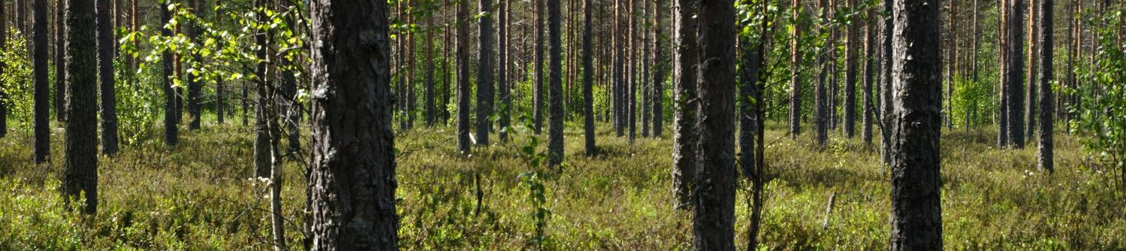
Questions…
What are the priorities and challenges with respect to ecosystem services in different countries and sectors?
How can forestry and agriculture be driven to optimize provisioning of ecosystem services at a landscape level?
What trade-offs may be necessary, and will these be the same in different countries?
What are the effects of differences in governance between countries?

